Slide 1


Some notes on fMRI
Michael S. Beauchamp, Ph.D.
Assistant Professor
Department of Neurobiology and Anatomy
University of Texas Health Science Center at Houston
Houston, TX
Michael.S.Beauchamp@uth.tmc.edu
Texas Children’s Hospital fMRI Interest Group
2 Dec 2009

Slide 2
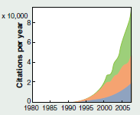
fMRI Is the Most Popular Method for Studying Human Brain Function
fMRI
PET/SPECT
EEG/MEG
Friston, Science (2009)

Slide 3
Learning Objectives
Information about fMRI resources in TMC
Help you become a more educated consumer of fMRI studies
Learn about different fMRI designs and different ways to analyze fMRI data, so that you can intelligently design your own studies this week and in the future
An attitude for skeptical examination of fMRI data

Slide 4
Courses
UT GSBS/BCM/Rice course: “Introduction to fMRI” (Fall 2010)
Savoy/Zeffiro SPM8 class (Dec 11-14,2009)
Cox AFNI class (Oct 4-8, 2010)

Slide 5
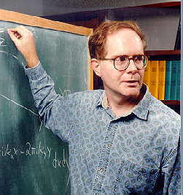
Analysis of Functional NeuroImages afni.nimh.nih.gov
Robert W. Cox, Ph.D.
Chief, Scientific and Statistical Computing Core, NIMH
Intramural Program Director, NIfTI (NeuroImaging Informatics Technology Initiative)

Slide 6
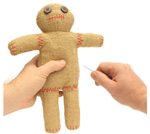

Slide 7
Why do we need to combine fMRI with anything?
Vul et al, Perspectives in Psychological Science, 2009

Slide 8
Vul et al, Perspectives in Psychological Science, 2009
Notes:
This voodoo doll analogy is interesting on several levels—
Voodoo correlations refers to the fact that the correlations observed between fMRI measures of brain activity and other measures is suspiciously high and could only come about through supernatural intervention

Slide 9
Notes:
I don’t want to go into too many details, but essentially they engaged in circular reasoning.
Which would be obvious with a less sophisticated technique but because fMRI is so complicated many people don’t exactly understand how their data is being analyzed.
However, even if data is analysed perfectly, fMRI has some key problems.
First and foremost,

Slide 10
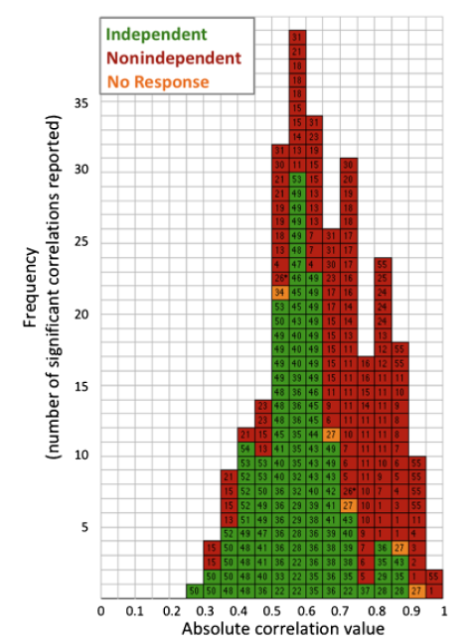
Fig. 5, Vul et al

Slide 11
Notes:
This voodoo doll analogy is interesting on several levels—
Voodoo correlations refers to the fact that the correlations observed between fMRI measures of brain activity and other measures is suspiciously high and could only come about through supernatural intervention , or as they write

Slide 12
Things to look for
Unaltered, Whole-Brain Activation Maps
Average MR Timeseries from Regions of Interest
Maps from Multiple Individual Subjects
Random-Effects Group Maps
Behavioral Data
Clear explanation of the analysis, especially statistical tests

Slide 13

Things to look for
Unaltered, Whole-Brain Activation Maps
Common deception techniques:
Using different thresholds for different regions (low where you want to see activity, high where you don’t)
Photoshop-ing (or otherwise eliminating) regions with activity you don’t want to explain
Poor Quality Data
Good Quality Data
What the authors actually show you

Slide 14

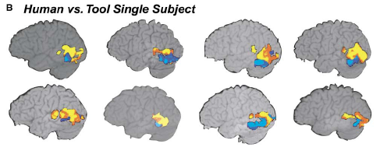

Slide 15
Things to look for
Average MR Timeseries from Regions of Interest
Common deception techniques: Showing bar graphs, t-statistics, curve fits to the data (especially SPM) or any other method to avoid showing the actual MR data
Arrow indicates stimulus onset—note that histogram is actually generated from mean +SD of poor quality data!
What the authors actually show you
Poor Quality Data
Good Quality Data

Slide 16
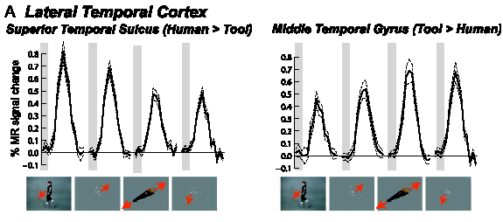

Slide 17
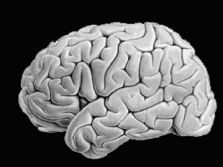
Things to look for
Maps from Multiple Individual Subjects + Random-Effects Group Map (random effects better captures variability across subjects; conjunction and other techniques hide it)
Poor Quality Data
Good Quality Data
What the authors actually show you
S1
S2
S3
Average Map (Conjunction Technique)
S1
S2
S3

Slide 18

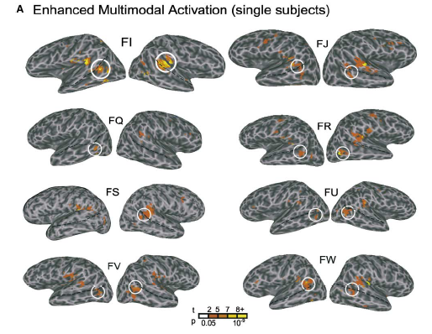

Slide 19
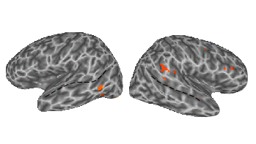
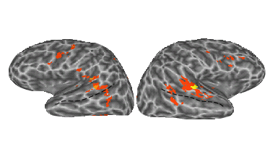
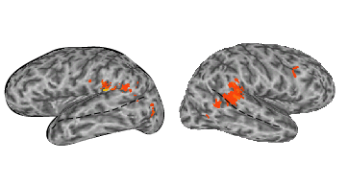
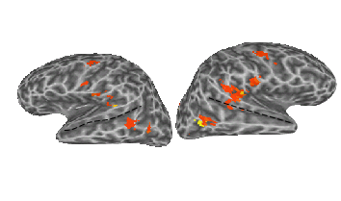
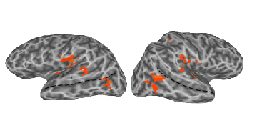
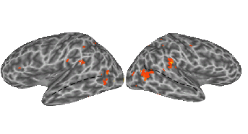
Location of STS-MS

Slide 20
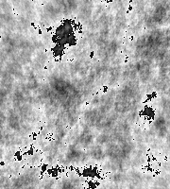
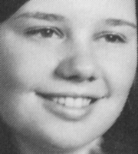
Things to look for
Behavioral Data
Poor Quality Experiment: Different Stimuli, No Task
Is this because….
Neurons like not
OR
The subject
was less alert

Slide 21
100-Hue Task

Slide 22
Things to look for
Clear explanation of the analysis, especially statistical tests
Many ways to analyze fMRI data → if you try enough ways you will find SOMETHING; therefore, essential to know exactly what the authors have done.
Most egregious example:
“The data was analysed using SPM 99”
(fMRI methods section in its entirety)

Slide 23
The BOLD Signal
Chapter 2 (p. 38-63) of Jezzard et al.
Neuronal
Measured
Activation
fMRI
Signal
Hemodynamics

Slide 24
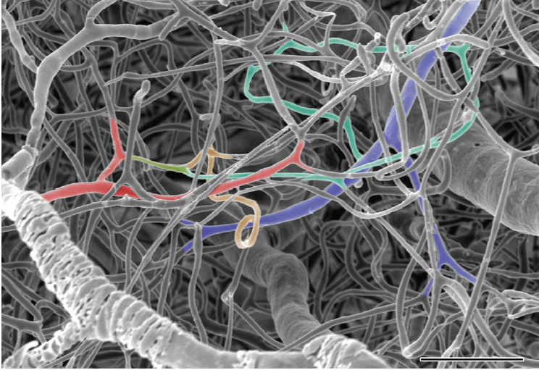
50 um
Harrison et al. Cerebral Cortex (2002) 12: 255-233

Slide 25
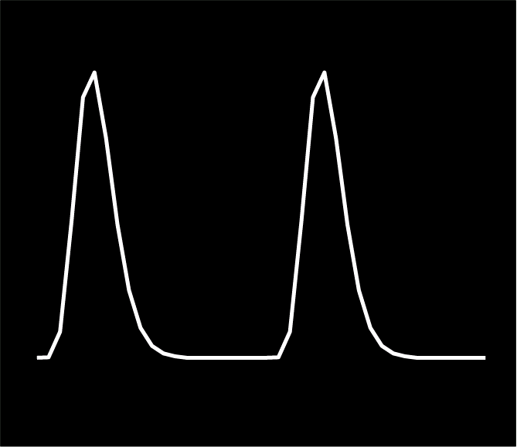
Hemodynamic Response to Single Stimulus
15 seconds
| | | | | | | | | | | | | | | | | | | | | | | | | | | | | | | | | | | | | | | | | | | | | | | | | | | | | | | | | | |

Slide 26
Introduction to fMRI Data
. . .
Notes:
So, let’s focus on this step.
Somehow we have to take this giant volume of data and compress it down to a simple map that we can easily make sense of.

Slide 27
Sample MR Time Series
. . .
Notes:
So, let’s focus on this step.
Somehow we have to take this giant volume of data and compress it down to a simple map that we can easily make sense of.

Slide 28
Things to look for
Unaltered, Whole-Brain Activation Maps
Average MR Timeseries from Regions of Interest
Maps from Multiple Individual Subjects
Random-Effects Group Maps
Behavioral Data
Clear explanation of the analysis, especially statistical tests

Slide 29


Types of fMRI Design
Data
Acquisition
1 – 4 seconds per time point (brain volume)
| | | | | | | | | | | | | | | | | | | | | | | | | | | | | | | | | | |
Block Slow Rapid
Event-Related Event-Related
Stimulus
Presentation

Slide 30
History of Block Design
PET
Data Acquisition
Stimulus Presentation
40 seconds per data point
|
|
. . .
. . .
Blocks of stimuli, 40 seconds

Slide 31
fMRI Block Design
Data Acquisition
Stimulus Presentation
1 – 4 seconds per time point
| | | | | |
| | | | | |
. . .
| | | | | |
| | | | | |
. . .
Blocks of stimuli, 15 seconds – 45 seconds total

Slide 32
Slow Event-Related Design
Data Acquisition
Stimulus Presentation
1 – 4 seconds per time point
| | | | | | | | | | | | | | | | | | | | | | | | | | | | | | | | | | |
. . .
. . .
Single stimuli, 10 – 20 seconds interstimulus interval

Slide 33
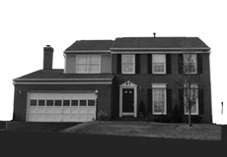
Rapid Event-Related Design
Data Acquisition
Stimulus Presentation
1 – 4 seconds per time point
| | | | | | | | | | | | | | | | | | | | | | | | | | | | | | | | | | |
. . .
. . .
Single stimuli, 1 – 4 seconds interstimulus interval

Slide 34
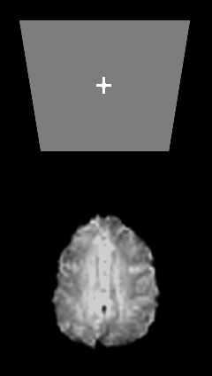
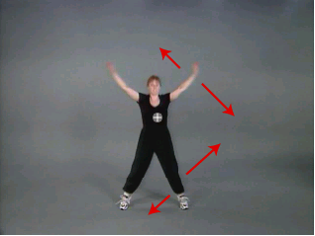
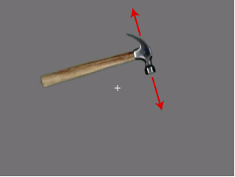
Types of fMRI Design
Block Slow Rapid
Event-Related Event-Related
100-Hue Test Head Movements Human and Object Motion

Slide 35
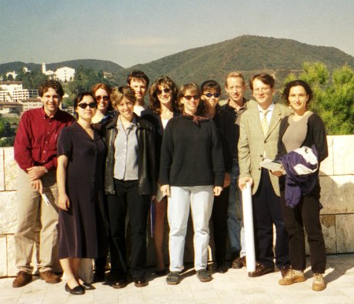
What's all this fuss about data analysis?
1 Brain Volume:
10,000 to 100,000 tissue-containing voxels
10 scan series:
each containing 100-400 time points
10 subjects
Total: 300 MILLION data points
Notes:
So, why should we spend time talking about fMRI data analysis?
Well, when you scan a patient or a research subject, every 2 seconds or so you collect an image of the brain that looks like this.
So, for each voxel in the brain at the end of every 4 minutes scan you end up with a time series like this. On the y-axis is MR intensity, and on the x-axis is time, with variations that reflect changes in the subjects’ brain activity.
Typically, you’ll collect a number of scans from each subject.
And you’ll have from 5-10 subjects in a typical study.
Which means that we can end up with 300 Million data points.
We can collect all of this data in a day.
But the post-processing necessary to turn it into understandable results can take months or years. So if you're going to spend most of your research time analysing data, it's worth figuring out a good way to do it.
300 million data points is far too much to put into SPSS or Excel, so we need specialized programs to help us deal with all of the data.

Slide 36
Software Tools for Analysis of fMRI datasets
AFNI
http://afni.nimh.nih.gov
FEAT/FSL
http://www.fmrib.ox.ac.uk
SPM
http://www.fil.ion.ucl.ac.uk/spm
Brain Voyager
http://www.brainvoyager.com/
Event-Related analysis by Doug Greve, MGH
ftp://ftp.nmr.mgh.harvard.edu/pub/flat/fmri-analysis/
GLM by Keith Worsley, MNI
http://www.bic.mni.mcgill.ca/users/keith
Notes:
Fortunately, there are a number of such programs available.
One of the most powerful, and the one you’ll hear most about during the course, is AFNI…but it’s important to be aware that there are other options out there, especially SPM, the most widely used functional imaging analysis program.
Now AFNI is incredibly powerful and versatile. It’s sort of like a fancy scientific calculator for fMRI data—you can analyse your data using any method you can dream up, even methods that no one has ever tried before.
And there’s no one RIGHT way to analyse fMRI data, so trying all of the different ways you can think of to analyse your data can chew up a lot of time.

Slide 37
Typical Processing Steps
. . .
Collect fMRI Data
Preprocess:Image Registration
Find Active Regions
Make Data Summary
Perform traditional statistics across subjects
. . .
Condition A Condition B
PreCentral Sulcus (PreCS) 3% 5%
Intraparietal Sulcus 4% 4%
Calcarine Sulcus 2% 2%
Condition A Condition B
PreCS Subject 1 3% 5%
PreCS Subject 2 4% 8%
PreCS Subject 3 1% 2%
Condition A Condition B
PreCS Subject 4 7% 7%
PreCS Subject 5 5% 5%
PreCS Subject 6 6% 6%
Notes:
So that you don’t have to repeat everyone else’s errors, here are some of the sample steps that provide a useful framework for analysing your data.
First, you need to collect some fMRI data. These dots indicate that we’ve got lots of data: for one subject we have 10 runs times 100 data points, so a thousand of these little brains.
Then there are a number of preprocessing steps; about the only one that everyone agrees upon is some sort of image registration, so for each time point we jigger the brain a little bit to compensate for movement. This really doesn’t affect your data too much; and since there’s fairly standard ways to do it that won’t differ much from experiment to experiment it’s not worth spending too much time on.
Now, the next step, finding active regions, does vary a great deal from experiment to experiment, and is critical in the success of your experiment. Somehow you need to take all of the voxels in the brain—and you have a thousand timepoints for each one—and decide which show activity changes related to your task.
This is the perhaps the most difficult and complicated step in the analysis, and the one I’ll spend the rest of the talk describing.
For once we’ve found out where the active regions are, it’s relatively simple to make a data summary.
For instance, we could say that there was signal change of …
Then, we can use the traditional statistics that we already now—like ANOVAs and t-tests—to decide if there is a consistent difference between different conditions for different subjects, or even across different groups of subjects.

Slide 38
Data Reduction
Time Series
Find Active Regions
. . .
Notes:
So, let’s focus on this step.
Somehow we have to take this giant volume of data and compress it down to a simple map that we can easily make sense of.

Slide 39
Examine Results for Each Contrast
0 0 1 0
0 0 0 1
Notes:
We can use these values to make statistical maps.
We choose only those voxels that showed an experimental effect.
Then, we color the voxels that showed a significant effect of the first regressor.
Here, we see that visual areas in dorsal and ventral occipital cortex showed a significant response to stimulation, as measured by the first regressor.
One of the most beautiful things about AFNI is how easy it is to look at your data. For instance, what if I know want to look at whether these areas have a significant effect of the second regressor?

Slide 40
Examine Results for Each Contrast
0 0 1 -1
Notes:
Returning to our color experiment, we see that when we examine the significance of the second regressor, we see that only voxels in ventral cortex preferred chromatic to achromatic stimulation.
So, multiple regression allowed us to combine two stimulus types in a single scan series and make separate maps showing areas that responded to both stimulus types and areas that preferred one stimulus type to the other.
The last step, which is very important, is to make an average time series from these active voxels and see what the actual data looks like.

Slide 41
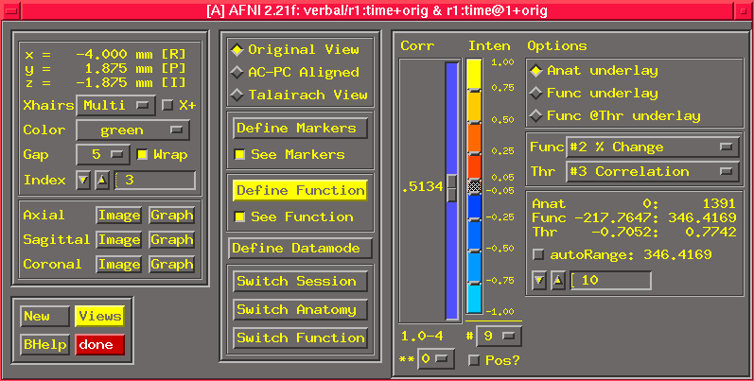
AFNI Controller Window

Slide 42
Types of fMRI Design
Block Slow Rapid
Event-Related Event-Related
100-Hue Test Head Movements Human and Object Motion

Slide 43
Rapid Event-Related Design
Data Acquisition
Stimulus Presentation
1 – 4 seconds per time point
| | | | | | | | | | | | | | | | | | | | | | | | | | | | | | | | | | |
. . .
. . .
Single stimuli, 1 – 4 seconds interstimulus interval

Slide 44
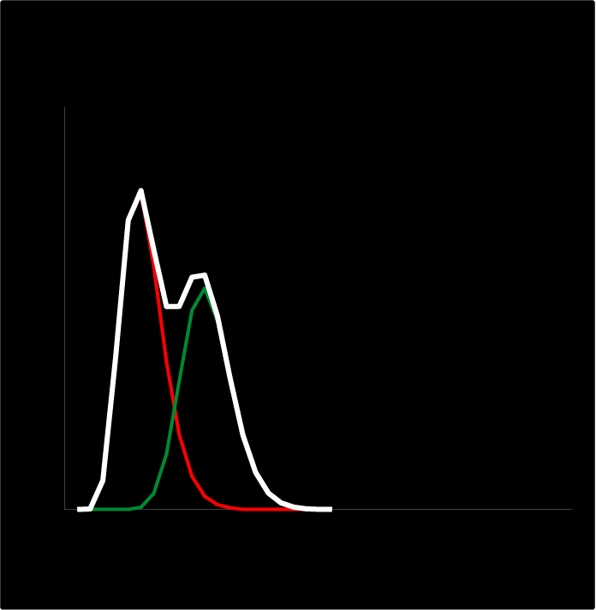
Isn’t the hemodynamic response too slow?
It works for EEG/MEG, where the response is short
3 seconds
How can it work for fMRI where the response is long
3 seconds

Slide 45
How Can It Work?
Short Answer: Linear; Time Invariant
. . .

Slide 46
Block Design vs. Rapid Event Related: Positives
Block Design
Accurate estimate of amplitude of response to each stimulus type
Rapid Event Related
Accurate estimate of amplitude of response to a single stimulus AND exact temporal dynamics of response to single stimulus

Slide 47
Block Design vs. Rapid Event Related: Negatives
Block Design
Biggest flaw:
requires blocked trials of same type
Rapid Event Related
Biggest flaws:
less detectability
experimentally much more difficult: requires stimulus randomization, jittering and PRECISE scanner synchronization

Slide 48
Block Design: Biggest Flaw

Slide 49
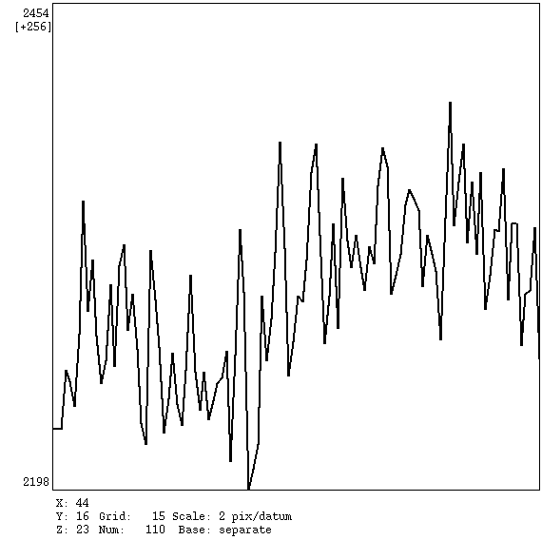
Event Related: Biggest Flaw

Slide 50
Block Design vs. Rapid Event Related
Block Design
Biggest flaws:
requires blocked trials of same type
Rapid Event Related
Biggest flaws:
Less detectability—HOW MUCH?
experimentally much more difficult: requires stimulus randomization, jittering and PRECISE scanner synchronization

Slide 51
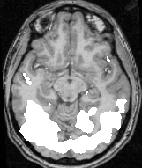
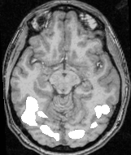
Block vs. Event Related Activation Maps
Block
Rapid Event Related
p < 10⁻¹⁰
p < 10⁻¹⁰

Slide 52
Block vs. Event Related Activation Maps
Block
Rapid Event Related
p < 10⁻¹⁰

Slide 53
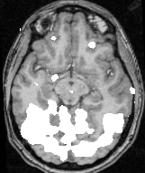
Block vs. Event Related Activation Maps
Block
Rapid Event Related
p < 10⁻¹⁰
p < 0.001

Slide 54
Block vs. Event Related Activation Maps
Block
Rapid Event Related
p < 10⁻¹⁰
p < 0.001

Slide 55
Block Design vs. Rapid Event Related
Block Design
Biggest flaws:
requires blocked trials of same type
Rapid Event Related
Biggest flaws:
Less detectability
Experimentally much more difficult: requires stimulus randomization, jittering and PRECISE scanner synchronization

Slide 56
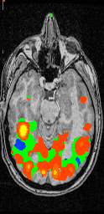
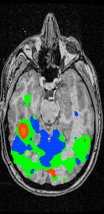
Block
Rapid Event Related
p < 10⁻¹⁰
p < 0.001
p < 0.05

Slide 57
Block Design vs. Rapid Event Related
Block Design
Biggest flaws:
-- requires blocked trials of same type
Rapid Event Related
Biggest flaws:
-- Somewhat less detectability
-- experimentally much more difficult: requires stimulus randomization, jittering and PRECISE scanner synchronization

Slide 58
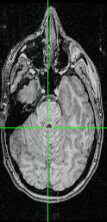
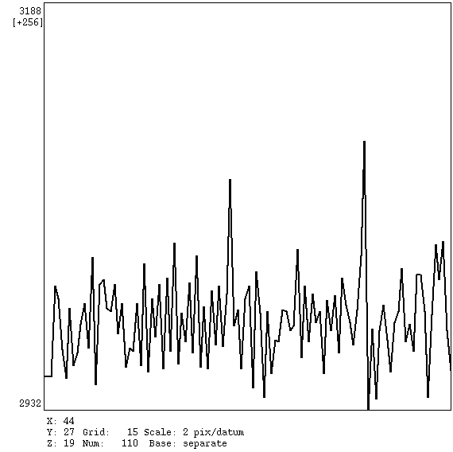
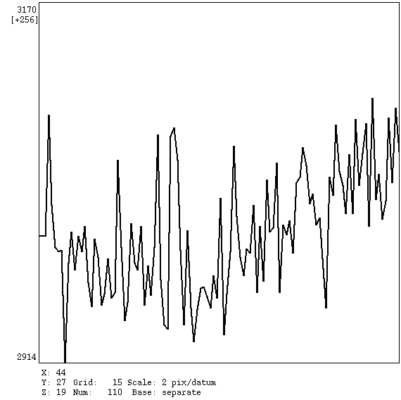
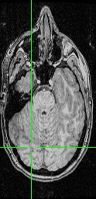
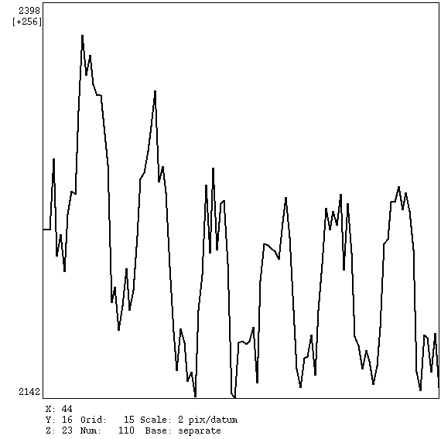
Problem: Experimentally Difficult

Slide 59
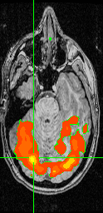
Block Design Analysis
Robust

Slide 60
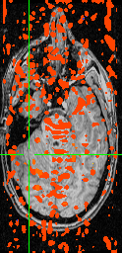
Event Related Analysis

Slide 61
Block Design vs. Rapid Event Related: Positives
Block Design
Accurate estimate of amplitude of response to each stimulus type
Rapid Event Related
Accurate estimate of amplitude of response to a single stimulus AND exact temporal dynamics of response to single stimulus

Slide 62
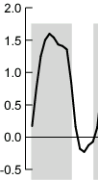
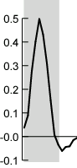
The response to a single cognitive event
Block
Rapid Event Related

Slide 63
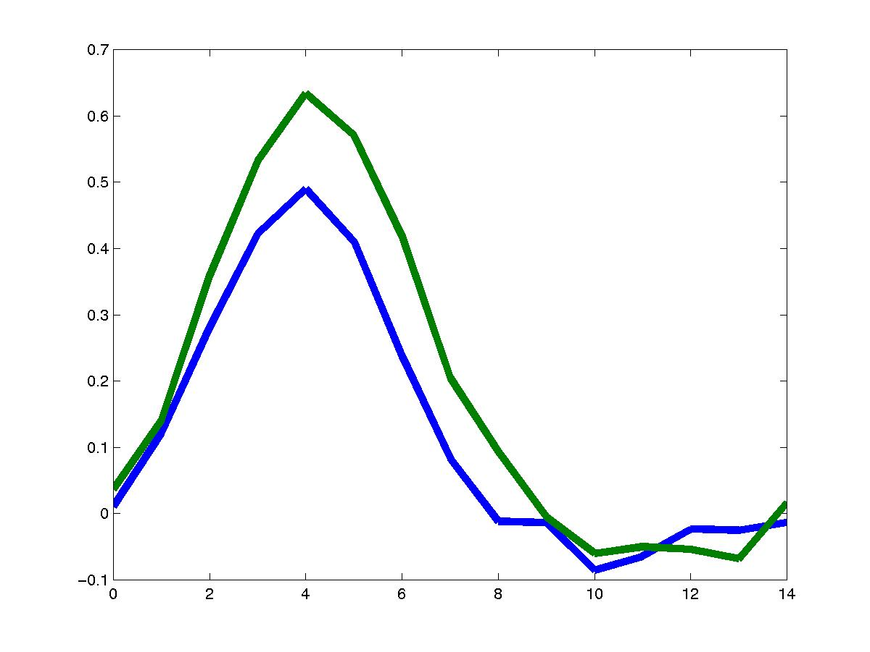
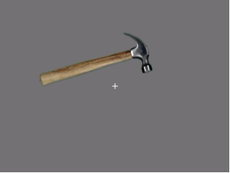
Temporal Dynamics

Slide 64
Conclusions
New experimental designs are one of the most fertile areas of fMRI research--clever event-related designs allow the study of previously inaccessible cognitive and neuroscience processes
Event-related designs require sophisticated data analysis and precise timing techniques—if possible, pilot experiments should be block design to assess viability
Use the simplest techniques that are able to answer your experimental question

Slide 65
Multiple Regression--the math behind it
y = β₀x₀ + β₁x₁ + β₂x₂ + .... + β_{p}x_{p}+ ε
y: MR time series
x: regressors of the same length as the time series
Underlying inference assumptions:
(1) Constant Variance and (2) Normal Populations
y has a constant variance for any x_{i} and y has a normal distribution for any x_{i}
Notes:
In all forms of multiple regression, we describe the MR time series, y, as the best-fit sum of a number of regressors.
At each time point in the MR time series, we take a point in each regressor of interest and multiply it by the beta weight for that regressor. At each point in the time series, we also generate an error term, which is the difference between the predicted and actual time series.
If we're doing mulktiple regression, these regressors can represent contrasts of interest, as shown here; they can represent different event types; or they can represent different time points in each event, which I've called deconvolution. But the underlying mathematics are identical.
To calculate the statistical significance of our model, we need to make sume assumptions about the MR time series. We assume that at each point in the time series, this error term is normally distributed, and that it has equal variance at each point in the time series.
These assumptions are likely to be weakly violated, but they hold pretty well.

Slide 66
Multiple Regression--the math behind it
y = β₀x₀ + β₁x₁ + β₂x₂ + .... + β_{p}x_{p}+ ε
Inference assumption: (3) Independence
each measured y is statistically independent
Always violated: extensive autocorrelation in the fMRI time series due to
i) respiratory induced signal change
ii) cardiac signal change, aliased to lower frequencies
iii) stimulus uncorrelated synchronous neuronal activity
iv) stimulus correlated responses not fit by the model
Calculate ε at each time point to measure autocorrelation, reduce degrees of freedom accordingly
Notes:
A more flawed assumption is that each sample of y, the MR time series, is statistically independent.
But we know this is never true, because subjects are always breathing and their heart is always beating (we hope).
This introduces a high degree of autocorrelation into the signal, because when the subject breathes in, the signal will be higher, then lower, etc.
Because all of the samples are not statistically independent, we should remember that the significance values we receive are inflated.
One way around this problem is to measure the cardiac and respiratory fluctuations and filter them from our MR signal.

Slide 67
References II
Buckner RL., Event-related fMRI and the hemodynamic response. Hum Brain Mapp. 1998;6(5-6):373-7.
Friston KJ, et al. Nonlinear event-related responses in fMRI. Magn Reson Med. 1998 Jan;39(1):41-52.
Vazquez AL, et al. Nonlinear aspects of the BOLD response in functional MRI. Neuroimage. 1998 Feb;7(2):108-18.
Josephs, et al. Event-related functional magnetic resonance imaging: modelling, inference and optimization. Philos Trans R Soc Lond B Biol Sci. 1999 Jul 29;354(1387):1215-28.
Cohen, Mark S. 1997. Parametric Analysis of fMRI Data Using Linear Systems Methods NeuroImage, 6: 93-103
Notes:
Doug Greve and others have been developing deconvolution methods even more recently (here's some more references).
So how do we pick one of these methods?

Slide 68
References III
Dale AM. Optimal experimental design for event-related fMRI. Hum Brain Mapp. 1999;8(2-3):109-14
FM Miezin, L Maccotta, JM Ollinger, SE Petersen and RL Buckner. "Characterizing the Hemodynamic Response: Effects of Presentation Rate, Sampling Procedure, and the Possibility of Ordering Brain Activity Based on Relative Timing" NeuroImage, 2000 Vol 11 No. 6 pp. 735-759.
Worsley, K.J., Liao, C., Grabove, M., Petre, V., Ha, B., Evans, A.C. (2000). A general statistical analysis for fMRI data. HBM 2000 (abstracts)
Notes:
Deconvolution is still quite new, so not many papers have been published describing the method. However, it's important to remember that it really is just another form of multiple regression.

Slide 69
Analysis of Functional NeuroImages afni.nimh.nih.gov
Robert W. Cox, Ph.D.
Chief, Scientific and Statistical Computing Core, NIMH
Intramural Program Director, NIfTI (NeuroImaging Informatics Technology Initiative)

Slide 70
Why is AFNI so great?
For novice users:
Excellent manuals and technical support
Easy to use and interactive; won’t overwrite data
For advanced users:
Infinitely expandable, Dozens of sophisticated tools
Fast & Interactive: helps you do better experiments (lets you immediately visualize experimental manipulations and alternative analysis techniques)
Powerful and Flexible
SUMA!!

Slide 71
An FMRI Analysis Environment
Philosophy:
Encompass all needed classes of data and computations
Extensibility + Openness + Scalability: Anticipating what will be needed to solve problems that have not yet been posed
Interactive vs. Batch operations: Stay close to data or view from a distance
Components:
Data Objects: Arrays of 3D arrays + auxiliary data
Data Viewers: Numbers, Graphs, Slices, Volumes
Data Processors: Plugins, Plugouts, Batch Programs

Slide 72
AFNI Controller Window

Slide 73
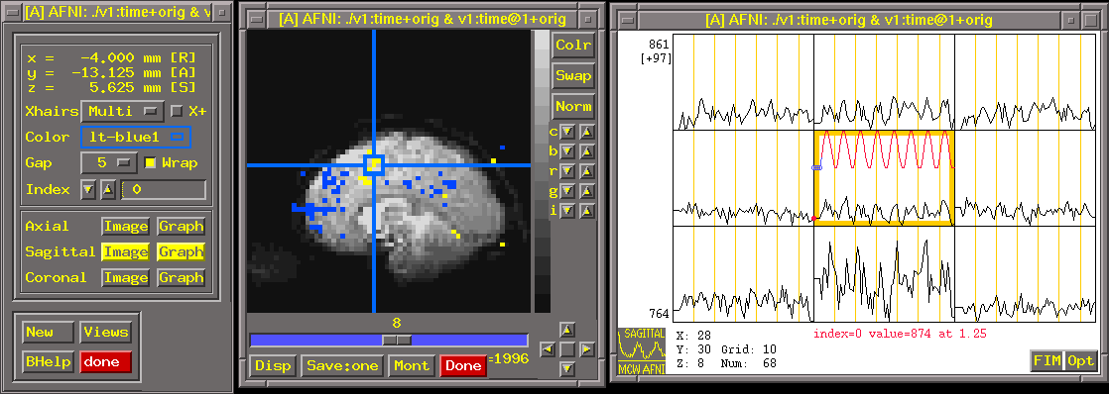
Interactive Analysis with AFNI
Control
Panel
Displaying EP images
from time series
Graphing voxel
time series data

Slide 74
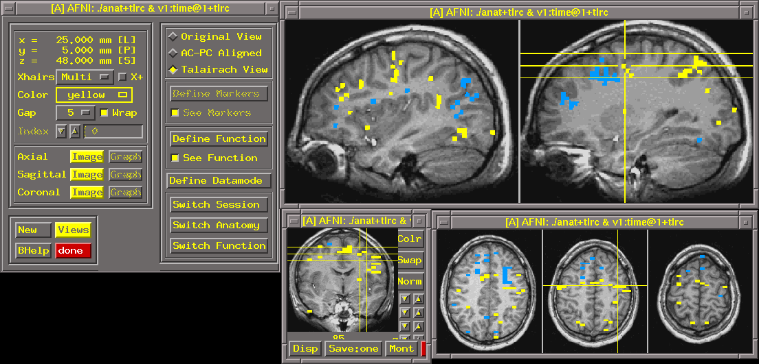
Looking at the Results
Multislice layouts
FIM overlaid on SPGR, in Talairach coords

Slide 75
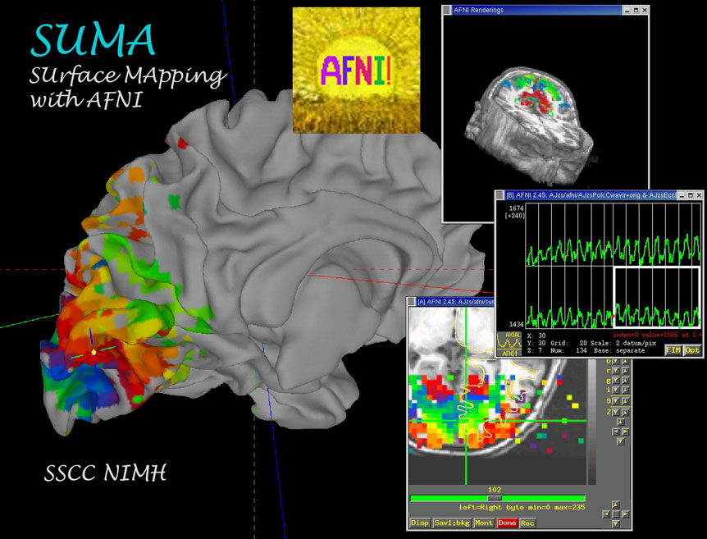
SUMA

Slide 76
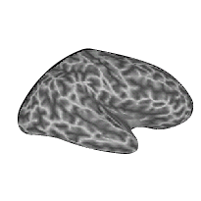
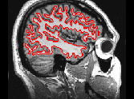
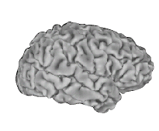
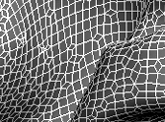
Cortical Surface Models

Slide 77
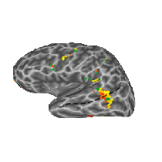




Cortical Surface Models Single Subjects
n=4

Slide 78

AFNI
Notes:
We'll spend all day tomorrow with AFNI, but I just wanted to show you a couple features that make it very easy to do look at multiple regression data and generate the sort of pictures I've been showing you.

Slide 79


AFNI
Notes:
The main point is that AFNI automatically loads the results of all regressors.
So, you see lots of blue on this map meaning that the values for this regressor are mainly negative.

Slide 80

AFNI Makes it easy to examine the effects of different regressors
Notes:
By just clicking here, I get a list of the significance and amplitude of all the regressors used in my analysis.

Slide 81

AFNI Makes it easy to examine the effects of different regressors
Notes:
If I click on the amplitude of a different regressor,

Slide 82

AFNI Makes it easy to examine the effects of different regressors
Notes:
AFNI updates the map, and the voxels turn to orange, showing that the Beta-weights for this regressor are mainly positive.
This is extendable to as many regressors as we use in our analysis, the list just gets longer.

Slide 83

Sample
Rendering:
Coronal slice
viewed from side;
function not cut out
Rendering is easy to
setup and carry out
from control panel

Slide 84
Integration of Results
Done with batch programs (usually in scripts)
3dmerge: edit and combine 3D datasets
3dttest: voxel-by-voxel t-tests
3dANOVA:
Voxel-by-voxel: 1-, 2-, and 3-way layouts
Fixed and random effects
Other voxel-by-voxel statistics are available
3dpc: principal components (space × time)
ROI analyses are labor-intensive alternative

Slide 86



Anterior Hippocampus Mask

Slide 87
Realtime AFNI
AFNI software package has a realtime plugin, distributed with every copy
Price: USD$0 [except for time & effort]
Runs on Unix/Linux
Requires input of reconstructed images and geometrical information about them
For more information see Web site

Slide 88
Interactive Functional Brain Mapping
See functional map as scanning proceeds
1 minute 2 minutes 3 minutes

Slide 89
Estimated
subject
movement
parameters

Slide 90

http://afni.nimh.nih.gov
Notes:
AFNI is fairly widely used, and has an excellent manual. Support for AFNI is available from the message board and other users. About 60 published papers have been written using AFNI.

