Slide 1


Principles of Neuroimaging
Michael S. Beauchamp, Ph.D.
Assistant Professor
Department of Neurobiology and Anatomy
Michael.S.Beauchamp@uth.tmc.edu
Friday, February 25th@ 8 a.m., MSB 2.006
M1 Medical Neuroscience. Nachum Dafny, Course Director

Slide 2
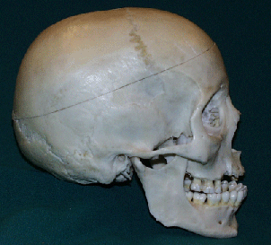
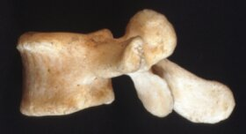
Why is neuroimaging difficult?
2 - 17
17 - 21
21 - 23
Notes:
CNS is soft tissue surrounded by hard bone

Slide 3
Palpation/Sensation
skull: can’t feel much from outside (sorry, ultrasound)
-no nerves in brain: can’t feel much from inside

Slide 4

Alphabet Soup
SPECT
CT
MRI
PET
MEG
EEG
fMRI

Slide 5
Taxonomy of Neuroimaging Methods
Accessory (non-imaging)
Methods
Neuroimaging Methods
MEG
EEG
External Ionizing Radiation
Internal Ionizing Radiation
Non-ionizing radiation
(Radio Waves)
CT
PET
MRI
Angiogram/
Arteriogram
SPECT
fMRI
MR Angiography
X-Ray
(radiograph)
Diffusion Imaging (DWI/DTI)
MR Spectroscopy

Slide 6
Taxonomy of Neuroimaging Methods
Accessory (non-imaging)
Methods
Neuroimaging Methods
MEG
EEG
External Ionizing Radiation
Internal Ionizing Radiation
Non-ionizing radiation
(Radio Waves)
CT
PET
MRI
Angiogram/
Arteriogram
SPECT
fMRI
MR Angiography
X-Ray
(radiograph)
Diffusion Imaging (DWI/DTI)
MR Spectroscopy

Slide 7
Taxonomy of Neuroimaging Methods
Accessory (non-imaging)
Methods
Neuroimaging Methods
MEG
EEG
External Ionizing Radiation
Internal Ionizing Radiation
Non-ionizing radiation
(Radio Waves)
CT
PET
MRI
Angiogram/
Arteriogram
SPECT
fMRI
MR Angiography
X-Ray
(radiograph)
Diffusion Imaging (DWI/DTI)
MR Spectroscopy

Slide 8
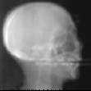
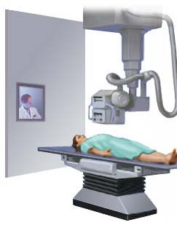
X-Ray (radiograph)—bones, not brain!
(tissue density)

Slide 9
Taxonomy of Neuroimaging Methods
Accessory (non-imaging)
Methods
Neuroimaging Methods
MEG
EEG
External Ionizing Radiation
Internal Ionizing Radiation
Non-ionizing radiation
(Radio Waves)
CT
PET
MRI
Angiogram/
Arteriogram
SPECT
fMRI
MR Angiography
X-Ray
(radiograph)
Diffusion Imaging (DWI/DTI)
MR Spectroscopy

Slide 10
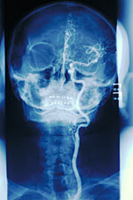
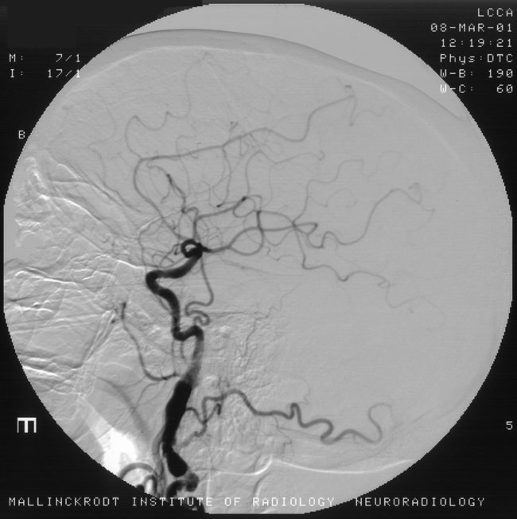
Arteriogram (a.k.a. Angiogram)
Basic principle: Inject contrast agent (dye)
that is radio-opaque i.e. iodine containing agents
Notes:
Dangerous because have to feed a catheter up through the vessels—if puncture one then big trouble

Slide 11
Taxonomy of Neuroimaging Methods
Accessory (non-imaging)
Methods
Neuroimaging Methods
MEG
EEG
External Ionizing Radiation
Internal Ionizing Radiation
Non-ionizing radiation
(Radio Waves)
CT
PET
MRI
Angiogram/
Arteriogram
SPECT
fMRI
MR Angiography
X-Ray
(radiograph)
Diffusion Imaging (DWI/DTI)
MR Spectroscopy

Slide 12
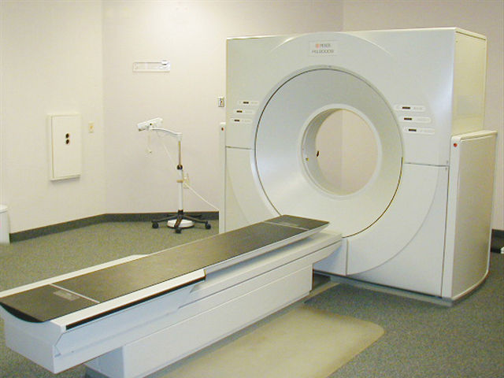
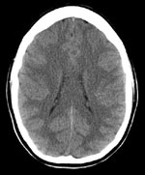
CT (computed tomography)

Slide 13
CT (computed tomography)
Pros:
Widely available
Very fast to collect whole-head images
(one slice in < 1 ms; whole head in ~ seconds; whole exam in 10 minutes )
Somewhat cheaper than MRI
(~$500 vs ~$1000 for MRI)
Less hassle (few contraindications)
Best for an emergency
Cons:
Exposure to ionizing radiation (increased risk of cancer)
can require a contrast agent—for brain, injectable iodine compound
Poor tissue contrast
not versatile

Slide 14
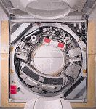
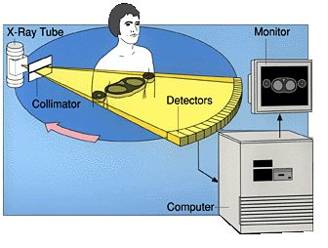
CT (computed tomography)
Basic Principle: rotate machinery
to take multiple x-rays with different paths through the body

Slide 15
Common clinical use: stroke
Patient presents with stroke
80%
20%
ischemic
hemorraghic
Give tPA, dissolve clot,
Blood flow restored,
Patient recovers
Give tPA, prevent clotting,
Patient dies of massive bleed

Slide 16
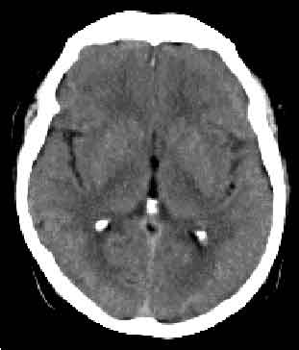
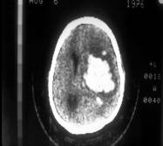
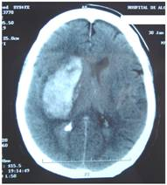
Common clinical use: stroke
Patient presents with stroke
80%
20%
ischemic
hemorraghic

Slide 17
CT (computed tomography)
Pros:
Widely available
Very fast to collect whole-head images
(one slice in < 1 ms; whole head in ~ seconds; whole exam in 10 minutes )
Somewhat cheaper than MRI
(~$500 vs ~$1000 for MRI)
Less hassle (few contraindications)
Best for an emergency
Cons:
Exposure to ionizing radiation (increased risk of cancer)
can require a contrast agent—for brain, injectable iodine compound
Poor tissue contrast
not versatile

Slide 18
Accessory (non-imaging)
Methods
Neuroimaging Methods
MEG
EEG
External Ionizing Radiation
Internal Ionizing Radiation
Non-ionizing radiation
(Radio Waves)
CT
PET
MRI
Angiogram/
Arteriogram
SPECT
fMRI
MR Angiography
X-Ray
(radiograph)
Diffusion Imaging (DWI/DTI)
MR Spectroscopy

Slide 19
“Nuclear Medicine”
Accessory (non-imaging)
Methods
Neuroimaging Methods
MEG
EEG
External Ionizing Radiation
Internal Ionizing Radiation
Non-ionizing radiation
(Radio Waves)
CT
PET
MRI
Angiogram/
Arteriogram
SPECT
fMRI
MR Angiography
X-Ray
(radiograph)
Diffusion Imaging (DWI/DTI)
MR Spectroscopy

Slide 20
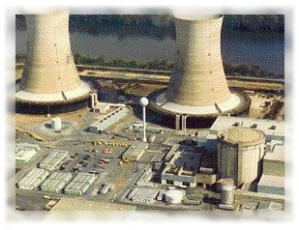
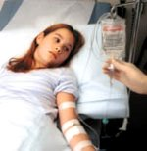
“Nuclear Medicine”: PET/SPECT
Basic priniciple:
Inject radioactive isotope attached to metabolic compound (Oxygen, Glucose, etc.)
Wait for it to decay, look for radioactive decay products

Slide 21
PET/SPECT
Pros:
Fairly cheap (~ $1000)
Shows function (metabolism)
Cons:
Exposure to ionizing radiation (increased risk of cancer)
~1 year of background radiation
Low-resolution
Slow to very slow
not versatile

Slide 22
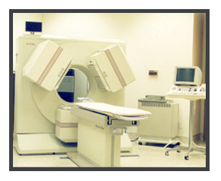
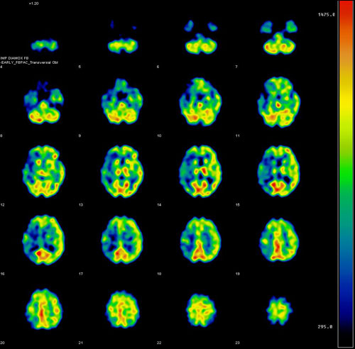
SPECT
Single Photon Emission Computed Tomography
“Nuclear Medicine”:
~unclear medicine

Slide 23
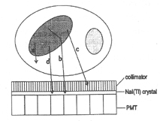
SPECT
Single Photon Emission Computed Tomography
Radionuclides
  Single-Gamma emitting
  99mTc, 123I, 67Ga, 111In

Slide 24
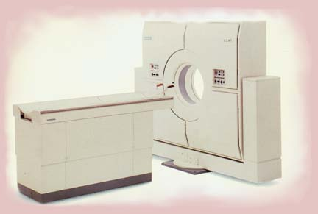
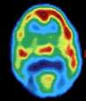
PET: Positron Emission Tomography
Basic priniciple:
Inject radioactive isotope attached to important metabolic compound (Oxygen, Glucose)
Wait for it to decay.
Pick up two particles going in opposite directions—improves spatial resolution
PET uses beta-plus-emitting radionuclides such as C-11, N-13, O-15, and F-18 which annihilate into two 511-keV photons that travel in opposite directions.

Slide 25
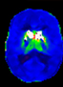
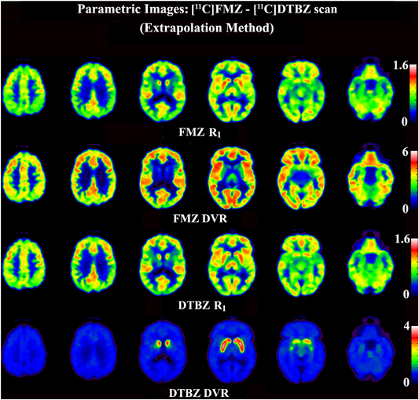
Developments in PET
Development of new radiotracers
[11C]DTBZ
VMAT2
~dopamine,serotonin
[11C] Flumazenil
(benzodiazepine receptor antagonist
~ GABA-A )
[11C]PMP
Substrate for AChE
Joshi et al., JCBFM 2009

Slide 26
2 –photons instead of one → better resolution

Slide 27
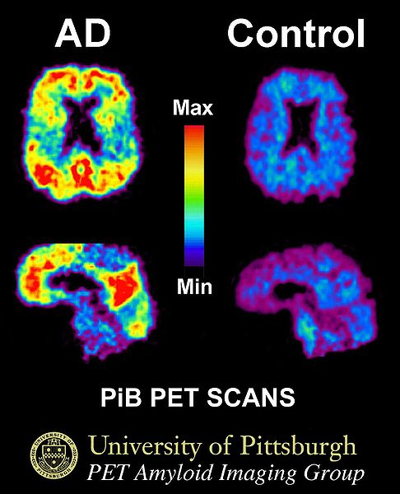
Sample Clinical Application: Alzheimer’s Diagnosis
Compounds that bind to AD plaques
Conditional approval by FDA (Jan 2011)
C. M. Clark et al. J. Am. Med. Assoc. 305, 275–283; 2011

Slide 28
Accessory (non-imaging)
Methods
Neuroimaging Methods
MEG
EEG
External Ionizing Radiation
Internal Ionizing Radiation
Non-ionizing radiation
(Radio Waves)
CT
PET
MRI
Angiogram/
Arteriogram
SPECT
fMRI
MR Angiography
X-Ray
(radiograph)
Diffusion Imaging (DWI/DTI)
MR Spectroscopy

Slide 29
MRI: Magnetic Resonance Imaging
Pros:
incredible images
advancing very rapidly
extremely high resolution
extremely versatile
NO ionizing radiation
Cons:
moderately expensive (~$1000)
complex
some contraindications
Can require injection of contrast agents (Gadolinium/Iron compounds)

Slide 30
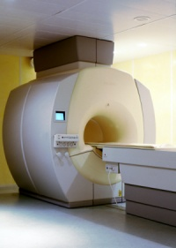
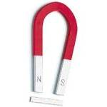
Imaging Techniques: MRI
the MR scanner is a giant magnet: 1.5T, 3T, 7T, 9T

Slide 31
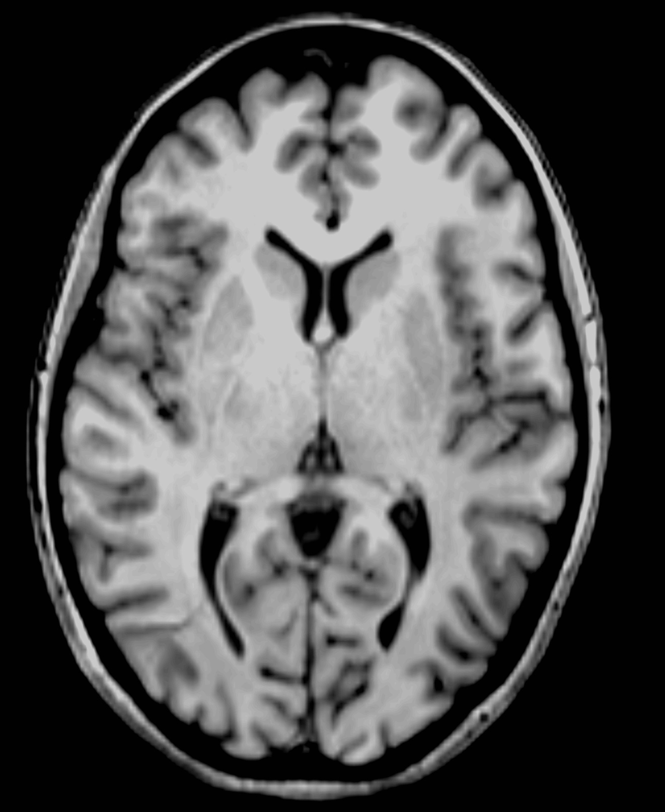
Notes:
Left—CT; right—MRI

Slide 32
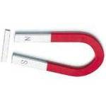
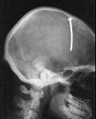

Contraindications I
Ferrous metal in body

Slide 33
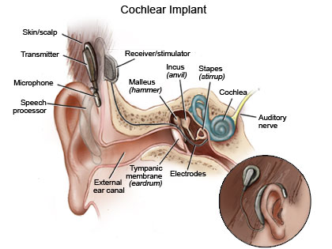
Contraindications II
Cochlear implants (always)
Maybe: pacemakers, vagal nerve stimulators, old (> 20 year) surgical implants

Slide 34
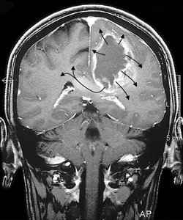
Clinical Applications

Slide 35
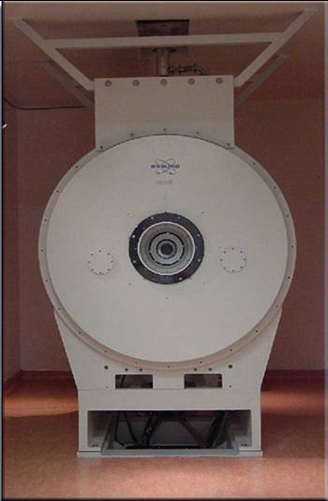
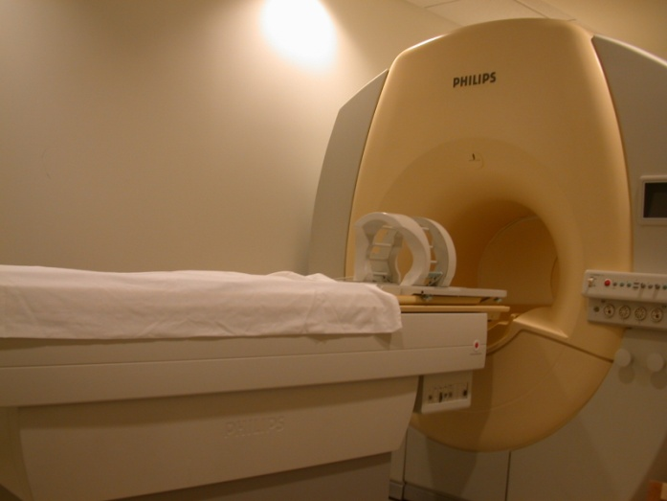
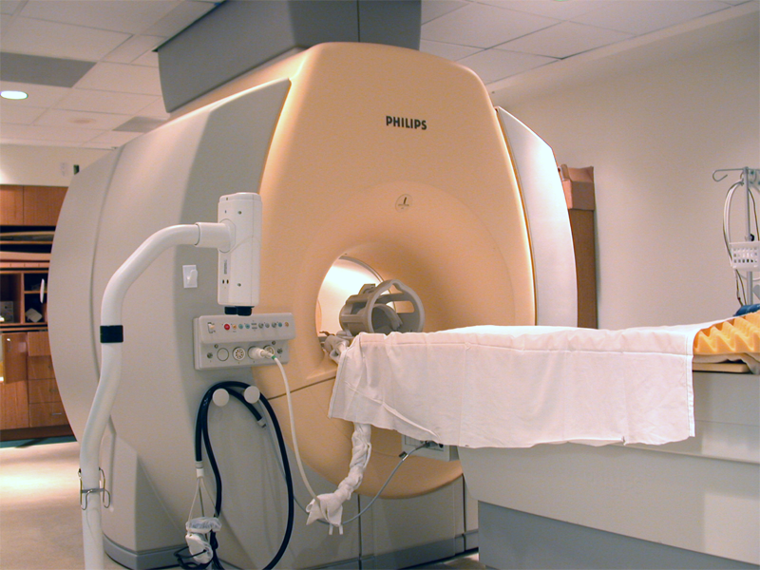
UTH MRI Facility
Location: Ground Floor, MSB Building
Equipment: Phillips 3T whole body human MRI scanner
Mock scanner for testing and training
Bruker 7T small animal (rodent) scanner

Slide 36

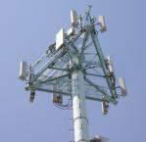

MRI (Magnetic Resonance Imaging)
Basic principle: uses radio waves to interrogate protons in water molecules in the brain

Slide 37
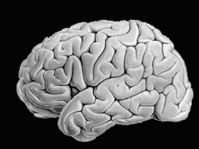
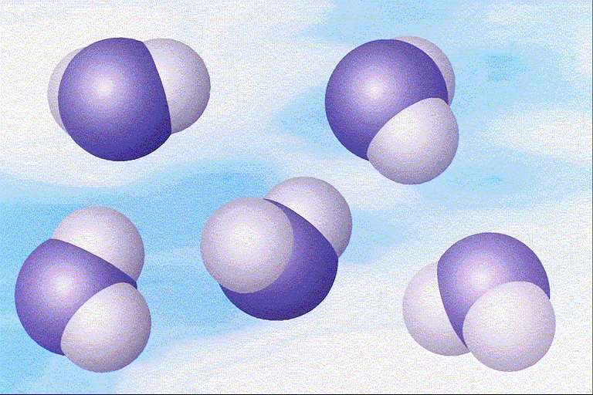
MRI (Magnetic Resonance Imaging)
Basic principle: uses radio waves to interrogate protons in water molecules in the brain

Slide 38
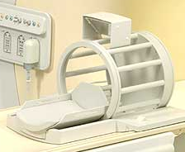

128 MHz at 3T (~ FM Radio)

Slide 39
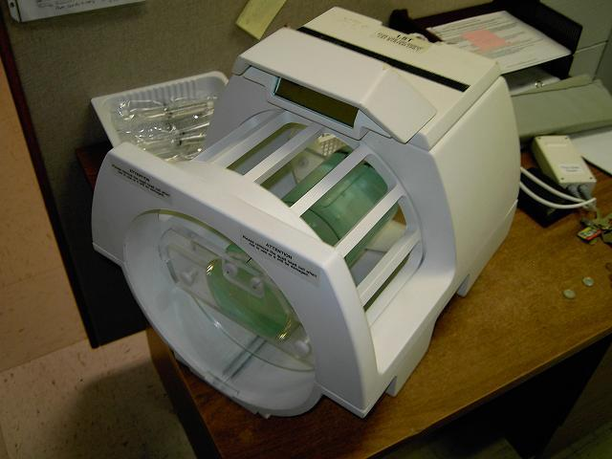

We listen to these radio waves with an “RF coil” (radio antenna)
H₂O
H₂O
H₂O

Slide 40
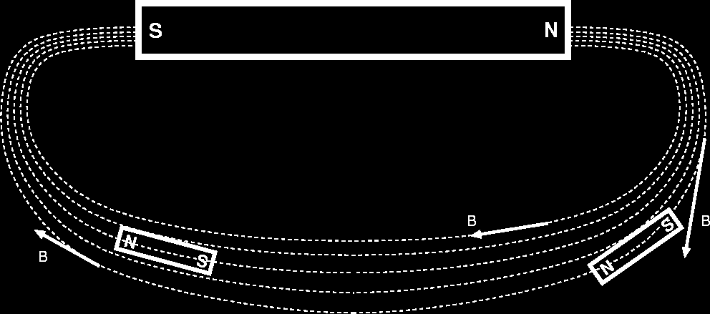
B₀ = Giant Field Produced by Giant Magnet
Purpose is to align H protons in H₂O (little magnets)
[Main magnet and some of its lines of force]
[Little magnets lining up with external lines of force]

Slide 41
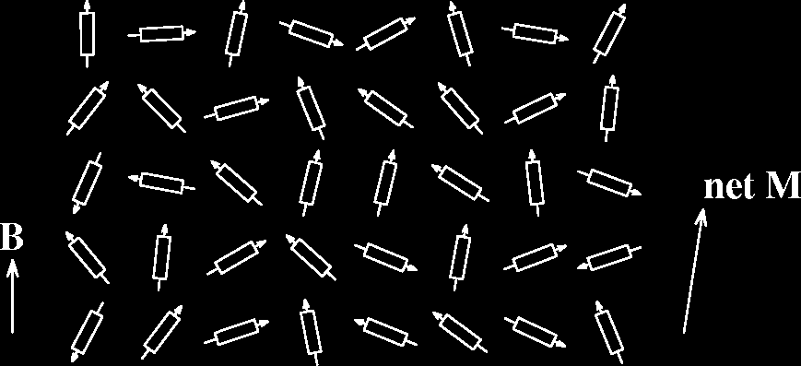
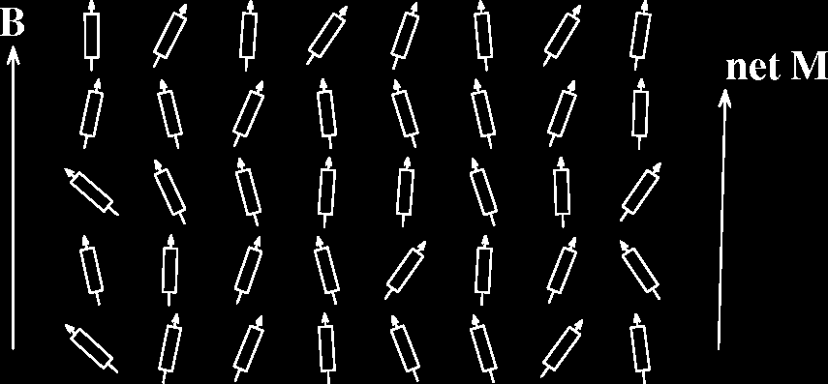
Small B₀ produces
small net
magnetization M
Thermal motions
try to randomize
alignment of
proton magnets
Larger B₀ produces
larger net
magnetization M,
lined up with B₀
Reality check:
0.0003% of protons
aligned per Tesla
of B₀

Slide 42
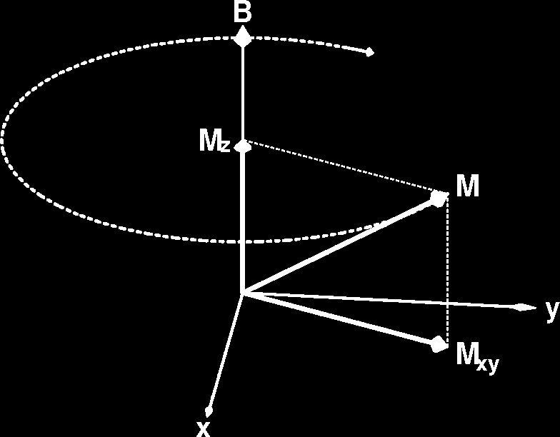
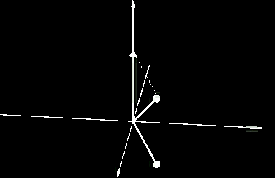
Precession of Magnetization M
Magnetic field causes M to rotate (or precess) about the direction of B at a frequency proportional to the size of B — 42 million times per second (42 MHz), per Tesla of B
If M is not parallel to B, then
it precesses clockwise around
the direction of B.
However, “normal” (fully relaxed) situation has M parallel to B, which means there won’t be any
precession
N.B.: part of M parallel to B (M_{z})
does not precess

Slide 43
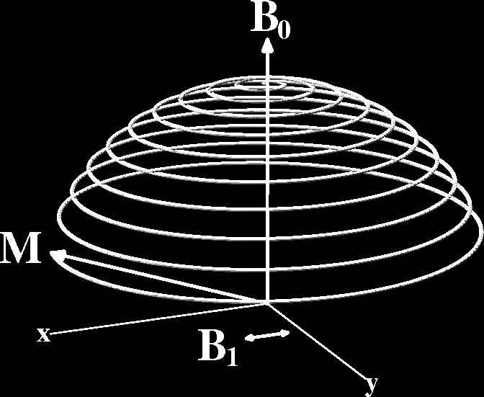
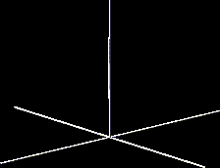
B₁ = Excitation (Transmitted) Radio Frequency (RF) Field
Left alone, M will align itself with B in about 2–3 s
So don’t leave it alone: apply (transmit) a magnetic field B₁ that fluctuates at the precession frequency and points perpendicular to B₀
The effect of the tiny B₁ is
to cause M to spiral away
from the direction of the
static B field
B₁≈10^{–4} Tesla
This is called resonance
If B₁ frequency is not close to
resonance, B₁ has no effect
Time = 2–4 ms

Slide 44
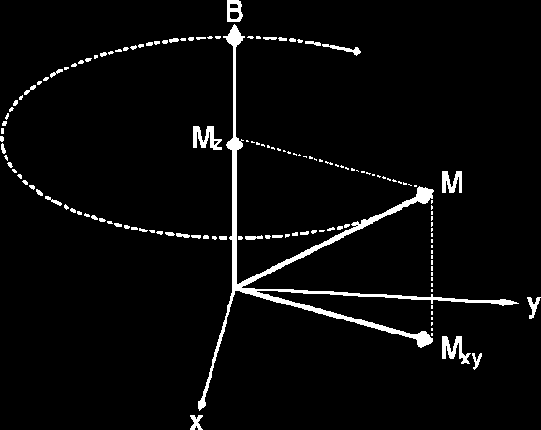
Relaxation: Nothing Lasts Forever
In absence of external B₁, M will go back to being aligned with static field B₀ — this is called relaxation
T2: Part of M perpendicular to B₀ shrinks [M_{xy}]
  This part of M is called transverse magnetization
  It provides the detectable RF signal
T1: Part of M parallel to B₀ grows back [M_{z}]
  This part of M is called longitudinal magnetization
  Not directly detectable, but is converted into transverse magnetization by externally applied B₁

Slide 45
Ants on a Pole analogy—two different physical properties

Slide 46
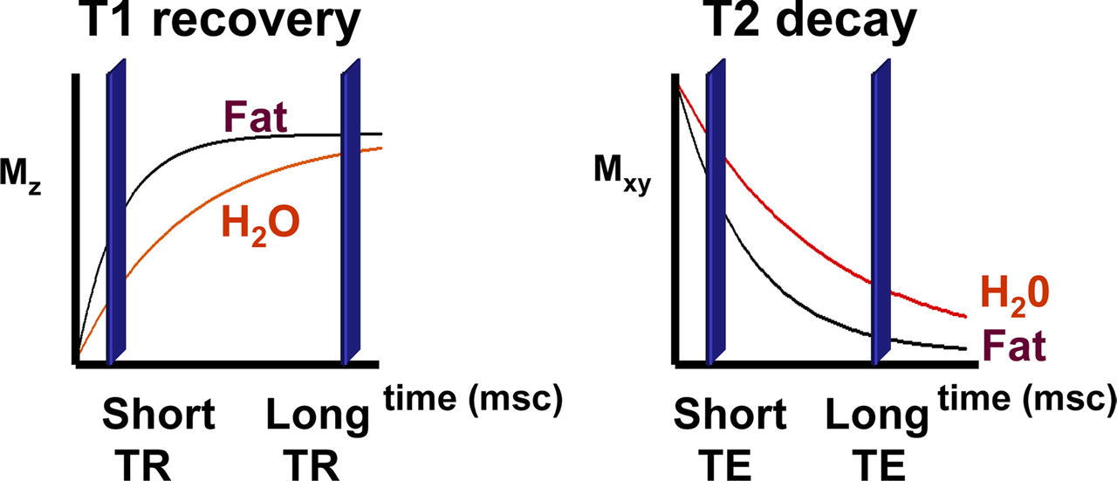
Bitar, R. et al. Radiographics 2006;26:513-537

Slide 47
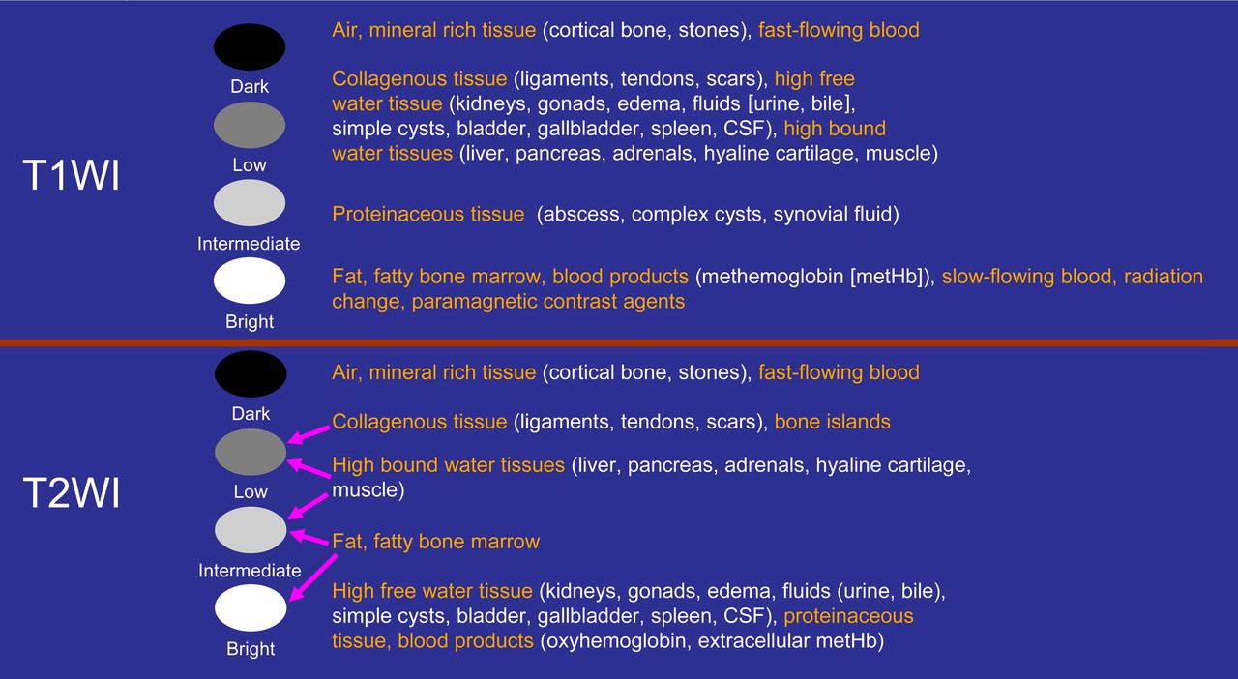

Slide 48
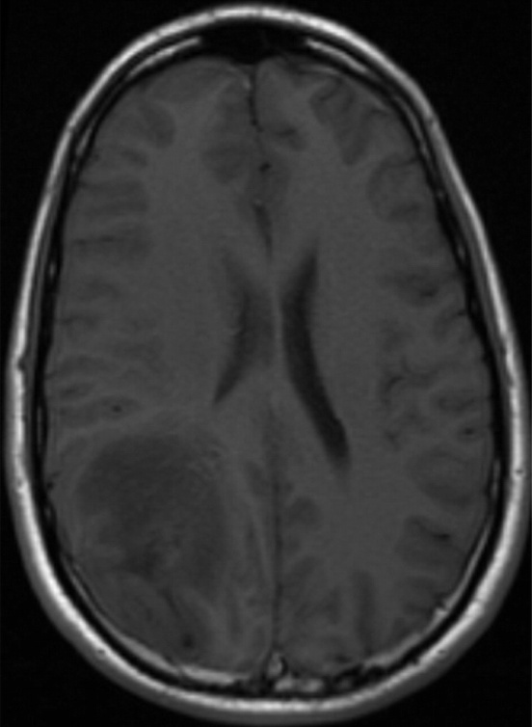
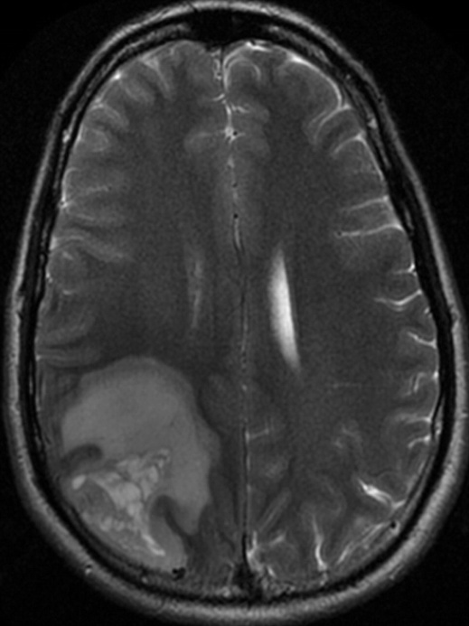
Basics of MR
T1 ~ Longitudinal Magnetization/Relaxation
“hi-resolution, normal anatomy”
T2 ~ Transverse Magnetization/Relaxation
“pathology”—water content
Notes:
Show MRIcron

Slide 49

Basics of MR—contrast agents
Gadolinium
can be injected to enhance contrast (usually in T1 images); hastens T1 recovery making image brighter

Slide 50

Clinical Applications: Multiple Sclerosis
T2 is best for seeing white matter abnormalities

Slide 51
Bonus—Shelf Exam Question
A 53-year-old woman dies 4 days after an automobile
collision. She sustained multiple injuries including a
femoral fracture. Widespread petechiae are found in the
cerebral white matter at autopsy. Which of the following is
the most likely cause of these findings?
(A) Acute respiratory distress syndrome
(B) Contrecoup injury
(C) Fat embolization
(D) Septicemia
(E) Subdural hematoma

Slide 52

Fat emboli (FLAIR T2)

Slide 53
Scanner as computer…
pulse sequences are software
CT vs MRI
TV with one channel (not that much good on)
vs.
Computer that can run lots of programs (takes longer to boot up, but get more for it)

Slide 54
Accessory (non-imaging)
Methods
Neuroimaging Methods
MEG
EEG
External Ionizing Radiation
Internal Ionizing Radiation
Non-ionizing radiation
(Radio Waves)
CT
PET
MRI
Angiogram/
Arteriogram
SPECT
fMRI
MR Angiography
X-Ray
(radiograph)
Diffusion Imaging (DWI/DTI)
MR Spectroscopy

Slide 55



MRI vs. fMRI
Functional MRI (fMRI) studies brain function.
MRI studies brain anatomy.
fMRI for Dummies

Slide 56

An “anonymous” M3

Slide 57

An “anonymous” M3

Slide 58


MRI vs. fMRI
MRI
fMRI
high resolution
(1 mm)
low resolution
(~3 mm but can be better)
one image
fMRI
Blood Oxygenation Level Dependent (BOLD) signal
  indirect measure of neural activity
…
many images
(e.g., every 2 sec for 5 mins)
↑ neural activity ➔ ↑ blood oxygen ➔ ↑ fMRI signal
fMRI for Dummies

Slide 59

An “anonymous” M3

Slide 60
Metabolism
Brain uses ~20% of total body oxygen
(even though only 1-2% of total body mass)
Complex mechanism for regulating cerebral blood flow to ensure adequate oxygen supply

Slide 61

Deoxygenated blood attenuates T₂*-weighted MR images
O₂
MRI volume element
Notes:
to emphasize that only the venous circulation matters in fMRI, I drew this schematic figure showing how deoxyhemoglobin arises in tissues. This square region [point] represents a perfused tissue volume element. These light blue molecules represent water within the tissue, which produces most of the MRI signal. The flow of blood through the volume element is regulated by varying the tone of smooth muscles in the walls of small arterial vessels. Arterial dHb levels are negligible in healthy individuals, though, so the arterial blood doesn’t normally influence the BOLD signal. In the capillaries, oxygen is removed from HbO₂, introducing blue, paramagnetic deoxyhemoglobin into the venous circulation.
this scenario occurs in every volume element of an MR image; for our purposes, arterial blood can be ignored and we need only consider the state of venous blood throughout the brain, which is uniformly blue at rest.
During increased perfusion, venous blood almost always becomes redder, though.

Slide 62
decrease of venous dHb during increased perfusion:
O₂
Notes:
This slide illustrates the two MRI-relevant consequences of increased cerebral blood flow.
Increased oxygenation of venous blood, shown by coloring the blood violet here, is by far the most important effect, as it causes the tissue MR signal to decay more slowly and makes decay-sensitive images brighter.
A secondary consequence of increased perfusion is a passive inflation of the highly compliant venous vessels, whose walls lack the muscular tone of the arteriolar vessels used to regulate perfusion. This causes an increase in Cerebral Blood Volume.
The increase in venous blood volume adds to the total amount of dHb in the tissue volume element, slightly counteracting the dilution of dHb caused by the increase in blood supply.
Although these two effects - blood volume and deoxyhemoglobin dilution - compete, the dilution effect is by far the dominant one.

Slide 63

Human 3T used for BOLD fMRI

Slide 64
One Fast Image
Graphs vs. time of 3×3 voxel region
This voxel did
not respond
Overlay on Anatomy
Colored voxels responded to the mental
stimulus alternation, whose pattern is shown in the
yellow reference curve plotted in the central voxel
68 points in time 5 s apart; 16 slices of 64×64 images

Slide 65



Notes:
fMRI used for presurgical mapping—find brains areas important for motor/language so surgeon doesn’t damage them

Slide 66




Slide 67
Accessory (non-imaging)
Methods
Neuroimaging Methods
MEG
EEG
External Ionizing Radiation
Internal Ionizing Radiation
Non-ionizing radiation
(Radio Waves)
CT
PET
MRI
Angiogram/
Arteriogram
SPECT
fMRI
MR Angiography
X-Ray
(radiograph)
Diffusion Imaging (DWI/DTI)
MR Spectroscopy

Slide 68

Diffusion Weighted Imaging—earliest post-stroke diagnosis

Slide 69

MR Angiography
Notes:
Show movie

Slide 70


Magnetic Resonance Spectroscopy
reduced GABA in panic disorder

Slide 71


Cortical Surface Models—AD/PD
Notes:
The thickness of gray matter is a sensitive measure of pathology, and can provide early diagnosis of Alzheimer’s and Parkinson’s

Slide 72
Accessory (non-imaging)
Methods
Neuroimaging Methods
MEG
EEG
External Ionizing Radiation
Internal Ionizing Radiation
Non-ionizing radiation
(Radio Waves)
CT
PET
MRI
Angiogram/
Arteriogram
SPECT
fMRI
MR Angiography
X-Ray
(radiograph)
Diffusion Imaging (DWI/DTI)
MR Spectroscopy

Slide 73


Slide 74
EEG/MEG
Pros:
Completely non-invasive—only modality that NEVER requires injection of a contrast agent
no ionizing radiation
direct measurement of neuronal activity
Cons:
not really neuroimaging
Limited clinical utility:
EEG—sleep studies
MEG--epilepsy

Slide 75


Slide 76


EEG
basic priniciple: electrodes on scalp surface record summed electrical activity (mainly synaptic)
of many neurons

Slide 77


MEG Scanner
basic priniciple: sensors near scalp surface record summed magnetic field resulting from
electrical activity (mainly synaptic) of many neurons

Slide 78


EEG/MEG Results
EEG Activation Map
MEG Activation Map
Notes:
Sometimes EEG/MEG are combined with MRI for greater resolution.

Slide 79
Taxonomy of Neuroimaging Methods
Accessory (non-imaging)
Methods
Neuroimaging Methods
MEG
EEG
External Ionizing Radiation
Internal Ionizing Radiation
Non-ionizing radiation
(Radio Waves)
CT
PET
MRI
Angiogram/
Arteriogram
SPECT
fMRI
MR Angiography
X-Ray
(radiograph)
Diffusion Imaging (DWI/DTI)
MR Spectroscopy

Slide 80
Want to know more?
MS4 Elective: BSCI Advances in Translational Neuroimaging (Independent Study)
This elective will expose students to advances in translational neuroimaging. No technical background or experience with neuroimaging is required. Students will present the results of their literature review in a small group format. Meetings will be held once a week, with flexible scheduling to accommodate residency interviews; the majority of the effort will be in self-directed study.

