Slide 1


Motor Control: Lecture 1
Michael S. Beauchamp, Ph.D.
Assistant Professor
Department of Neurobiology and Anatomy
University of Texas Health Science Center at Houston
Houston, TX
Michael.S.Beauchamp@uth.tmc.edu
Notes:
Introduction - Invasive studies of human neurophysiology: past, present, and future. (Daniel Yoshor, 6 minutes) Michael Beauchamp University of Texas Health Sciences Center, Houston Strengths and limitations of BOLD fMRI: Can invasive human studies help fill some of the gaps? (16 minute presentation + 5 minutes Q&A) Geoffrey Ghose University of Minnesota, Minneapolis Invasive human recordings as a complement to studies of neurophysiology in awake behaving monkeys. (16 minute presentation + 5 minutes Q&A) Itzhak Fried University of California, Los Angeles Activity of individual human neurons as a gateway to understanding perception and memory (16 minute presentation + 5 minutes Q&A) Robert Knight University of California, Berkeley Network properties and neural coding in the human neocortex (16 minute presentation + 5 minutes Q&A) Discussion and Wrap-up Workshop Participants, (30 minutes) Abstract: Dramatic advances in noninvasive methods for mapping cortical function have been rapidly incorporated into the clinical assessment of epilepsy surgery patients. While these techniques are valuable, direct electrical stimulation mapping is still routinely used and is considered the gold standard in the clinical arena. In recent years, a number of groups have refined methods for using electrodes implanted in patients undergoing invasive monitoring for epilepsy in order to carry out research on human cortical function. This workshop will explore how these studies can serve as a powerful adjunct to monkey invasive electrode studies and work with human fMRI, and then review examples of the application of some of the current research methods for studying higher cortical function in patients undergoing invasive monitoring, with an eye towards how the field has advanced beyond the classic methods of Penfield.

Slide 2
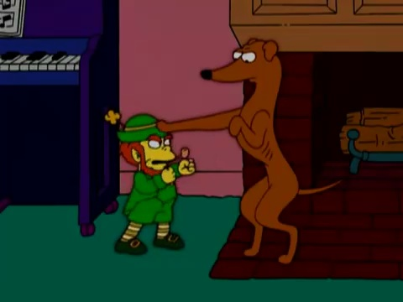

Slide 3

Muscles, what are they good for?

Slide 4
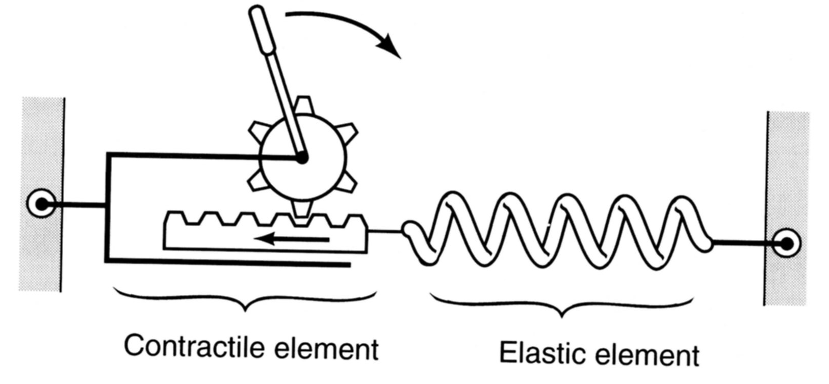
Muscle model
Notes:
A spring is a mechanical device that responds to an increase in length by generating a restoring force proportional to the change in length. However, this force is only develop when the length exceeds a threshold; before that, the sling is slack.
In muscles, sarcomeres have both contractile and spring like properties. Thus, muscles can be represented by two elements in series: a contractile element—a rack and pinion, and an elastic element (spring).
The elastic element includes a passive and an active component: tendon and connective tissue are the passive component. The muscle crossbridges are the active component.

Slide 5
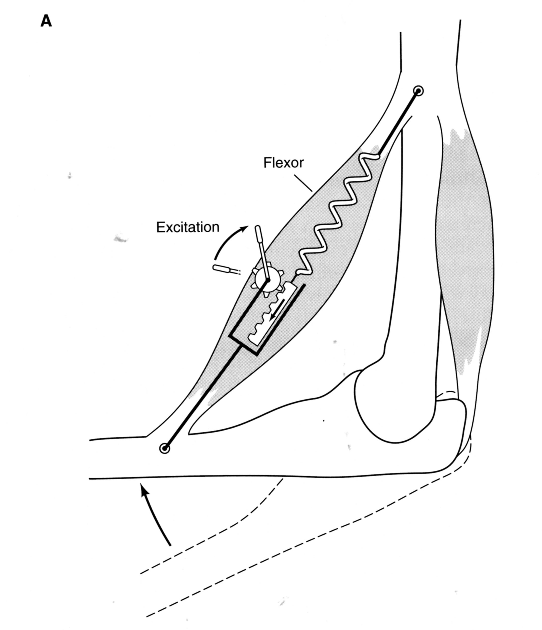
Body as machine
Notes:
Here is the elbow flexor muscle (biceps)
Changes in limb position result from changes in stiffness of the muscle.
Rotation of the gear resulting from increased neural activity pulls on the spring which flexes the forearm.

Slide 6
MOTOR CONTROL
ENVIRONMENT
Senses
Action
Cognition
Notes:
Complicated sensory processing useless without action
Can have simple reflezes
But almost all actions are under cognitive control

Slide 7
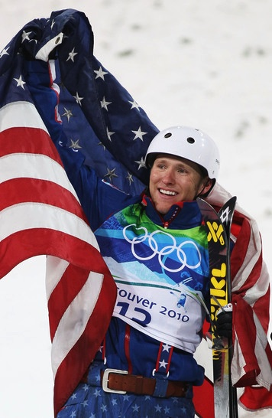
Notes:
Jeret Peterson—silver medalist in freestyle men’s aerials
Performing a jump called a Hurricane

Slide 8
Necessary Components of Proper Motor Control
Volition
Coordination of signals to many muscle groups
Proprioception
Postural adjustments
Sensory feedback
Compensation for body and muscles
Unconscious processing
Adaptability
Notes:
Volition—decision to make a movement
Almost all movements require coordination of many muscles
Proprioception—receptors in muscles and joints help you know where your arms are
Postural adjustments—automatic so we don’t fall over when we reach for something
Other Sensory feedback—e.g. vision
Compensation for body and muscles—to lift coffee cup, have to account for weight of arm
Unconscious processing—conscious can only handle a few things, so need to offload a lot of it
Adaptability—learn how to do new things—piano, microsurgery, baseball
Especially important during development (plasticity)

Slide 9

Motor control requires sensory input
The case of Ian Waterman
Lost all somatosensory and proprioceptive input
Initially unable to make any coordinated movement
After years of practice he trained himself to make movement under visual guidance
Requires total concentration to move and even maintain posture
Collapses to ground when lights unexpectedly go out
Jonathan Cole, Pride and a Daily Marathon, MIT Press, 1995.
Notes:
One day woke up, was unable to make any movements
“Large Fiber Sensory Neuropathy”
No ability to make a movement because lacks neccesary information to make a movement
Most people are effectively parazlyed—can make movements,but not purposeful effortful movements
Just to keep standing requires constant effortt-hence,”daily marathon”
19 years old at the time

Slide 10
The Man Who Lost His Body
1998 BBC documentary
Ian Waterman, age 19
Lost all somatosensory and proprioceptive input
Initially unable to make any coordinated movement
After years of practice he trained himself to make movement under visual guidance
Requires total concentration to move and even maintain posture
Collapses to ground when lights unexpectedly go out

Slide 11
Hierarchical Organization and Functional Segregation
of Central Motor Structures
Level 4: Association Cortex
Side Loop 1:
Basal Ganglia
(Caudate Nucleus, Putamen, Globus Pallidus, Substantia Nigra, Subthalamic Nucleus)
Level 3: Motor Cortex
Thalamus
(VA,VL,CM)
Level 2: Brain Stem
(Red Nucleus, Reticular Formation, Vestibular Nuclei, Tectum, Pontine Nuclei, Inferior Olive)
Side Loop 2: Cerebellum
Level 1: Spinal Cord
Notes:
Higher-level areas—what do I want to do
Lower level—what muscles have to contract to do the movements
Side loops—separate lectures on each of them
Start with the lower levels

Slide 12
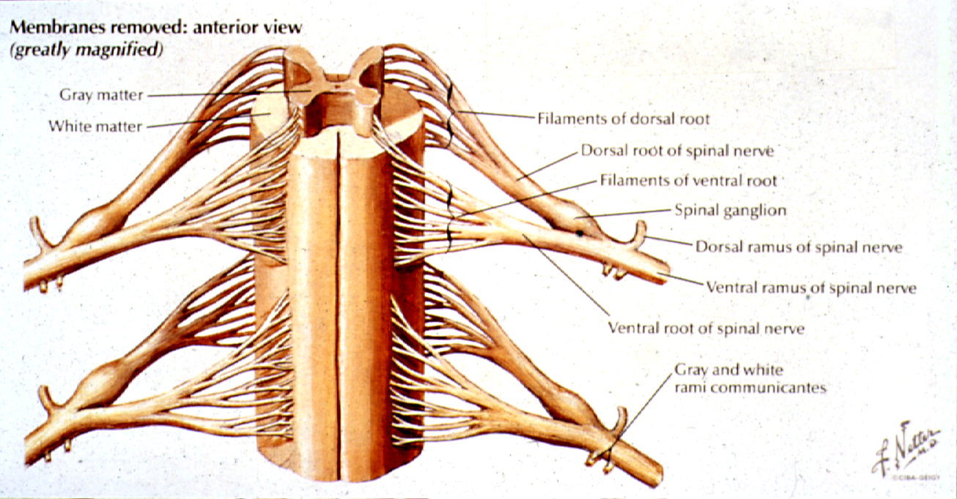

Slide 13
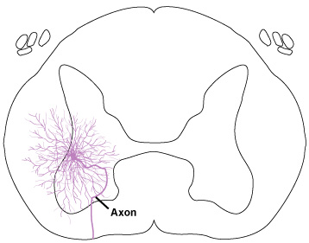
Alpha motor neuron
Notes:
Elaborate dendritic processing—lots of complicated processing even at the spinal cord

Slide 14
Alpha Motor Neurons
Innervate skeletal muscle and cause muscle contractions
Isometric contraction (equal size)
Isotonic contraction (equal force)
Release acetylcholine at the neuromuscular junction
Notes:
Final common pathway
All commands have to go through alpha motor neurons to finally make a muscle move.
Isometric contraction—changes force e.g. put a heavy bag on your head
Isotonic contraction—jump in the air
[[Dafny says—already got this in the first block]]

Slide 15
Motor Neuron Pool (Motor Nucleus)
The group of motor neurons that innervate an individual muscle
Notes:
1:1 relationship between a pool and a muscle

Slide 16
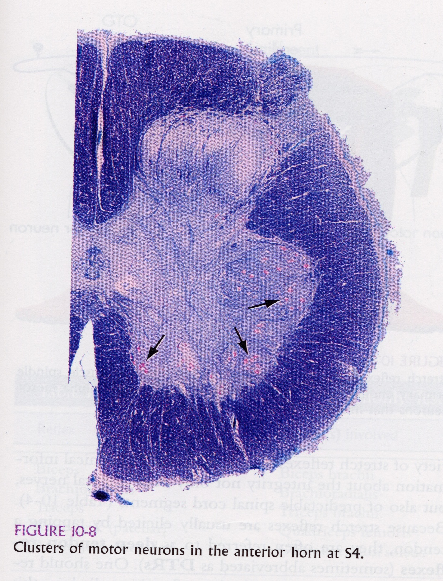
Motor Neuron Pool
From J. Nolte (2002) The Human Brain, 5th Edition

Slide 17
Motor Neuron Pool (Motor Nucleus)
The group of motor neurons that innervate an individual muscle
Motor Unit
An individual motor neuron and all the muscle fibers that it innervates

Slide 18
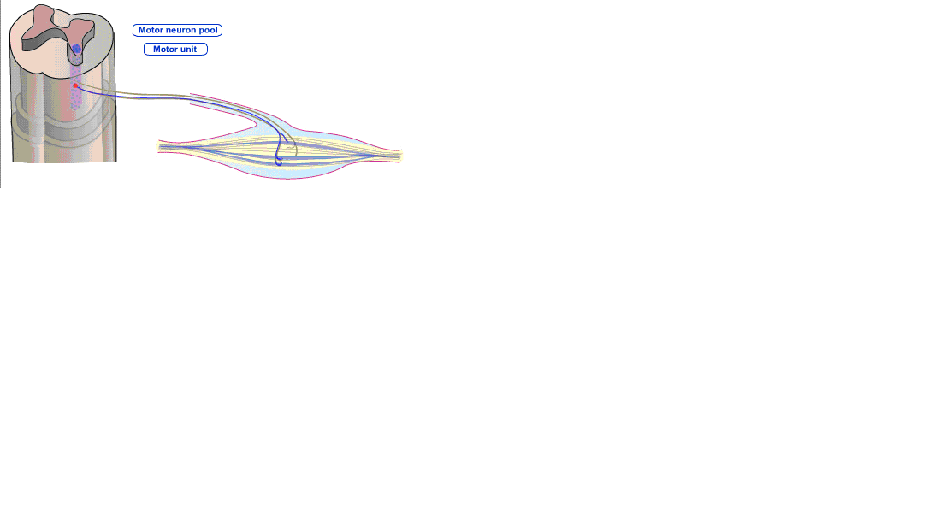
Motor Neuron Pool vs. Motor Unit
Notes:
Each muscle fiber gets input from one and only one motor neuron, but each motor unit innervates many fibers

Slide 19
Motor Neuron Pool (Motor Nucleus)
The group of motor neurons that innervate an individual muscle
Motor Unit
An individual motor neuron and all the muscle fibers that it innervates
Innervation Ratio
The number of muscle fibers innervated
by a single motor neuron

Slide 20
Control of muscle force
Rate Code: Increases in rate of action potentials of motor neuron cause increases in muscle force
Size Principle: With increasing strength of input, motor neurons are recruited from smallest to largest

Slide 21
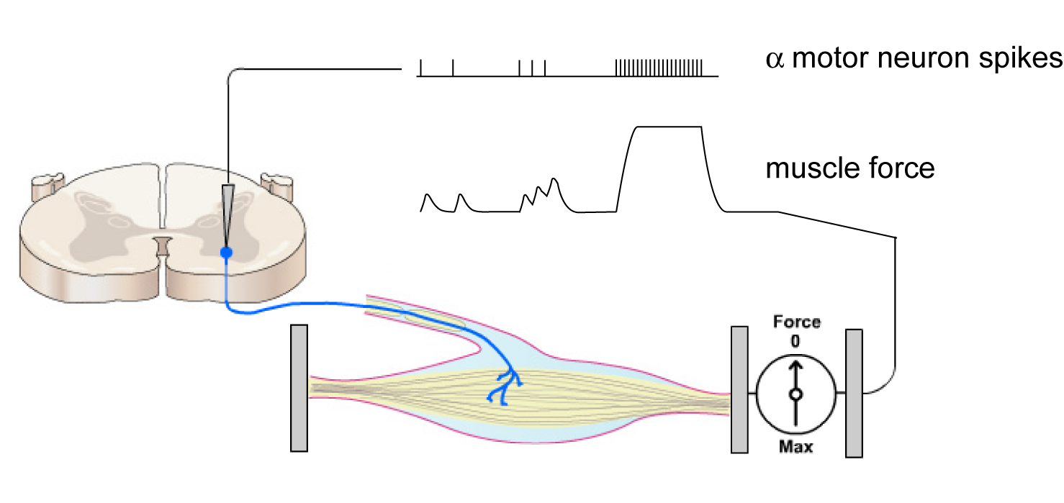
Rate Code
tetanus
Notes:
Experimental preparation
Take a bit of spinal cord and the muscles it is attached to
Clamp the ends of the muscles to a force meter
What is the relationship between spikes and muscle force
Force accumulates with nearby spikes
Summation
Until it maxes out

Slide 22
Control of muscle force
Rate Code: Increases in rate of action potentials of motor neuron cause increases in muscle force
Size Principle: With increasing strength of input, motor neurons are recruited from smallest to largest

Slide 23
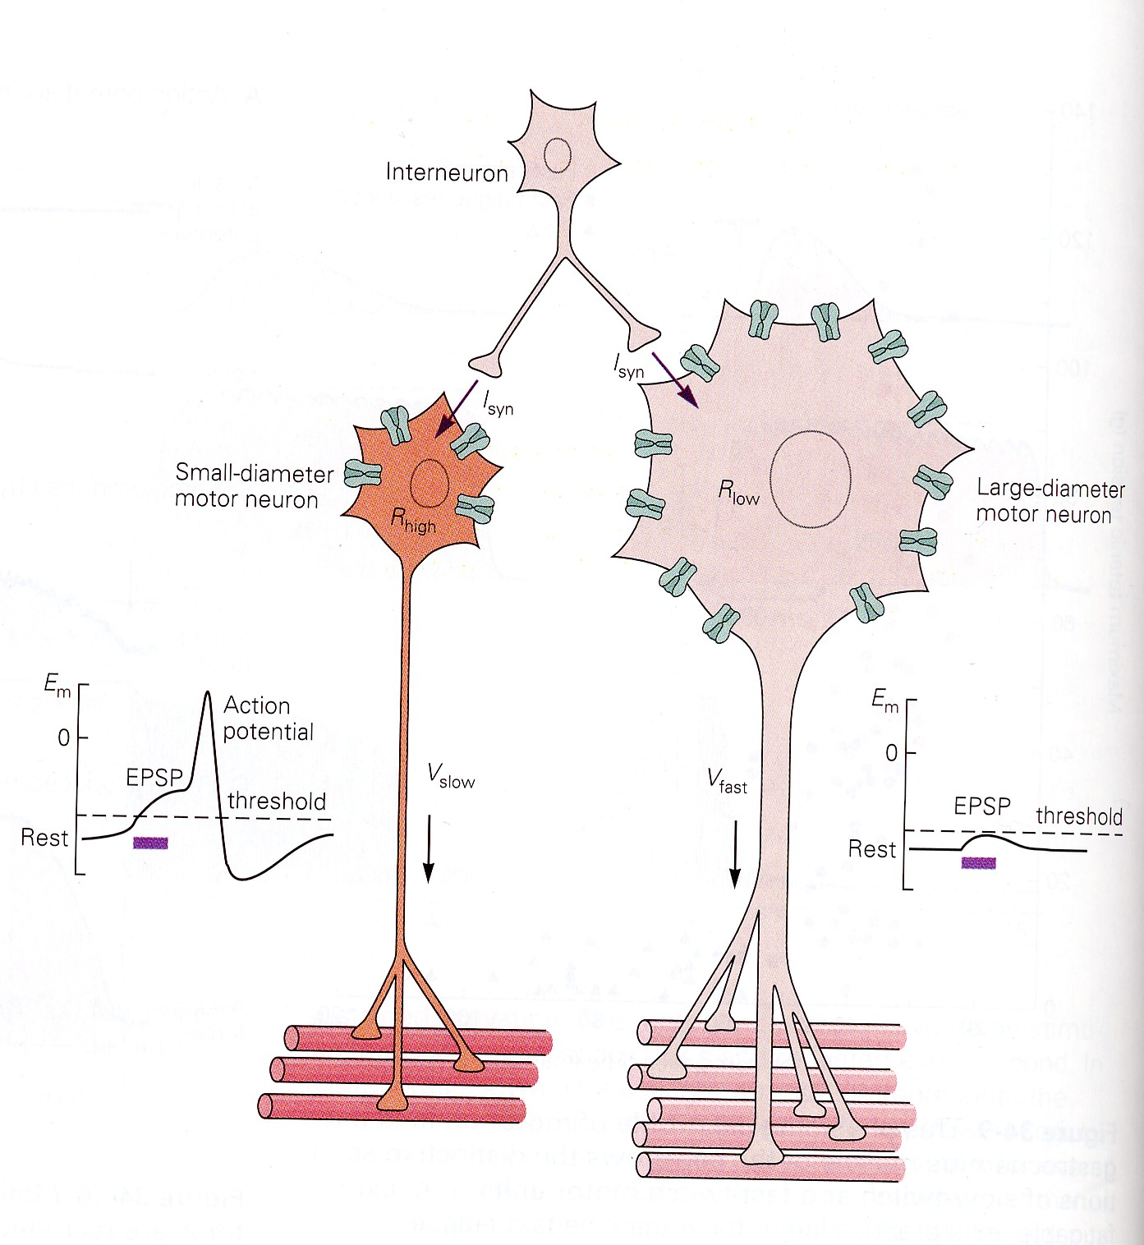
Size Principle
From G. E. Loeb & C. Ghez (2000), in Principles of Neural Science, 4th Edition (Kandel, Schwartz, & Jessel, Eds.)
V = IR
Notes:
Small neuron has less surface area, fewer ion channels, higher input resistance
Means if current is the same (I) R is greater, V is greater too
For larger motoneuron, need more input to fire
Recruited in an orderly fashion from small to large
How does this affect how much force?

Slide 24
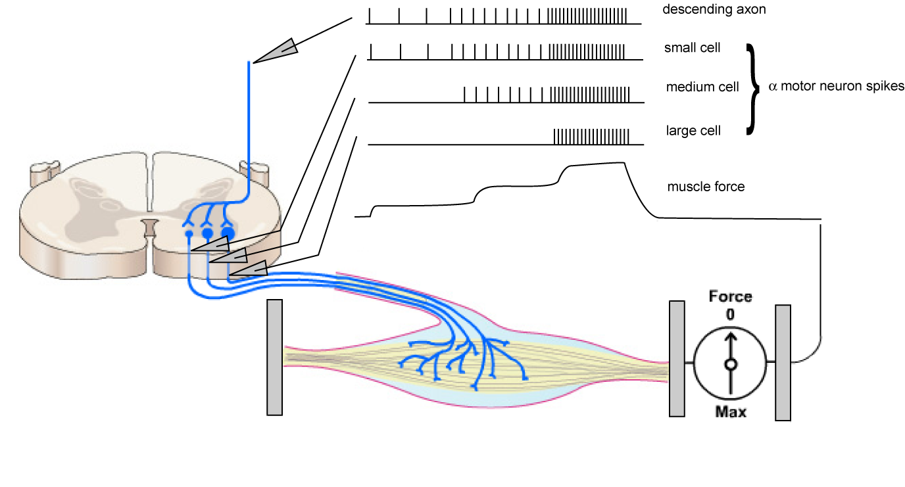
Size Principle
Small motor neurons innervate slow-twitch muscle fibers
Large motor neurons innervate fast-twitch, fatigable muscle fibers
Medium motor neurons innervate fast-twitch, fatigue-resistant muscle fibers
Notes:
NOT as drawn (all in same pool, same motor nucleus)
As input increases, you generate activity in more and more fibers, generating increased forces
ALSO, different neurons innervate different types of muscle fibers
Slow-twitch muscle fibers for postural control
Medium—used for normal movements
Large—fatigue easily, burst of energy
Possible link—how do you know if you are getting tired, going to drop something?

Slide 25
Proprioception
Specialized receptors provide information
about muscle:
length
velocity (change in length)
load (force)

Slide 26
Receptors Involved in Proprioception
Muscle Spindles
Golgi Tendon Organ

Slide 27
Muscle model
Notes:
A spring is a mechanical device that responds to an increase in length by generating a restoring force proportional to the change in length. However, this force is only develop when the length exceeds a threshold; before that, the sling is slack.
In muscles, sarcomeres have both contractile and spring like properties. Thus, muscles can be represented by two elements in series: a contractile element—a rack and pinion, and an elastic element (spring).
The elastic element includes a passive and an active component: tendon and connective tissue are the passive component. The muscle crossbridges are the active component.

Slide 28
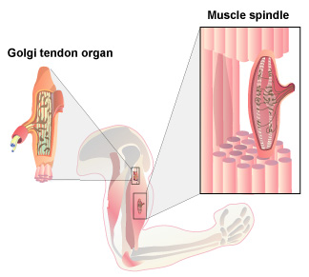
Intrafusal fibers
Extrafusal fibers
Notes:
Intrafusal fibers—inside the fusiform shape
Don’t cause the fibers to contract, they are there to measure how contracted the muscle is

Slide 29
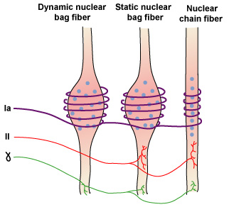
Muscle Spindles are made of intrafusal muscle fibers
Typical muscle spindle = 1 dynamic nuclear bag fiber
1 static nuclear bag fiber
~ 5 nuclear chain fibers
Notes:
Multinucleated cells
Nuclear chain fiber—nuclei are all in a row (static state)
Static nuclear bag fiber—static state (currently contracted or relaxed)
Dynamic—changing right now
Different types of afferents
1a—annulo-spiral endings
They have stretch receptors on the afferents, so when they get stretched, channels open and cause open potentions
1a-dynamic and static (velocity and length)
2—only dynamic (only velocity)
Talk about gamma motor neuron later

Slide 30
Sensory Fibers Involved
in Proprioception
Muscle Spindles
Group Ia (primary): velocity and length
Group II (secondary): length
Notes:
NOT the same as primary secondary in sensory systems (first order, second order, number of synapses in periphery)

Slide 31
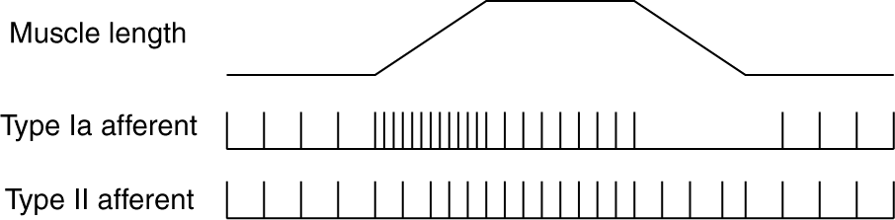
Type Ia afferents signal velocity and length, Type II afferents signal length only
Notes:
Signalling different kinds of information

Slide 32
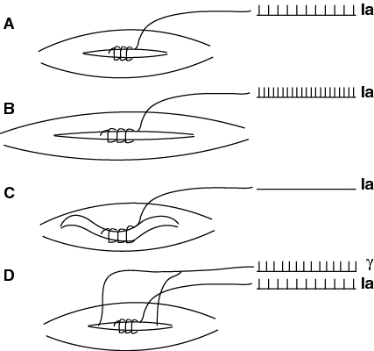
Gamma motor neurons maintain sensitivity of muscle spindle
Notes:
Extrafusal fibers generate forces
Need gamma motor neurons to contract back
Stretched muscle spindle has lost its tightness, can’t measure tightness any more
In order to tighten it back, fire gamma motor neurons to tighten it back up.

Slide 33
Receptors Involved in Proprioception
Muscle Spindles
Golgi Tendon Organs

Slide 35
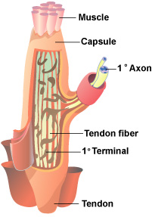
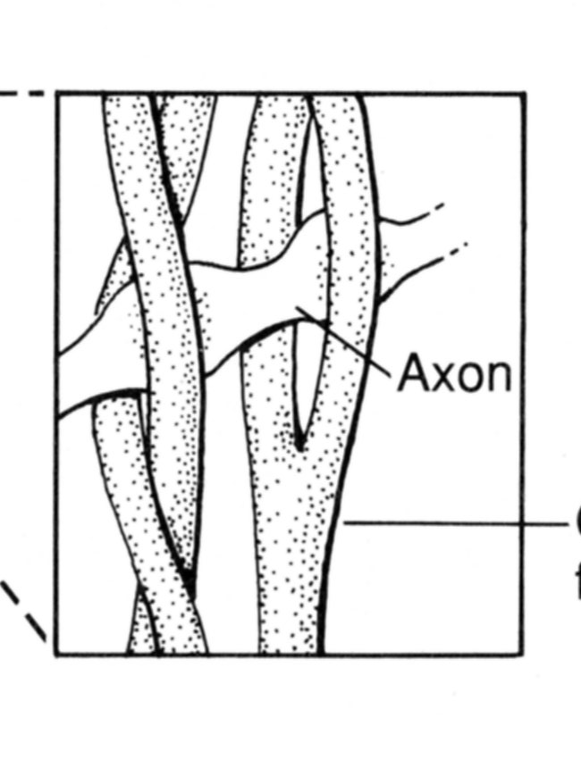
Golgi Tendon Organ
Notes:
Golgi tendon organs: specialized structures found at the junctions between muscle and tendon. A single 1b afferent axone enters the capsule and branches into many endings that
Wrap around the fibers. When it is stretch (usually by contraction of the muscle) the axon is compressed and fires.
Collagen fibers on golgi tendon
Groub 1b afferents innervate the goldi tendon organ
Sends out processes that weave between these collagen fibrils
Collagen fiber squeeze together and pinch terminal
Receptors sense that squeeze and fiber

Slide 36
Sensory Fibers Involved
in Proprioception
Muscle Spindles
Group Ia (primary): velocity and length
Group II (secondary): length
Golgi Tendon Organs
Group Ib: Tension or force
Notes:
Why do you need both?
Hold hand out, place balloon on hand, raise hand
Fiber velocity and length
Fire more and more and more as triceps contract
But but a weight on the hand
What happens now?
Muscle spindles fire the same as before
But Golgi tendon organs will fire differently

Slide 37
Next Lecture: Spinal Reflexes
Myotatic reflex
Muscle spindles (Ia)
+ alpha motor neurons
Autogenic inhibition
Golgi tendon organs (Ib)
- alpha motor neurons
Notes:
STOP at 9:50, give them a break
Dafny stands up 10 minutes before the end to signal you

