Slide 1


Motor Control: Lecture 2
Michael S. Beauchamp, Ph.D.
Assistant Professor
Department of Neurobiology and Anatomy
University of Texas Health Science Center at Houston
Houston, TX
Michael.S.Beauchamp@uth.tmc.edu
Notes:
Introduction - Invasive studies of human neurophysiology: past, present, and future. (Daniel Yoshor, 6 minutes) Michael Beauchamp University of Texas Health Sciences Center, Houston Strengths and limitations of BOLD fMRI: Can invasive human studies help fill some of the gaps? (16 minute presentation + 5 minutes Q&A) Geoffrey Ghose University of Minnesota, Minneapolis Invasive human recordings as a complement to studies of neurophysiology in awake behaving monkeys. (16 minute presentation + 5 minutes Q&A) Itzhak Fried University of California, Los Angeles Activity of individual human neurons as a gateway to understanding perception and memory (16 minute presentation + 5 minutes Q&A) Robert Knight University of California, Berkeley Network properties and neural coding in the human neocortex (16 minute presentation + 5 minutes Q&A) Discussion and Wrap-up Workshop Participants, (30 minutes) Abstract: Dramatic advances in noninvasive methods for mapping cortical function have been rapidly incorporated into the clinical assessment of epilepsy surgery patients. While these techniques are valuable, direct electrical stimulation mapping is still routinely used and is considered the gold standard in the clinical arena. In recent years, a number of groups have refined methods for using electrodes implanted in patients undergoing invasive monitoring for epilepsy in order to carry out research on human cortical function. This workshop will explore how these studies can serve as a powerful adjunct to monkey invasive electrode studies and work with human fMRI, and then review examples of the application of some of the current research methods for studying higher cortical function in patients undergoing invasive monitoring, with an eye towards how the field has advanced beyond the classic methods of Penfield.

Slide 2
Hierarchical Organization and Functional Segregation
of Central Motor Structures
Level 4: Association Cortex
Side Loop 1:
Basal Ganglia
(Caudate Nucleus, Putamen, Globus Pallidus, Substantia Nigra, Subthalamic Nucleus)
Level 3: Motor Cortex
Thalamus
(VA,VL,CM)
Level 2: Brain Stem
(Red Nucleus, Reticular Formation, Vestibular Nuclei, Tectum, Pontine Nuclei, Inferior Olive)
Side Loop 2: Cerebellum
Level 1: Spinal Cord
Notes:
Higher-level areas—what do I want to do
Lower level—what muscles have to contract to do the movements
Side loops—separate lectures on each of them
Start with the lower levels

Slide 3
Spinal Reflexes
Myotatic reflex
[myo- + G. tasis, a stretching]
a.k.a. stretch reflex
Muscle spindles (Ia)
+ alpha motor neurons
Notes:
Myotactic or “stretch” reflex

Slide 4
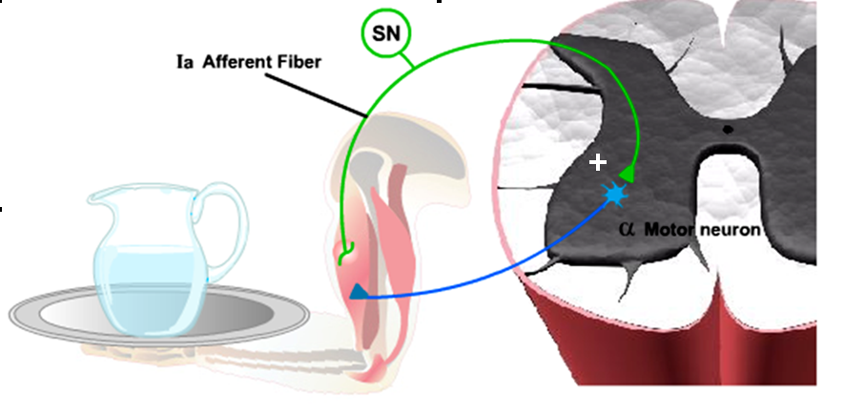
Myotatic reflex
Notes:
Put something on the tray, automatic reflex to keep things stable
1a afferent fires, fires alpha motor neurons, causes a contraction of the muscle, keeps things stable
Same or homonymous muscle

Slide 5

Myotatic Reflex Important for Posture Maintenance
Continuous feedback from muscle spindles allows automatic postural maintenance and adjustments
Notes:
Particularly important for postural control
e.g. think of your Christmas tree
Lets your conscious mind focus on more important things

Slide 6
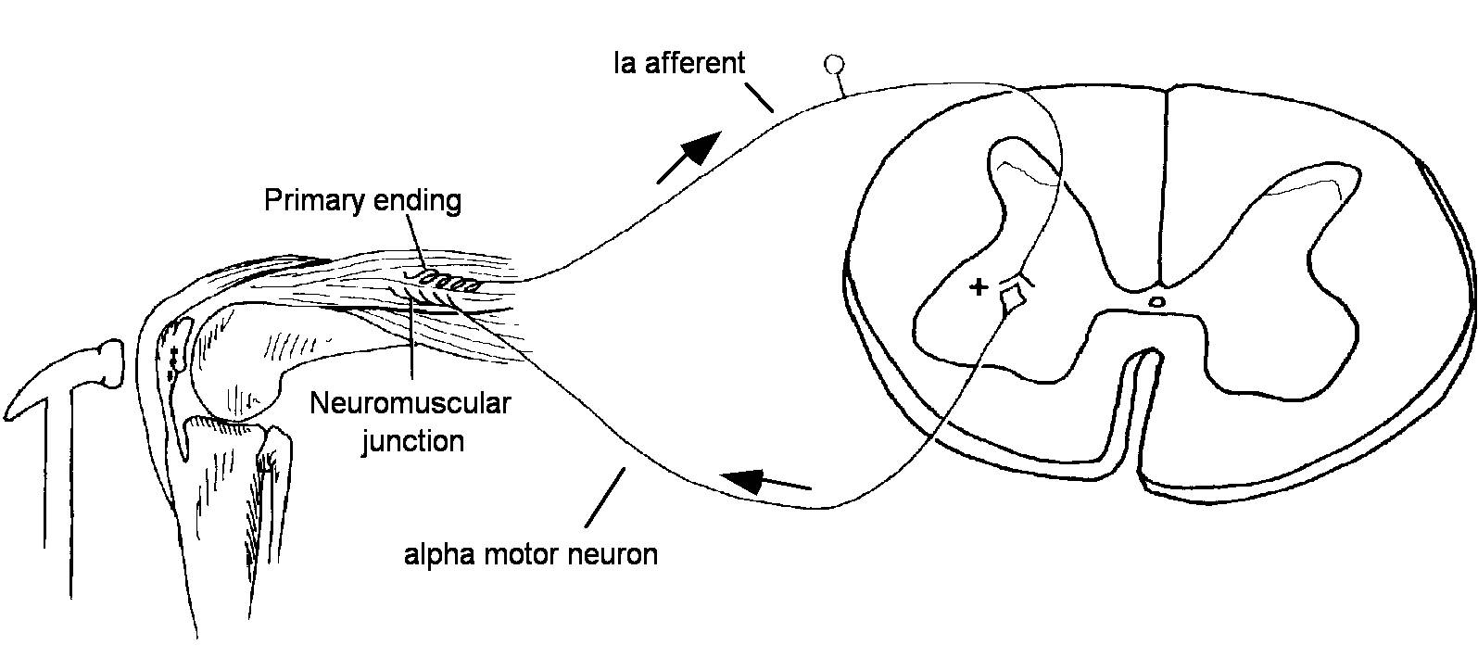
“Knee-jerk” Response
From J. Nolte (1993) The Human Brain, 3rd Edition
Notes:
All skeletal muscles (except extraocular muscles) contract when stretched.
The stretch reflex is used for clinical testing purposes. Tap the patellar tendon stretches the quadriceps slightly.
Ia endings in quad muscle spindles are exited and in turn excite quad alpha motor neurons, these cause the quads to contract.
Because you elicit them by tapping tendons, they are often referred to as Deep tendon reflex or DTR. But the responsible receptors are muscle spindles, not golgi tendon organ

Slide 7
Reciprocal reflexes
Reciprocal inhibition in the stretch reflex

Slide 8
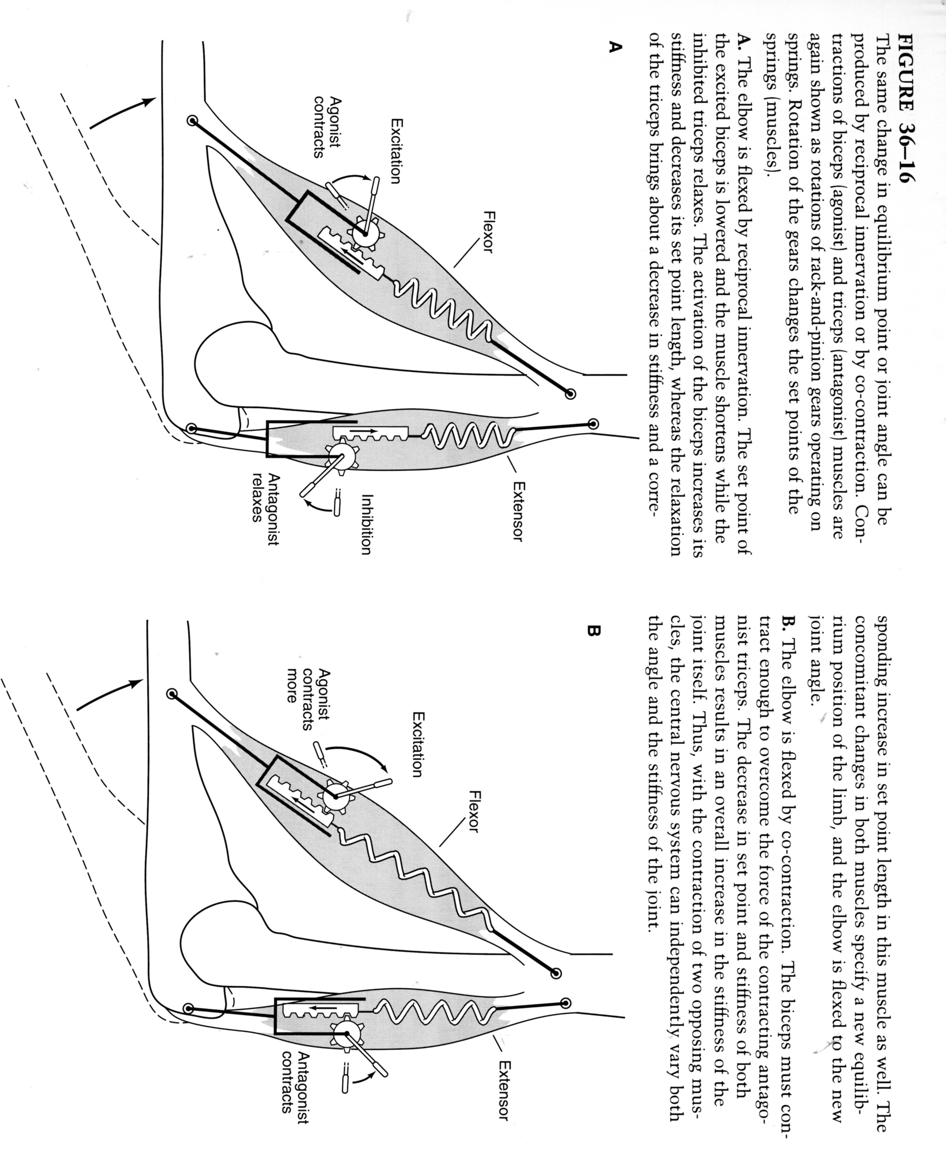
Flexor and extensor in opposition
Notes:
Biceps is the agonist
And triceps is the antagonist muscle.
There is recipriocal innervation os the two musclese.

Slide 9
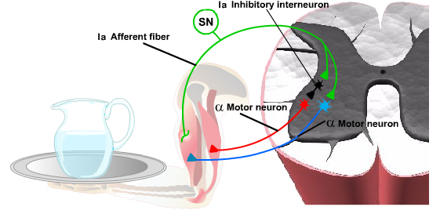
Reciprocal inhibition in the stretch reflex
+
–
+
Notes:
Also need to relax the opposing muscle
So, send out a collateral to 1a inhibitory neuron which inhibits the alpha motor neurons that innervate the antagonist muscle

Slide 10
Spinal Reflexes
Myotatic reflex
Muscle spindles (Ia)
+ alpha motor neurons
Autogenic inhibition
Golgi tendon organs (Ib)
- alpha motor neurons
Notes:
Autogenic inhibition reflex

Slide 11
Flexor and extensor: co-contraction
Notes:
Biceps is the agonist
And triceps is the antagonist muscle.
There is recipriocal innervation os the two muscles.
They don’t have to always work against each other.
We may flex the elbow by co-contraction.
The biceps contracts enough to overcome the force of the contract antagonist triceps.
This results in an increase in the stiffness of the joint—independently control the angle and stiffness.

Slide 12
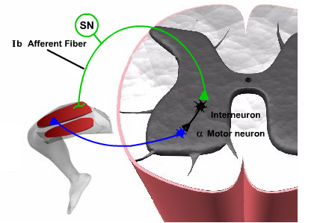
Autogenic Inhibition
+
–
Notes:
When force is applied to a muscle, golgi tendon organ fires, releases that muscle from firing
Contract the antagonist muscle through the inhibitory interneuron
OLD IDEA: this reflect operated to prevent damage
e.g. weightlifter lifting a very heavy weight, this reflex kicks in and shuts the muscle down
NEW IDEA: Golgi tendon organs also respond to even weak forces
Therefore, this helps distribute the load across different muscles and different muscle fibers
Makes most active fibers work a little less, make other fibers work more
Even distributing workload in an automatic fashion

Slide 13
Reciprocal reflexes
Reciprocal inhibition in the stretch reflex
Reciprocal excitation in the autogenic inhibition reflex

Slide 14
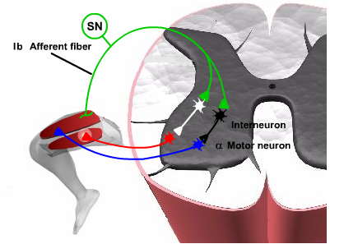
Reciprocal excitation in the autogenic inhibition reflex
+
+
+
–
Notes:
“clasp-knife” or “swiss-army knife
Leg collapses in flexion, like a knife snapping shut

Slide 15
Flexor and crossed extension reflexes
Flexor reflex
Cutaneous and nociceptive receptors (II, III, and IV)
+ alpha motor neurons
Notes:
Flexor reflex (also known as withdrawal reflex)
doesn’t involve proprioceptive afferents
Instead, it involves cutaneous and nociceptive receptors
e.g. walking along, step on a tack, your hand jerks up long before you have a percept of pain
This is adaptive because it keeps you from injuring yourself by moving your foot away from the painful stimulus before the tack gets completely embedded in your foot

Slide 16
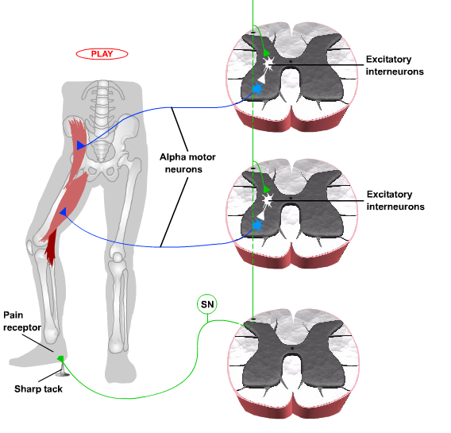
Flexor Reflex
Notes:
Muscles contract, causing leg to lift up in a quick and automatic way
Not just in the leg, in all of the joints and muscles of the body
e.g. touch a hot stove

Slide 17
Flexor and crossed extension reflexes
Flexor reflex
Cutaneous and nociceptive receptors (II, III, and IV)
+ alpha motor neurons
Reciprocal inhibition in the flexor reflex
Crossed extension reflex
Notes:
There is also reciprocal inhibition, which we won’t go into
Crossed extension reflex
If jerk leg up to get away from tack, then will fall over.
SO, must out other leg down—crossed extension reflex

Slide 18
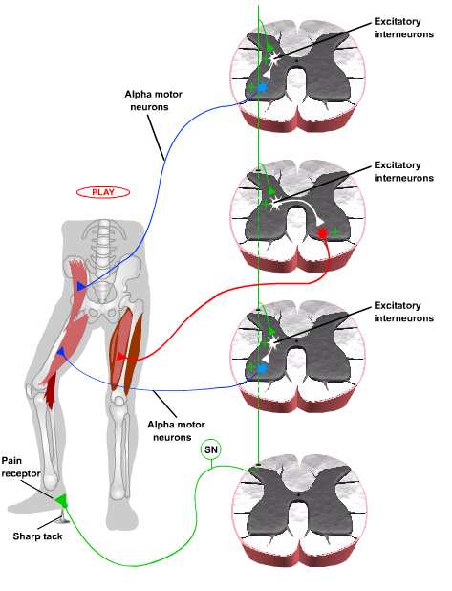
Crossed extension reflex
Notes:
Crosses the midline of the spinal cortex and excites extensors muscles on the contralateral thigh

Slide 19
Recurrent inhibition of motor neurons
Renshaw Cell

Slide 20
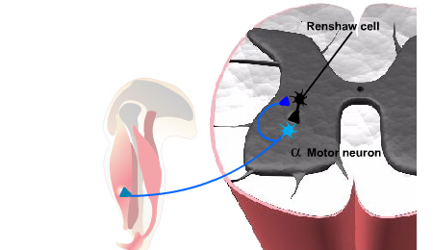
Renshaw cell
+
–
Notes:
Negative feedback loop—
After alpha motor neurons fire, they shut themselves off
Found throughout the whole spinal cord
Prevents runaway excitation
They receives lots of input from descending pathways. By changing the excitability of these cells, higher centers can adjust the sensitivity of motor neurons
To other descending inputs or to afferent inputs.

Slide 21
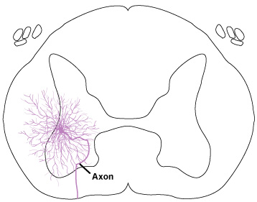
Alpha motor neuron
Clinically, often called Lower Motor Neurons
Notes:
These motor neurons are the only way to contract the muscle
If you have a disease that kills these neurons, you are paralyzed/weakness
e.g. polio
NO other way to compensate
Ditto for anterior root getting sheared
e.g. C3 to C5 neurons control diaphragm—damage those, can’t breathe on your own

Slide 22
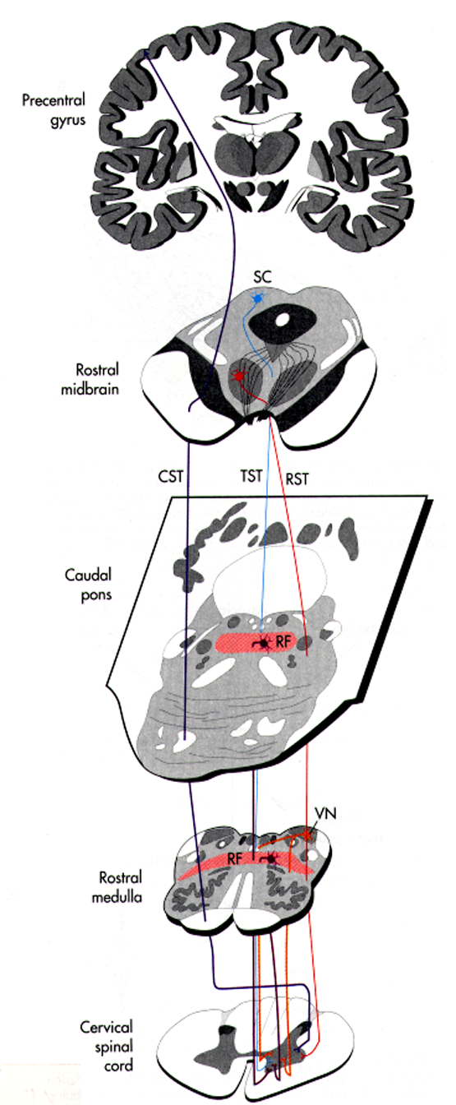
Descending Spinal Pathways
(from Nolte, p. 438)
Precentral
gyrus
Rostral
midbrain
Caudal
pons
Upper Motor Neurons
Rostral
medulla
Cervical
spinal cord
Notes:
upper motor neurons are the neurons before the alpha motor neurons
Project down to the alpha motor neurons
Do NOT directly innervate muscles
There is a parallel as well as a serial organization
Serial: M1 to midbrain to pons to medulla
Parallel: cortico-spinal tract
One results of this: more resistant to loss of function
e.g. even if cortico-spinal tract is damaged, can still get there by some other route

Slide 23
Anatomy and Physiology of Descending Spinal Pathways
Brain structures influence spinal motor neurons and spinal circuits through descending pathways
Flexor-extensor rule
Proximal-distal rule
Notes:
In the spinal cord, there is a mapping of how they are laid out and influenced by descending pathways
2 rules

Slide 24
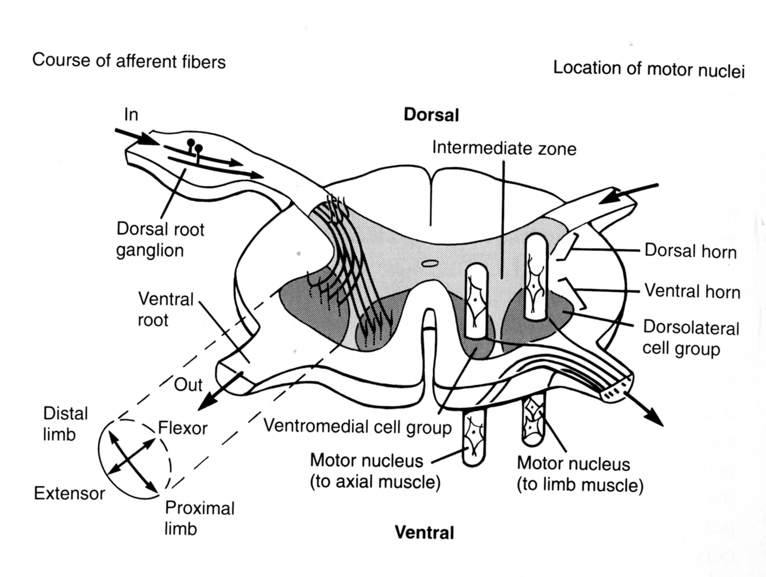
Organization of spinal tracts
Notes:
The motor nuclei of the spinal cord are group functionally in distinct medial and lateral positions. The medial group contains the motor neurons innervating axial muscles of the neck and back. Within the lateral group, the most medial motor neurons innervate proximal muscles while the most lateral innervate distal muscles. Ventrally located motor neurons innervate extensors while dorsal ones innervate flexors.

Slide 25
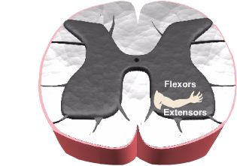
Flexor-Extensor Rule and Proximal-Distal Rule
Notes:
Flexor-extensor rule
Extensor motorneurons are ANTERIOR to alpha-motorneurons that innervate flexor muscles
Vowels—Anterior/Extensor
In the anterior horn
Proximal musculature more medial
Distal musculature more lateral

Slide 26
Two Groups of Descending Pathways
Lateral pathways
control proximal and distal muscles
Lateral corticospinal
Rubrospinal
Medial pathways
control axial muscles
Vestibulospinal
Reticulospinal
Tectospinal
Anterior corticospinal
Notes:
Lateral pathways
Primarily of the limbs
Medial pathways
Primarily the core/medial muscles

Slide 27
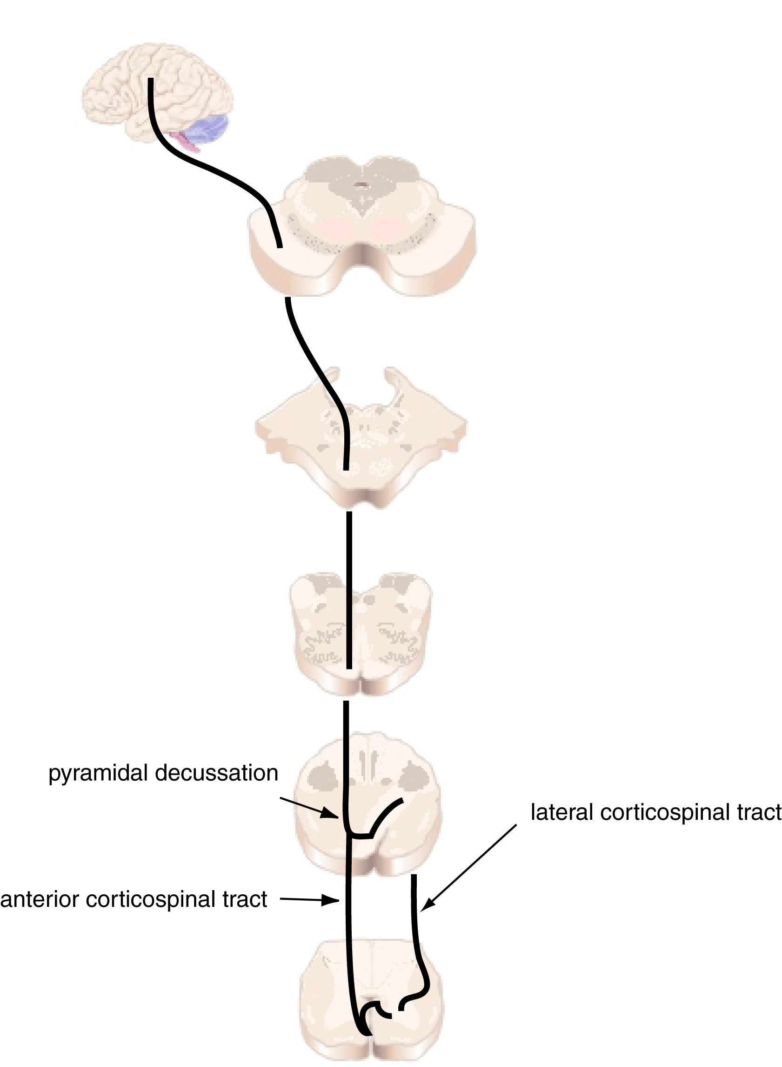
Corticospinal
Tracts
Notes:
Through the crux cerebri
Through the pyramids
About 90% of them cross over and go down the lateral funiculus
The other 10% go down anterior and cross over at the level at which they will exit the spinal cord

Slide 28
Corticospinal tracts
Control of distal musculature, esp. fine control of extremities
Control of axial muscles
Corticospinal and corticobulbar tracts constitute the major voluntary drive to the brain stem and spinal motor systems
Lesions produce initial paralysis, with eventual recovery of function (except fine control of distal musculature)
Notes:
The main voluntary drive to the motor system
Corticospinal—below the neck
Corticobulbar—above the neck
The corticospinal tract is the only descending pathway
That synapse directly on alpha motor neurons
[[Although only 5-10% actually do]]
Typically for things that need very fine control
e.g. the hand
Other ones go through direct pathway
[[use picture from Ratatouille]]
Lesions produce initial paralysis, but then other pathways can take over
BUT never get back fine control of distal musculature
e.g. picking up a cup gently
Primates are the only animals that have a lot of this
Because manual dexterity is so important for us

Slide 29
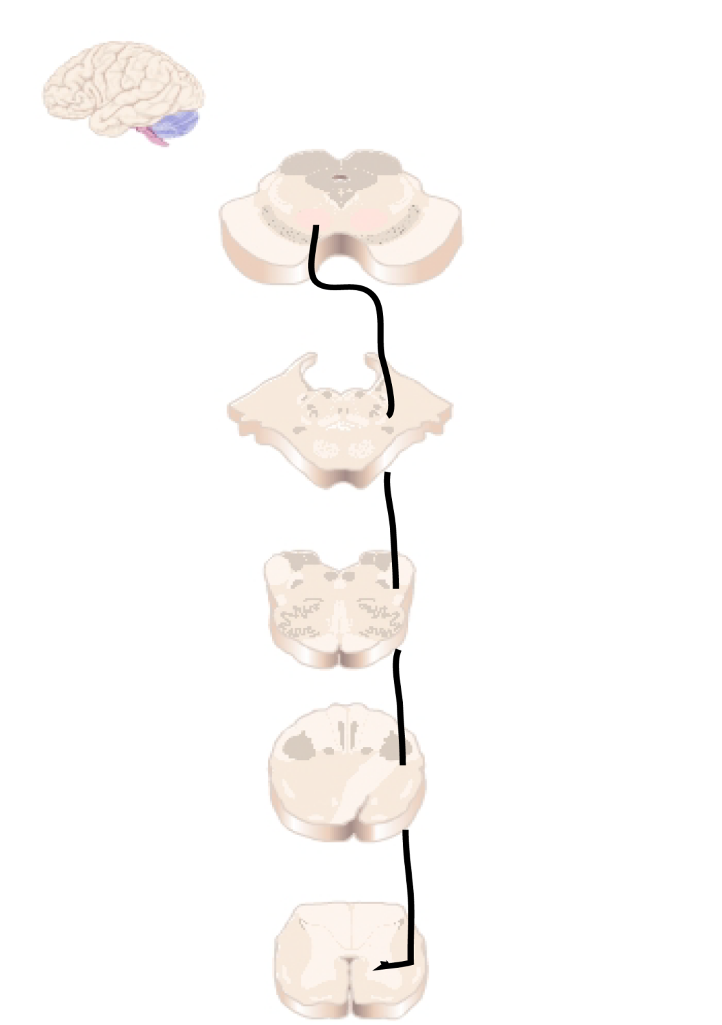
Rubrospinal
Tract
Notes:
Starts in the red nucleus
Crosses over and comes down to alpha motor neurons

Slide 30
Rubrospinal tract
Alternate route to corticospinal tract
Receives input from cerebellum and cerebral cortex
Encodes movement velocity
Excitation of flexors and inhibition of extensors
Relatively small in humans
Notes:
Will talk about this more in the cerebellum lecture
Damage causes slowness of movements
But can help with recovery of function

Slide 31
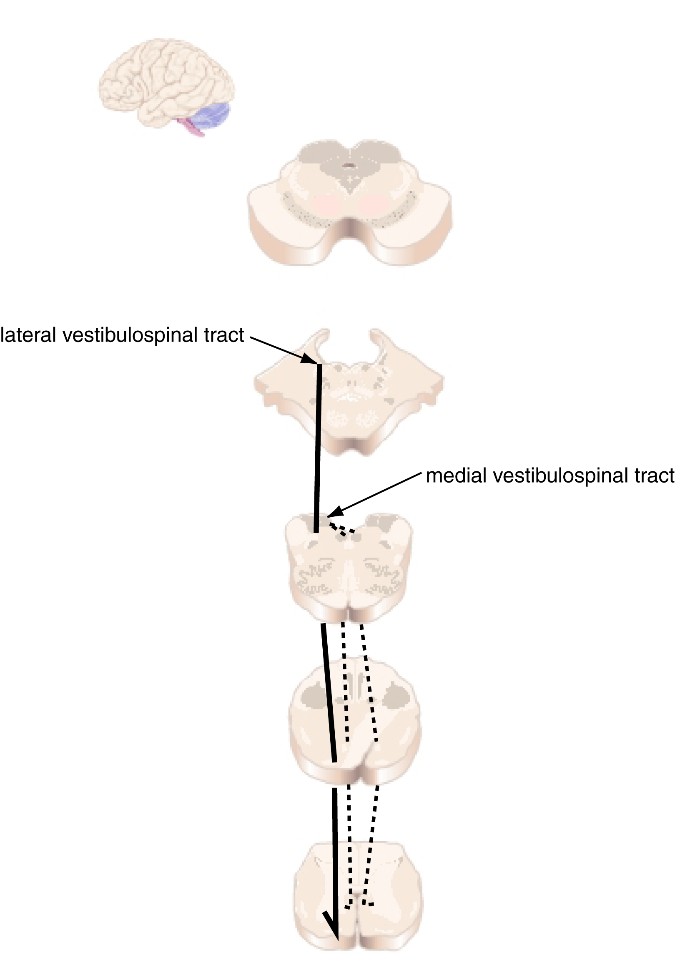
Vestibulospinal
Tracts
Notes:
Lateral—ipsilateral pathway
Medial--bilateral

Slide 32
Vestibulospinal tracts
Mediate postural adjustments and head movements
Control balance
Lateral vestibulospinal tract
Excites antigravity muscles
Controls postural changes to compensate for tilts and movements of body
Medial vestibulospinal tract
Innervates neck muscles to stabilize head position
Coordinates head and eye movements
Notes:
Not falling over is very important!!
As your are moving around, want to keep head stable to allow the visual system to work properly!!

Slide 33
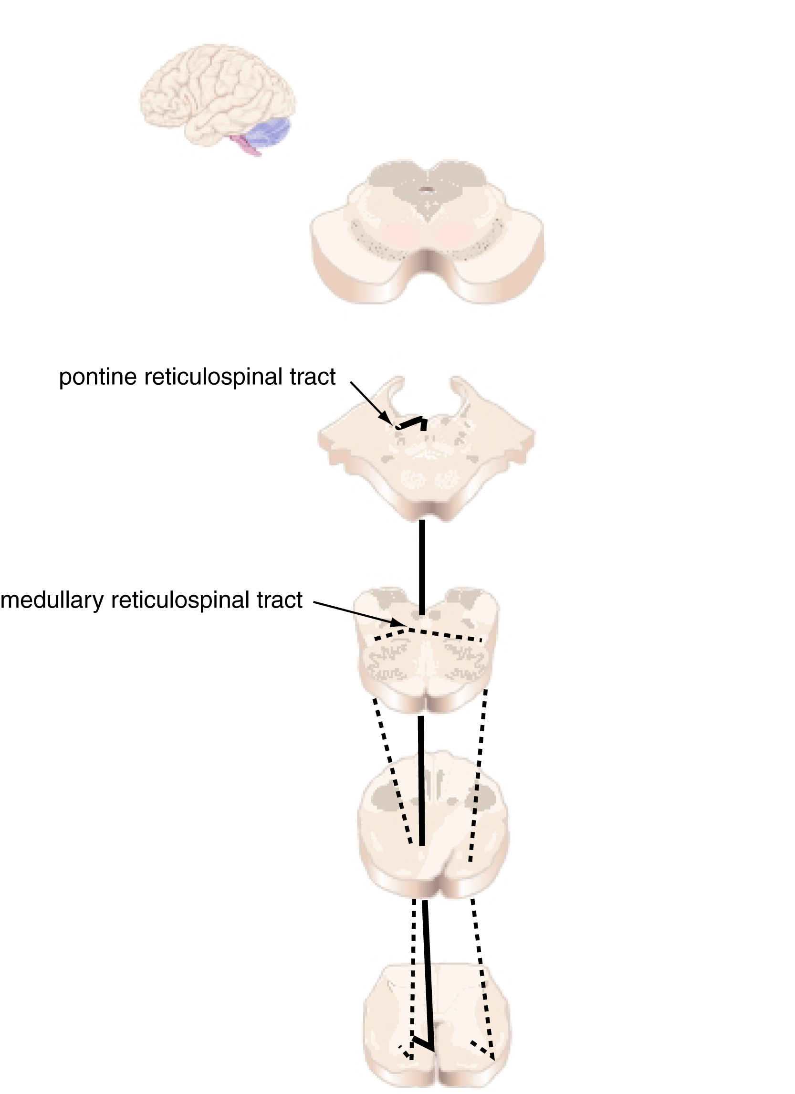
Reticulospinal
Tracts
Notes:
Starts in the reticular formation (a loose coalition of neurons) in the pons
Mainly ipsilateral
Medullary mainly bilateral

Slide 34
Reticulospinal tracts
Major alternate route (to the corticospinal tract) to spinal motor neurons
Regulate sensitivity to flexor reflexes, such that only noxious stimuli elicit them
Reticular formation contains circuitry for complex movements, including complex postures, orienting, and stretching
Integration of sensory input to guide motor output
Notes:
Patients with damage to reticulospinal tract will elicit flexor reflex inappropriately
e.g. to warm cup, not just hot cup
Co-ordinating locomotion movements
[[a lot of it happens in spinal cord itself—
Talk about spinal cords central pattern generators---
Take the brain out and animal will walk on the treadmill just fine]]
Important for taking over from corticospinal tract damage

Slide 35
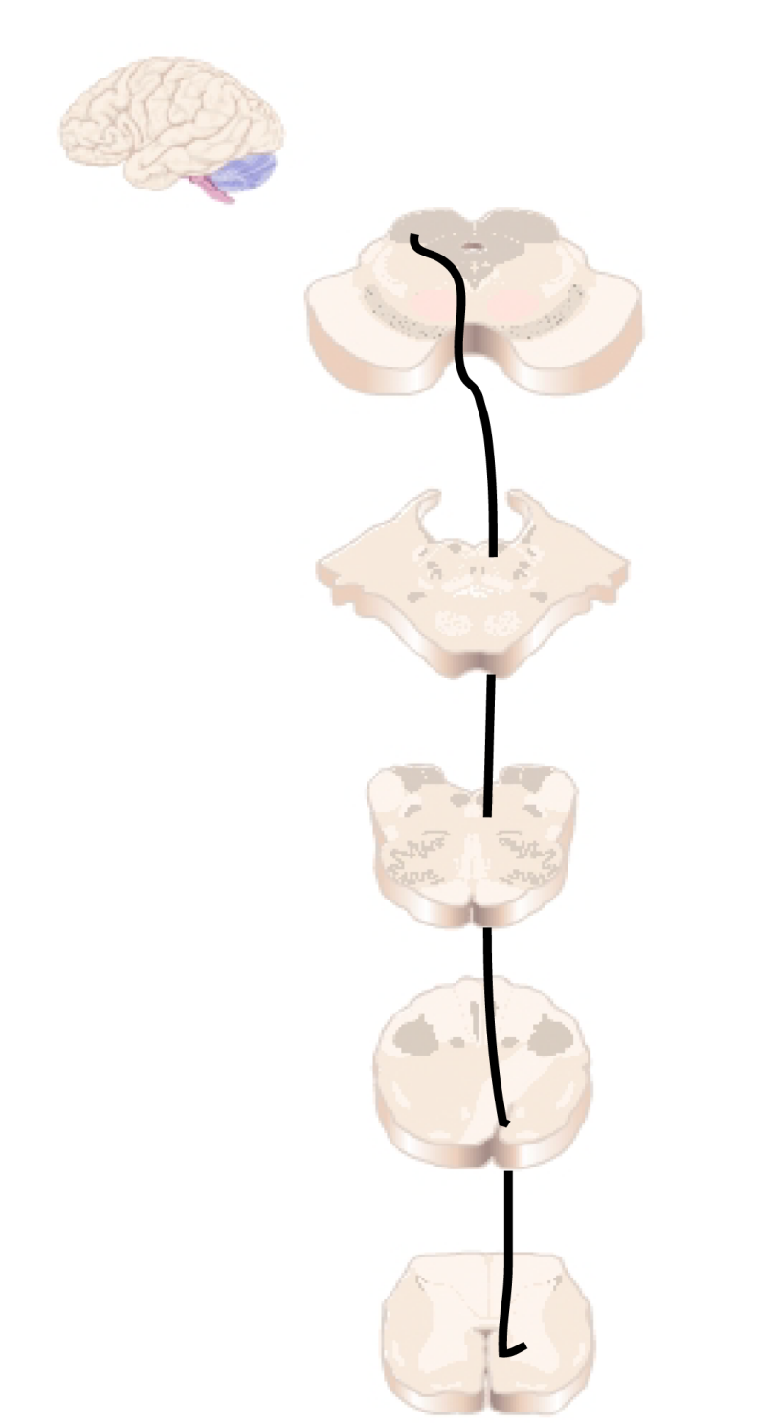
Tectospinal
Tract
Notes:
Crosses over in the cervical levels of spinal cord
Innervates neck and proximal muscles
Need it for reflex orienting
e.g. flash of light, move to look at it
Relatively minor in humans

Slide 36
Tectospinal tract
Originates in Superior Colliculus
Innervates neck and proximal muscles
Presumably involved in reflex orienting to visual stimuli
Relatively minor in humans

Slide 37
Influence of descending pathways on spinal mechanisms
voluntary movement
reflex modulation
Notes:
General functions
To create voluntary movements
MOST IMPORTANT: cortico-spinal tract
Reflex modulation
Reflexes are not hard-wired//all or noe—have to be tuned to circumstances
GAIN or SIGN

Slide 38
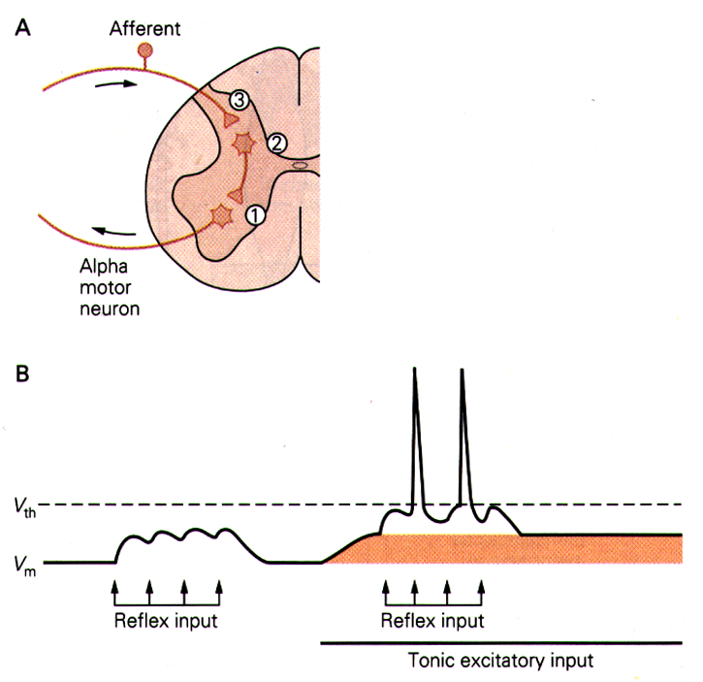
From K. Pearson & J. Gordon (2000), in Principles of Neural Science, 4th Edition (Kandel, Schwartz, & Jessel, Eds.)
Notes:
Reflex arc—afferents come in and cause reflexive output
If reflex input is small, don’t get a reflex output
Descending pathways can bias the system, make them more likely to happen with the same input
e.g. walking across floor of tacks
Touching something that you know is hot
Opposite case—don’t want to drop brownies on the floor, so turn down the reflex

Slide 39
Notes:
Can even change the sign of the reflex
Same perturbation causes opposite sign change
(Extension or reflexion)
Depending on the situation

Slide 40
Influence of descending pathways on
spinal mechanisms
voluntary movement
reflex modulation
gamma bias
alpha-gamma coactivation
Notes:
Extend arm to pick up cup
How do you ever make a movement in the face of the stretch reflex?
During voluntary movements, descending pathways coordinate with the gamma motor neurons to loosen up spindles for a moment to allow you to make the movement and not trigger the reflex

Slide 41
Hierarchical Organization and Functional Segregation
of Central Motor Structures
Level 4: Association Cortex
Side Loop 1:
Basal Ganglia
(Caudate Nucleus, Putamen, Globus Pallidus, Substantia Nigra, Subthalamic Nucleus)
Level 3: Motor Cortex
Thalamus
(VA,VL,CM)
Level 2: Brain Stem
(Red Nucleus, Reticular Formation, Vestibular Nuclei, Tectum, Pontine Nuclei, Inferior Olive)
Side Loop 2: Cerebellum
Level 1: Spinal Cord
Notes:
Higher-level areas—what do I want to do
Lower level—what muscles have to contract to do the movements
Side loops—separate lectures on each of them
Start with the lower levels

