Slide 1


Motor Systems: Lecture 3
Michael S. Beauchamp, Ph.D.
Assistant Professor
Department of Neurobiology and Anatomy
University of Texas Health Science Center at Houston
Houston, TX
Michael.S.Beauchamp@uth.tmc.edu

Slide 2
Hierarchical Organization and Functional Segregation
of Central Motor Structures
Level 4: Association Cortex
Side Loop 1:
Basal Ganglia
(Caudate Nucleus, Putamen, Globus Pallidus, Substantia Nigra, Subthalamic Nucleus)
Level 3: Motor Cortex
Thalamus
(VA,VL,CM)
Level 2: Brain Stem
(Red Nucleus, Reticular Formation, Vestibular Nuclei, Tectum, Pontine Nuclei, Inferior Olive)
Side Loop 2: Cerebellum
Level 1: Spinal Cord
Notes:
Higher-level areas—what do I want to do
Lower level—what muscles have to contract to do the movements
Side loops—separate lectures on each of them
Start with the lower levels

Slide 3
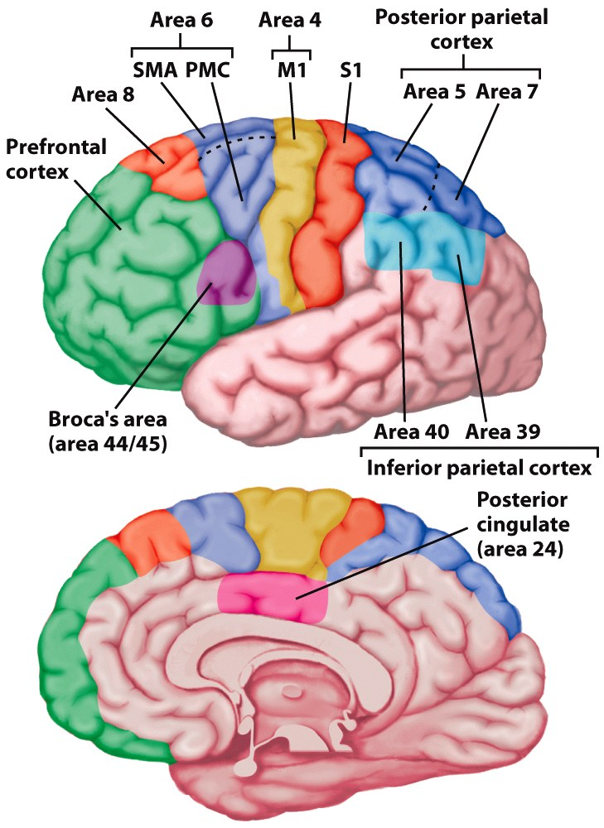
Notes:
Figure 7.6 Motor areas of the cerebral cortex. Area 4 is the primary motor cortex (M1). Brodmann area 6 encompasses the supplementary motor area (SMA) on the medial surface and premotor cortex (PMC) on the lateral surface. Area 8 includes the frontal eye fields. Inferior frontal regions (area 44) are involved in speech. Regions of parietal cortex associated with the planning and control of coordinated movement include S1, the primary somatosensory cortex, secondary somatosensory areas, and posterior and inferior parietal regions.

Slide 4
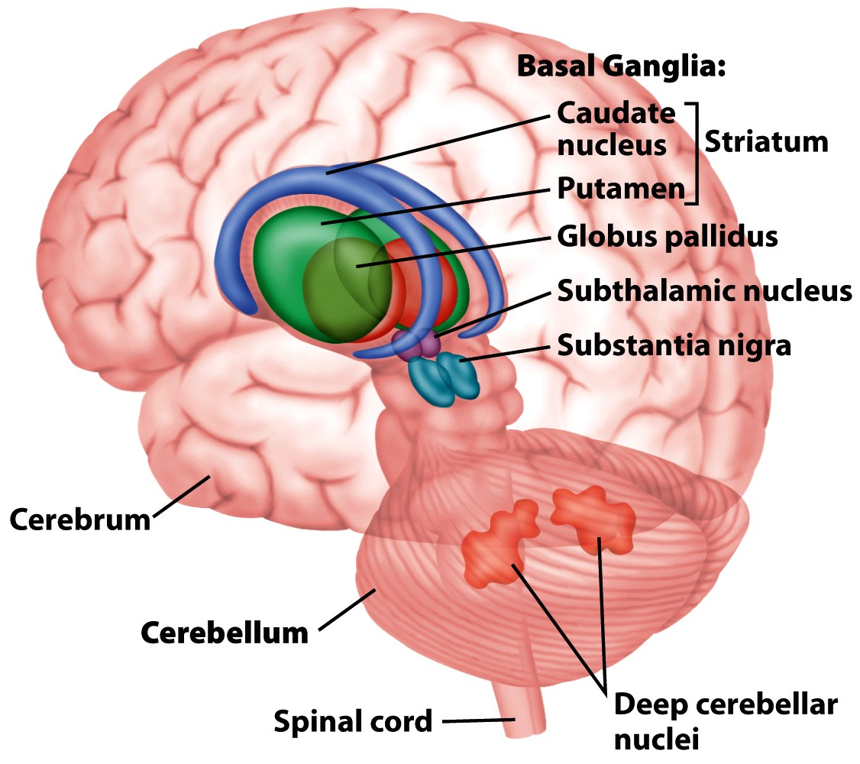
Notes:
Figure 7.5 The basal ganglia and the cerebellum are two prominent subcortical components of the motor pathways. The basal ganglia proper include the caudate, putamen, and globus pallidus, three nuclei that surround the thalamus. Functionally, however, the subthalamic nuclei and substantia nigra also are considered part of the basal ganglia. The cerebellum sits below the posterior portion of the cerebral cortex. All cerebellar output originates in the deep cerebellar nuclei.

Slide 5
Motor Neuron Pool (Motor Nucleus)
The group of motor neurons that innervate an individual muscle
Notes:
1:1 relationship between a pool and a muscle

Slide 6
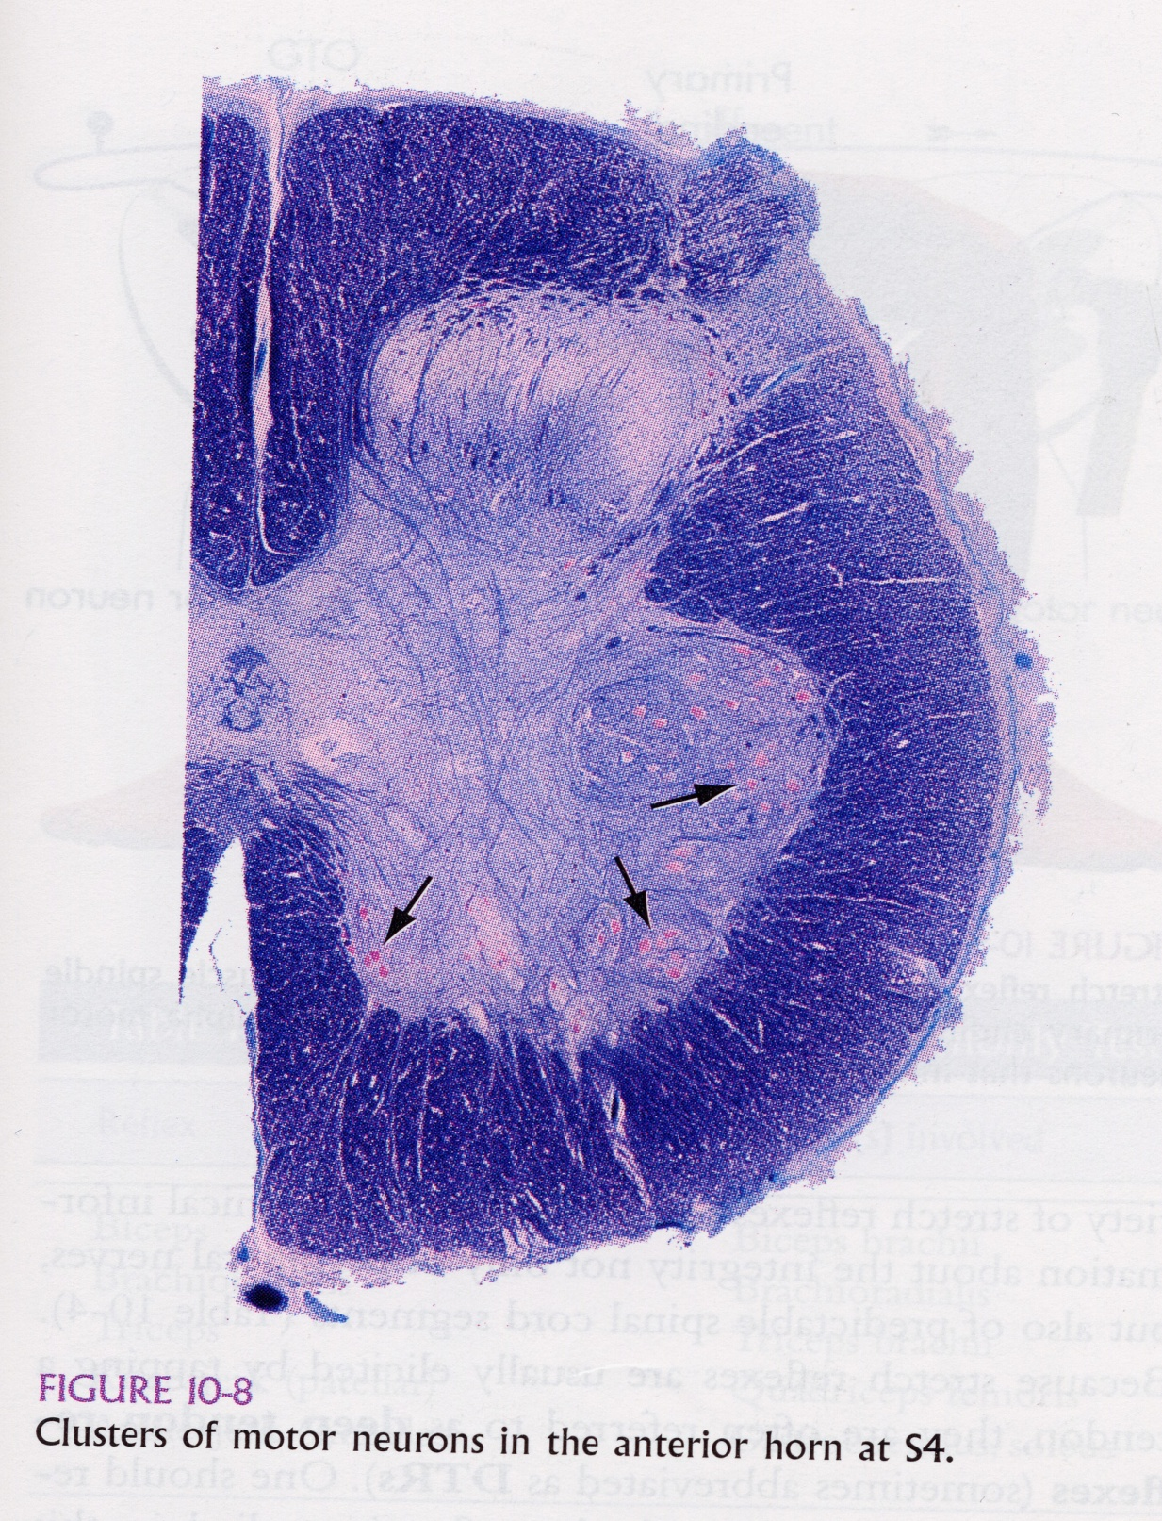
Motor Neuron Pool
From J. Nolte (2002) The Human Brain, 5th Edition
Notes:
Circle shows one pool

Slide 7
Motor Neuron Pool (Motor Nucleus)
The group of motor neurons that innervate an individual muscle
Motor Unit
An individual motor neuron and all the muscle fibers that it innervates

Slide 8
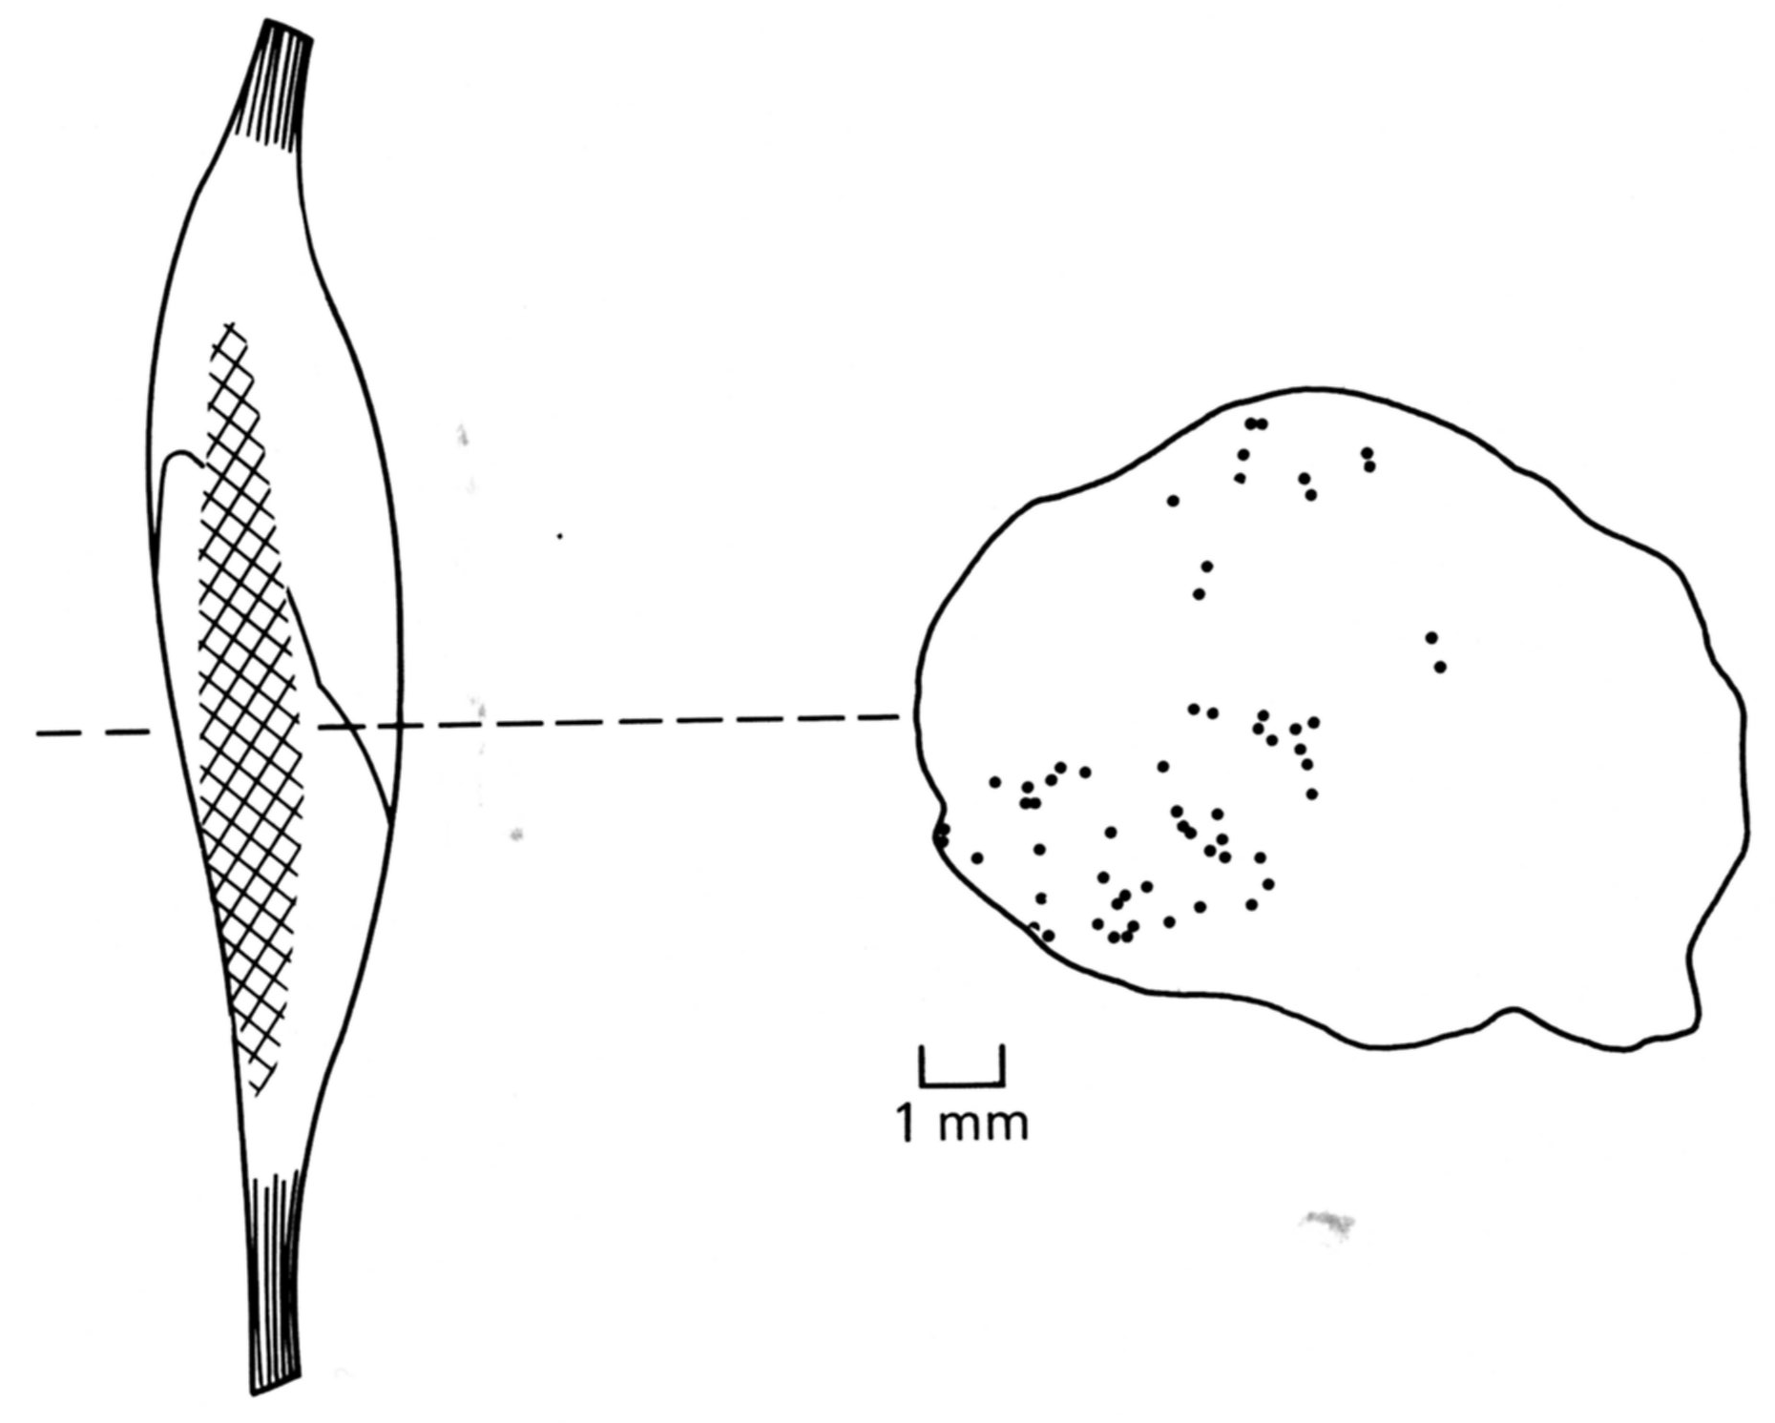
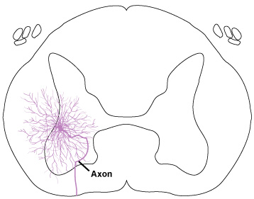
Motor Unit
+
Notes:
A single motor neuron innervates many muscle fibers, and these fibers are typically distributed quite widely, as shown by this example in the soleus muscle.
The location of individual muscle fibers making up the motor unit are shown in the cross section. Each dot represents a single motor fiber.

Slide 9
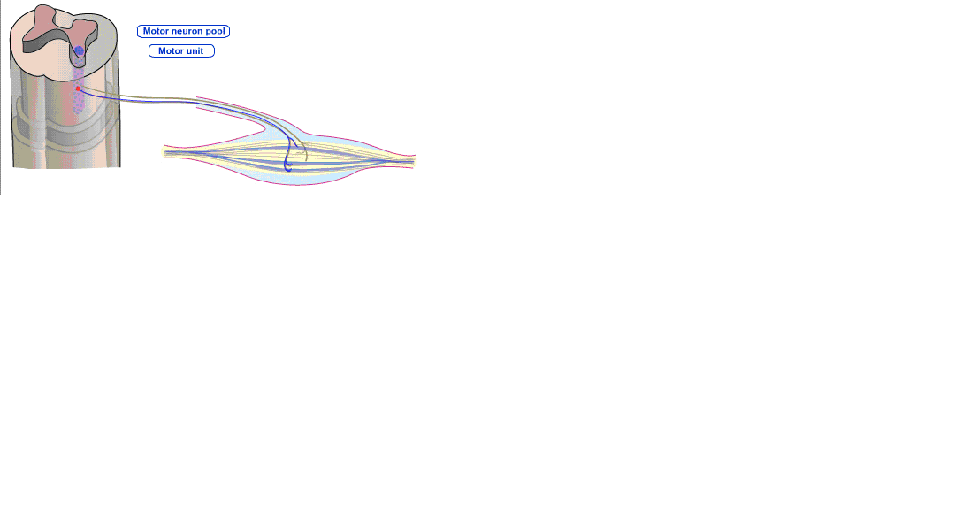
Motor Neuron Pool vs. Motor Unit
Notes:
Each muscle fiber gets input from one and only one motor neuron, but each motor unit innervates many fibers

Slide 10
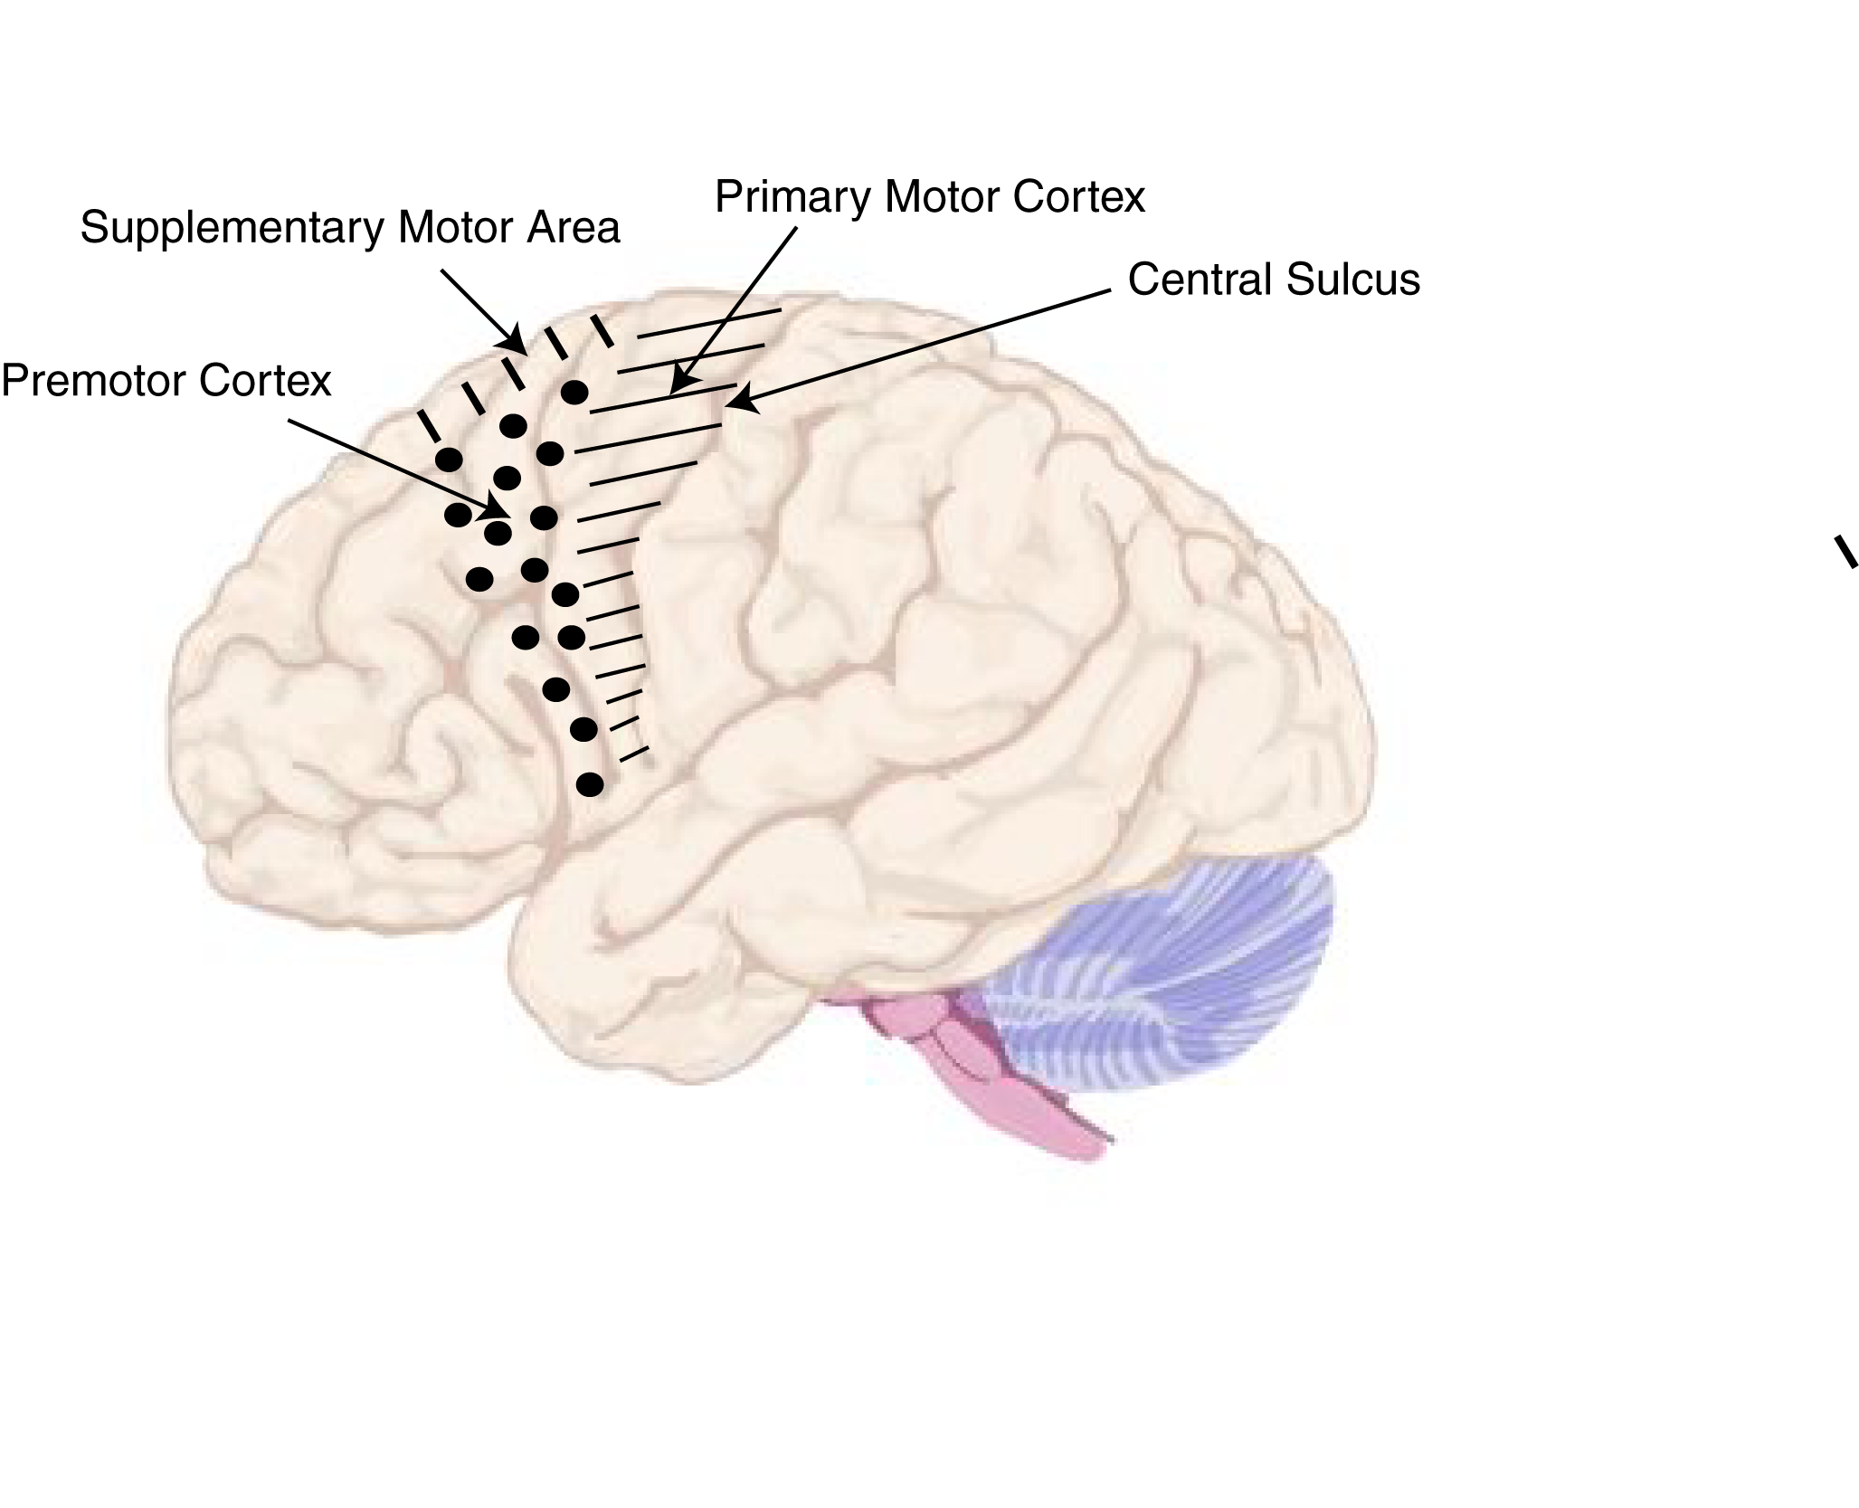
Motor Cortex
Notes:
3 regions of motor cortex
Primary motor cortex
SMA, premotor cortex
Actually, these are further subdivided into other areas, but we will skip his
If we take a coronal cross section, it looks like…

Slide 11
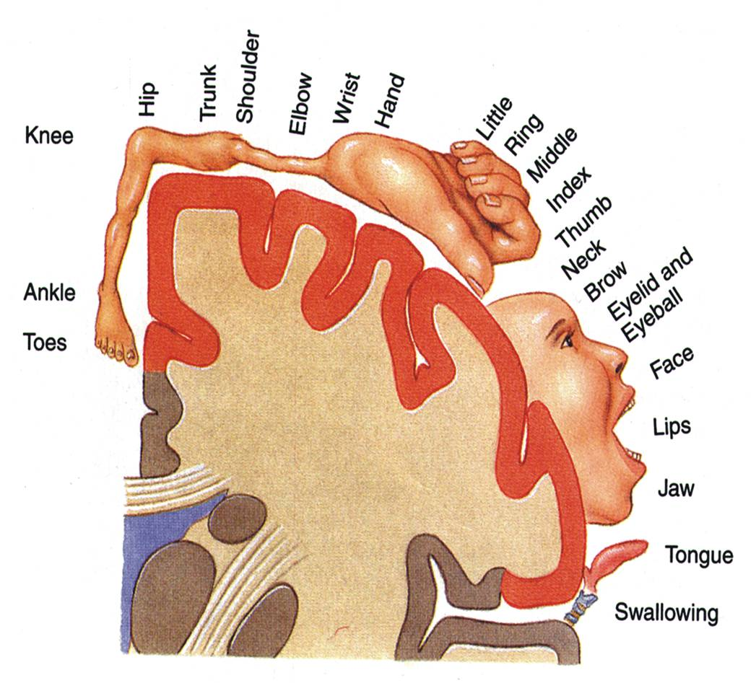
Motor Homunculus
Notes:
Primary motor cortex was defined by its ability to drive specific parts of the body upon electrical stimulation
Small amounts of cortex would cause movements in M1
In higher areas like SMA/PM, need more current
This corresponds to the somatosensory homunculus
There is an organized mapping of the brain onto the body
There is also a map in higher areas [[although it is a little bit less organized]]
Go through different parts of the body
Stimulate here, move hand etc.
More cortex for more important areas
e.g. need lots of neurons to make complicated hand movements
Like picking up a cup tossing it in the air
[[throw a ball into the audience]]
Facial expressions are very important for making good social signals, so need lots of motor cortex for it

Slide 12
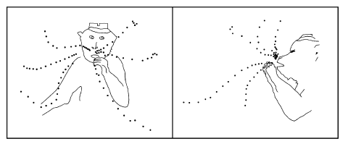
Long stimulation (e.g., 500 msec) of motor cortex elicits stereotyped postures
Graziano et al.,
Neuron, 2002 34:841-51.
Notes:
If stimulate M1 briefly, get a brief twitch
If stimulate longer, especially in higher areas, get a whole complex movement
So, the story is much more complicated than this simple picture
[[download Graziano video??]]

Slide 13
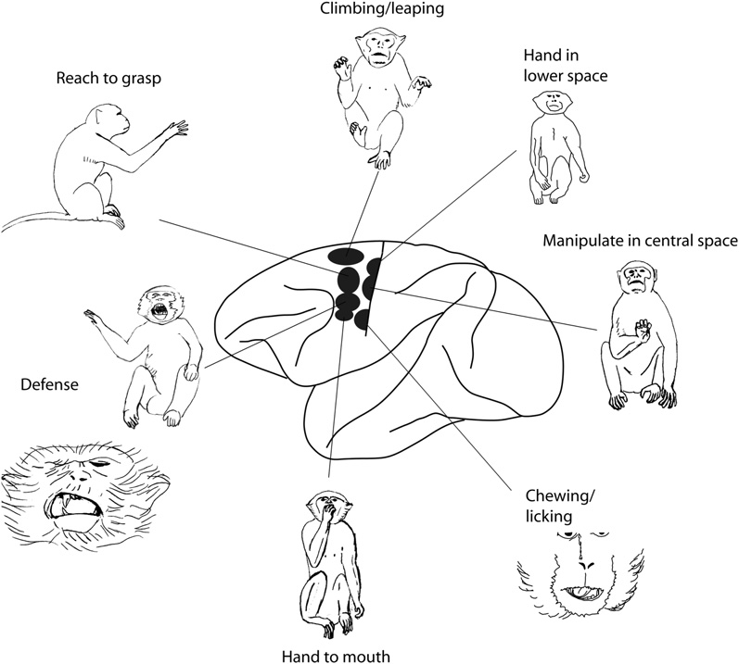
Action Zones
Aflalo & Graziano,
Neuron, 2007

Slide 14
Motor Homunculus vs. Action Zones
Notes:
Primary motor cortex was defined by its ability to drive specific parts of the body upon electrical stimulation
Small amounts of cortex would cause movements in M1
In higher areas like SMA/PM, need more current
This corresponds to the somatosensory homunculus
There is an organized mapping of the brain onto the body
There is also a map in higher areas [[although it is a little bit less organized]]
Go through different parts of the body
Stimulate here, move hand etc.
More cortex for more important areas
e.g. need lots of neurons to make complicated hand movements
Like picking up a cup tossing it in the air
[[throw a ball into the audience]]
Facial expressions are very important for making good social signals, so need lots of motor cortex for it

Slide 15
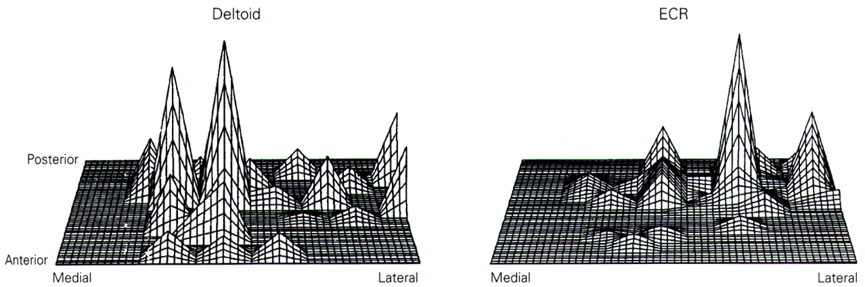
From J. Krakauer & C. Ghez (2000), in Principles of Neural Science, 4th Edition (Kandel, Schwartz, & Jessel, Eds.)
Notes:
Proof that it is more complicated
Hand and face muscles respond even when stimulate
e.g. stimulate just one part of the brain, get activity in many muscles
The motor cortex is to program a movement
The lower areas program the individual muscles, many if necessary

Slide 16
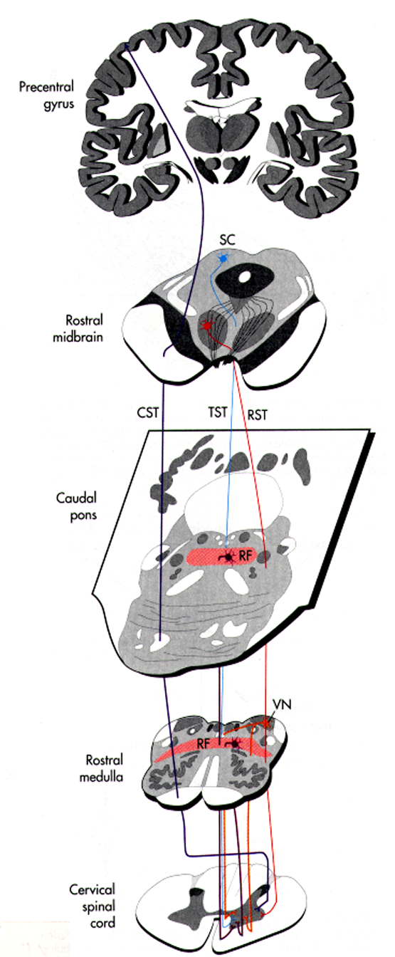
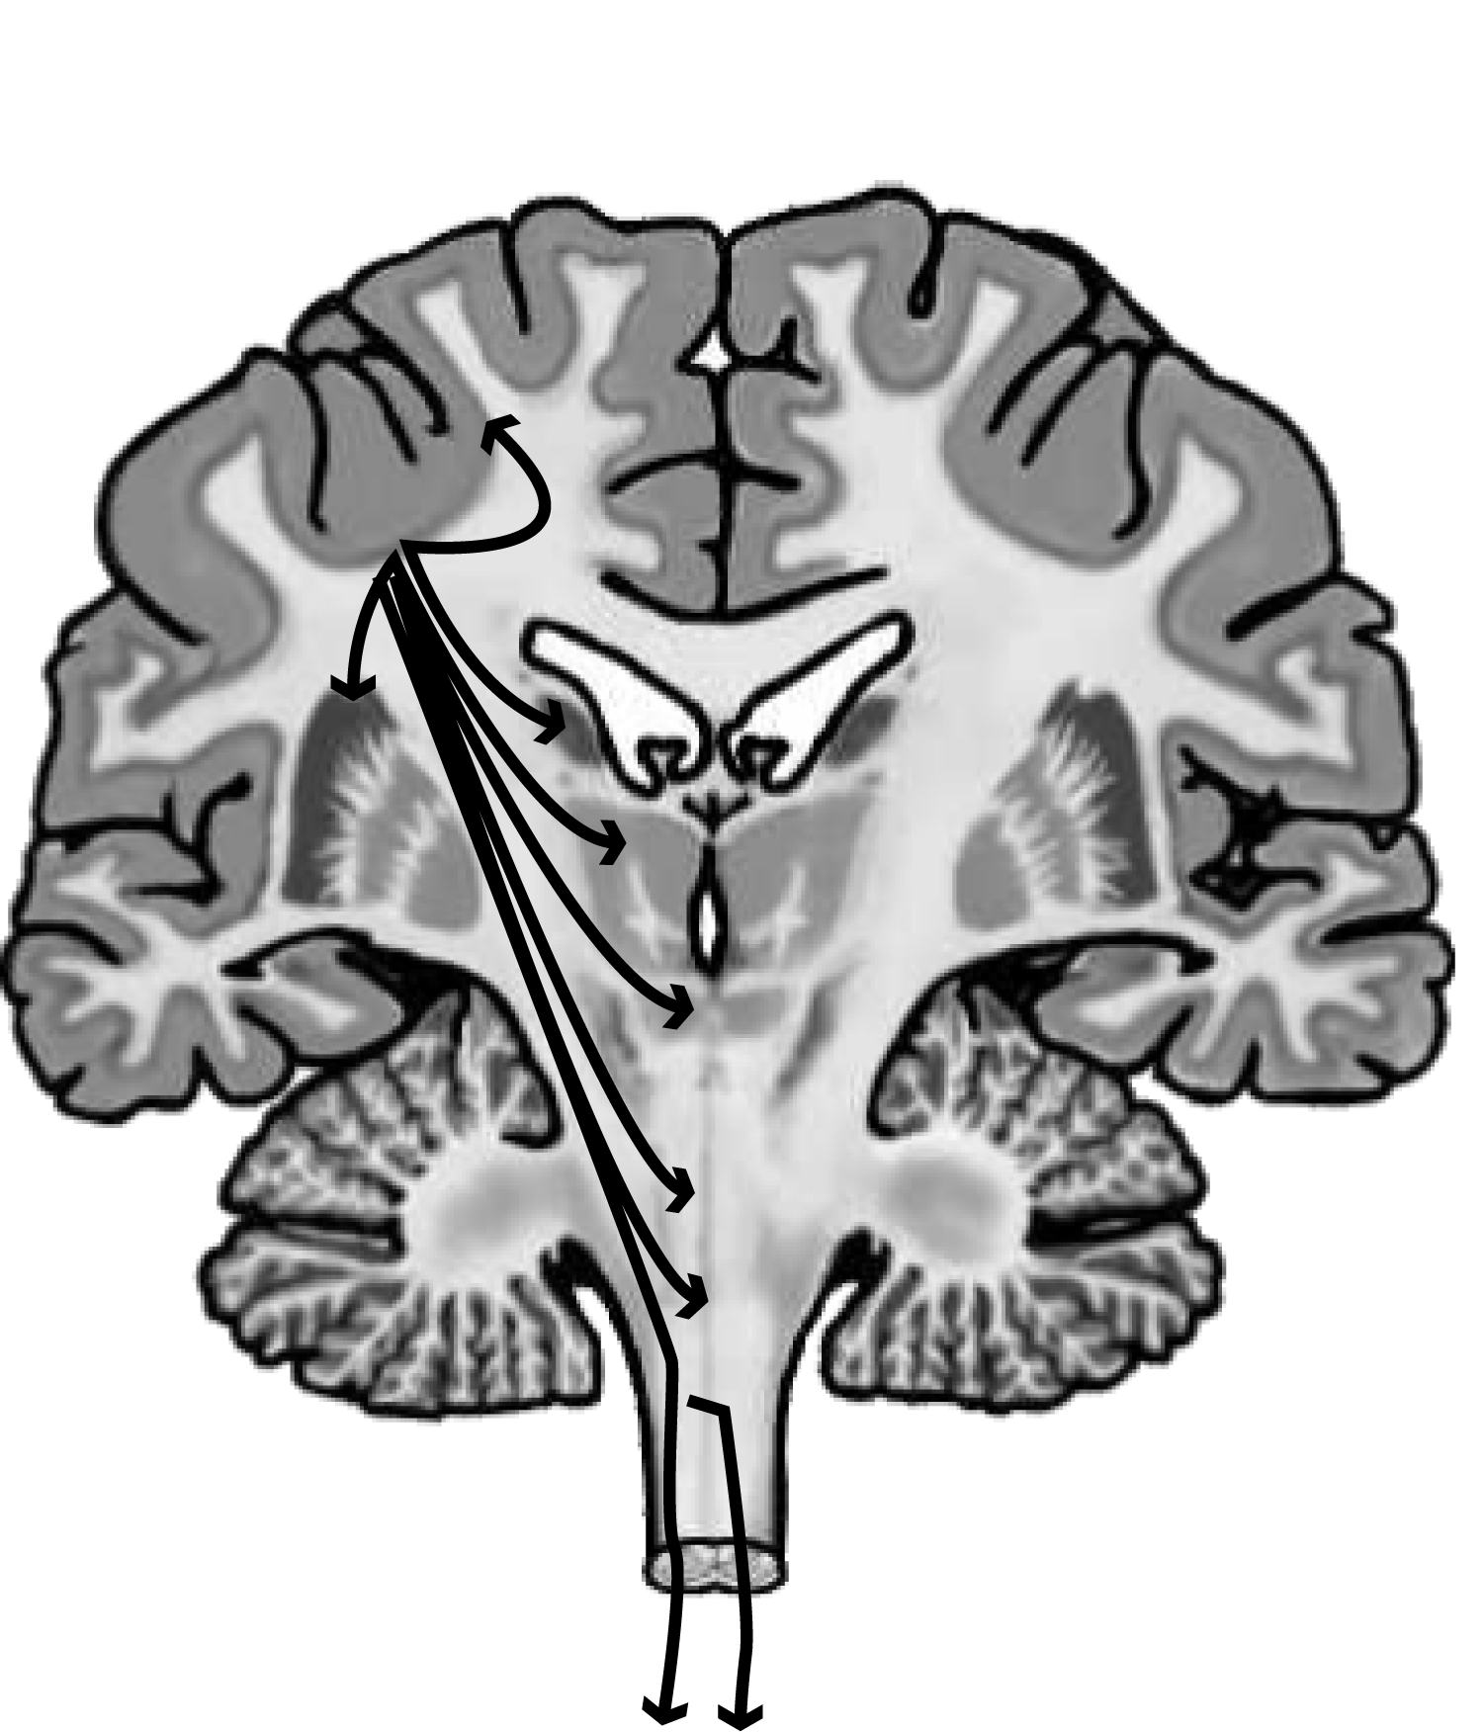
Notes:
Where does the motor cortex influence?
There are multiple parallel descending pathways that get input from motor cortex
[[maybe a car analogy—simple controller
Like a speed pedal—very complicated machinery that makes it happen]]

Slide 17
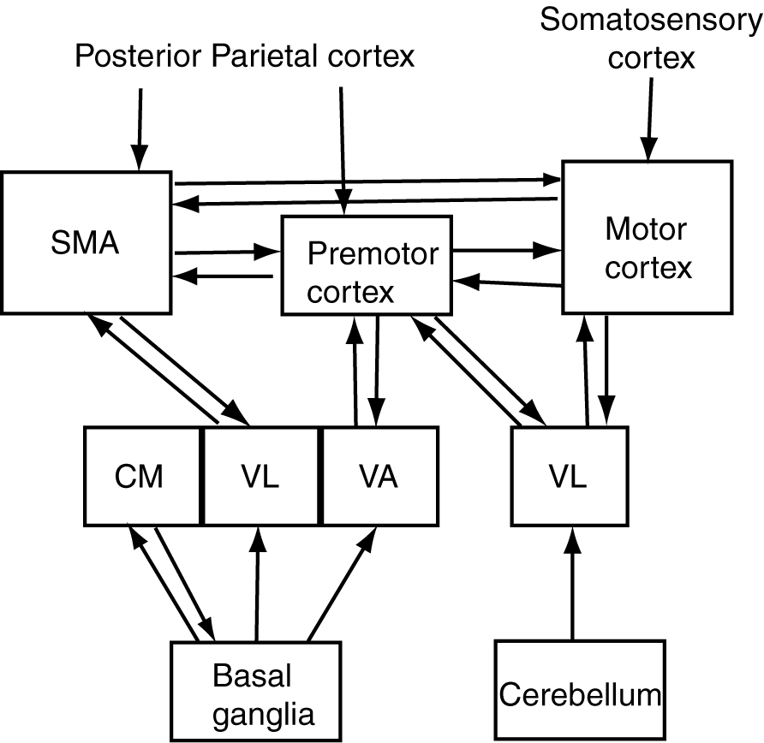
Thalamic
nuclei
Notes:
Similarly, within cortex, there is a lot of complicated wiring
Not a strict hierarchy
All of the areas are talking to each other
Why do you need somatosensory input?
Because it is ubuiquitous in the motor system—
Can have a good motor system without the
e.g. can’t talk after dental anesthesia?

Slide 18
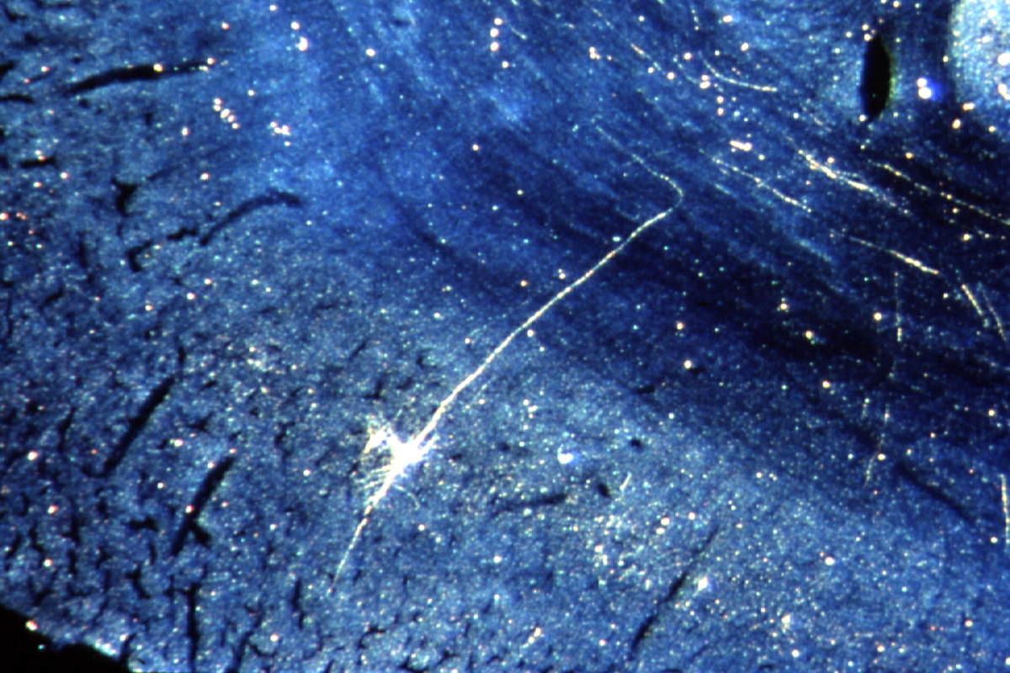
Betz Cell in Layer V of Motor Cortex
Notes:
One of the largest neurons in the brain are Betz cells

Slide 19
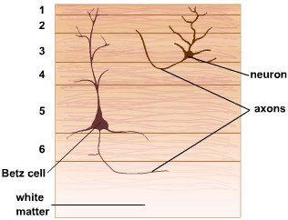

Notes:
Just like visual cortex has a very thick layer IV, the input layer
Motor cortex, has a very large layer 5, the output layer of the cortex

Slide 20
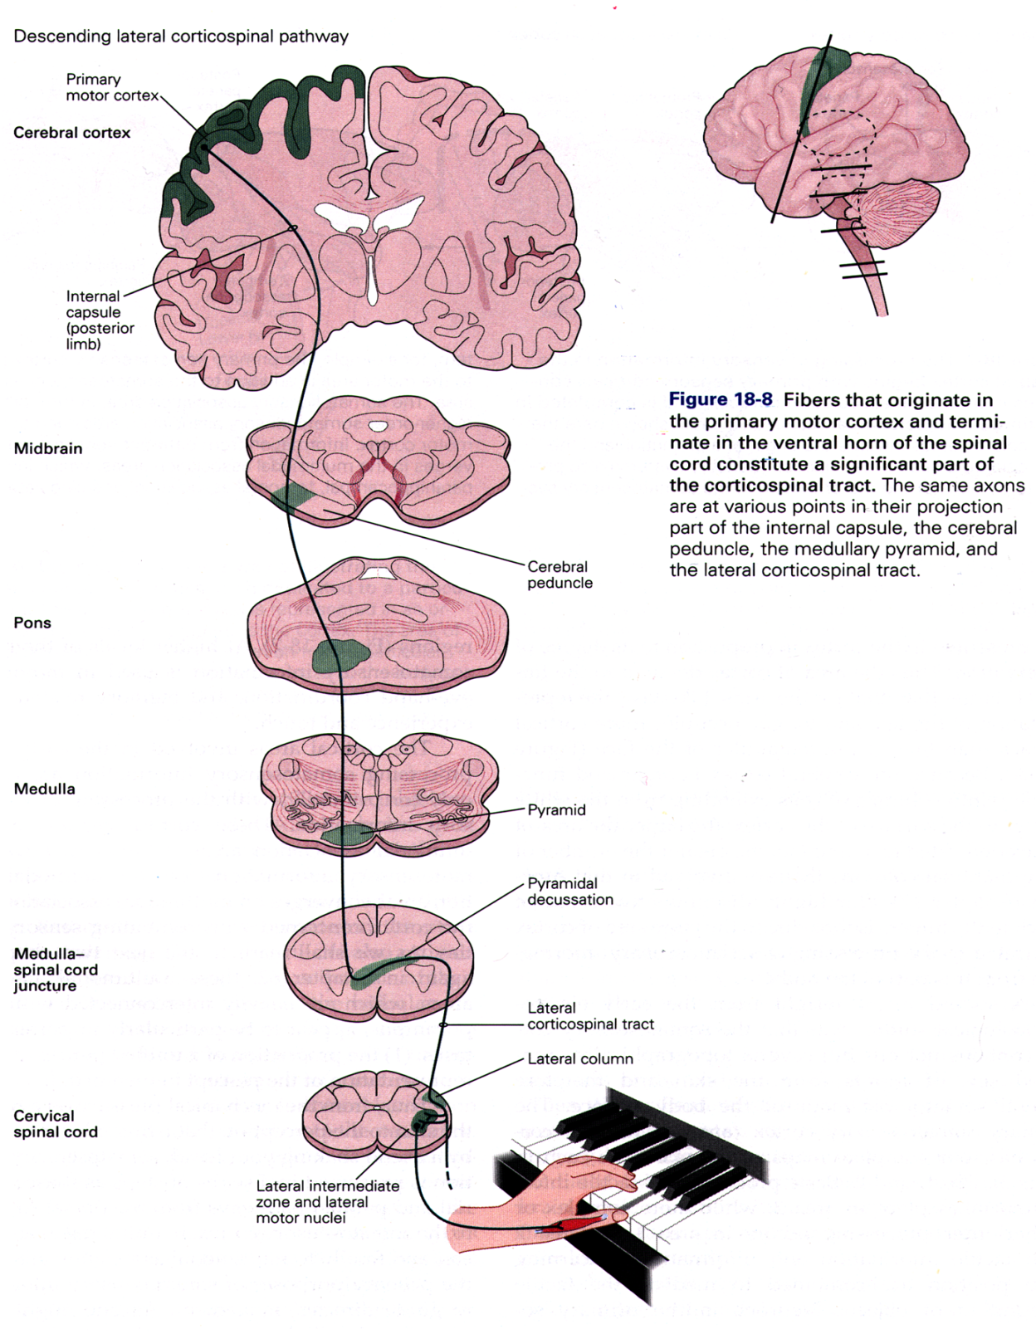
Primary motor cortex
From D. G. Amaral (2000), in Principles of Neural Science, 4th Edition (Kandel, Schwartz, & Jessel, Eds.)
Notes:
Primary motor cortex is one of the primary sources of the lateral corticospinal tract
Only pathway that makes direct monosynaptic connections onto the alpha motor neurons
Let’s us make very fine control of movements
Cats and rats don’t have these fine projections, so can’t make as fine movements

Slide 21
Origins of the Corticospinal Tract
Primary Motor Cortex (~30%)
Supplementary Motor Cortex
Premotor Cortex
Primary Somatosensory Cortex
Secondary Somatosensory Cortex
Posterior Parietal Cortex (~10%)
Other minor origins
} (~30%)
} (~30%)
Notes:
Not just M1, also other areas—even somatosensory cortex
Also parietal cortex

Slide 22
Primary Motor Cortex (M1)
Neurons fire before the contraction of muscle
Neurons encode force of contraction
Notes:
If we record these neurons, we find that they fire before the contraction of the videos.
Are they just saying move or don’t move?

Slide 23
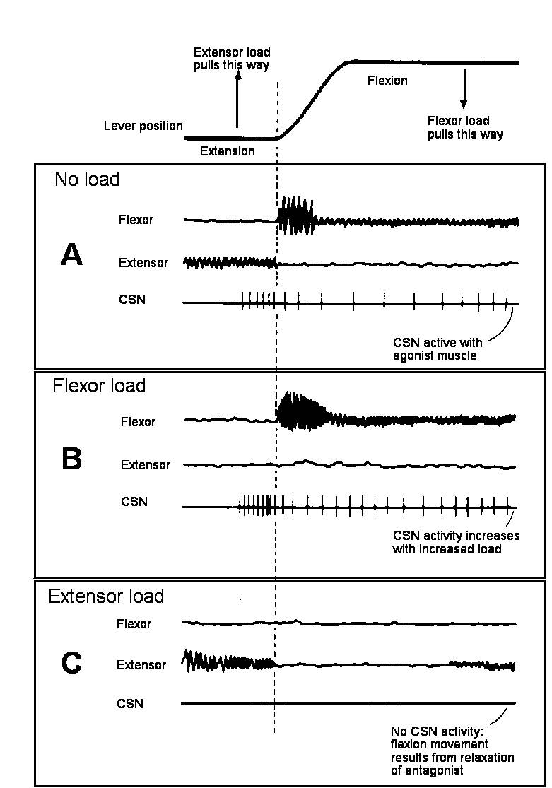
Primary Motor Cortex neurons encode the force of movements
Evarts EV (1968) J. Neurophysiol. 31:14-27.
Notes:
No, they are also encoding the force
Extend and flex the wrists, record the activity of both muscles, and a corticospinal neuron
Put a weight on—motor neuron fires more strongly, before the muscle starts to fire
No extensor muscle activity because the weight is pulling it that way
Put the weight on the other way, no firing is needed
Encode the force of the whole movement, not the individual muscles.

Slide 24
Primary Motor Cortex (M1)
Neurons fire before the contraction of muscle
Neurons encode force of contraction
Neurons encode direction of movement
Notes:
If we record these neurons, we find that they fire before the contraction of the videos.
Are they just saying move or don’t move?

Slide 25
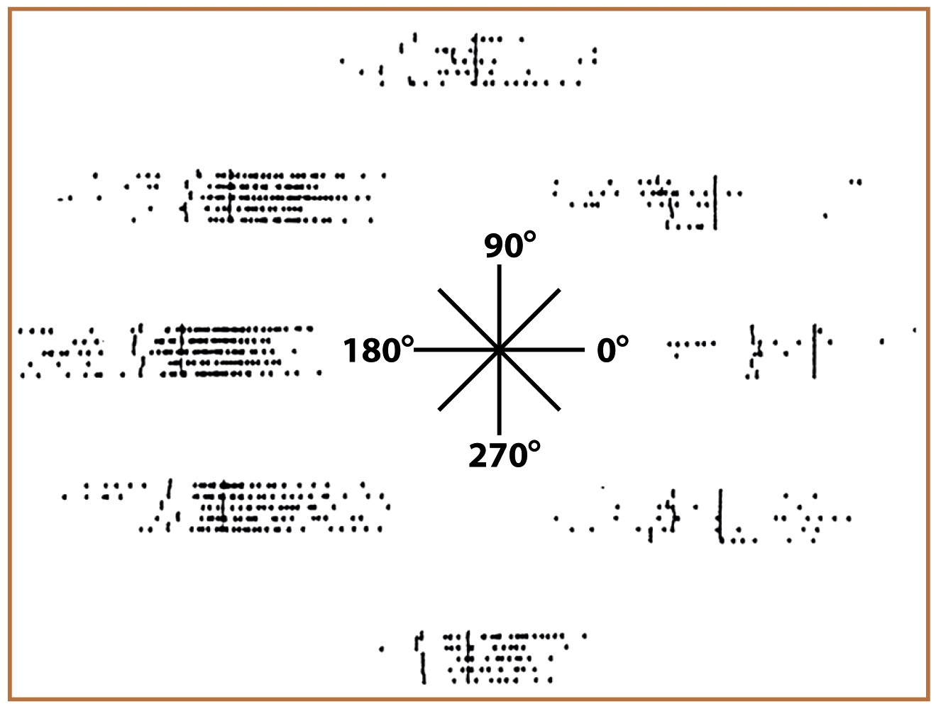
Direction Tuning of Primary Motor Cortex Neurons
Georgopoulos AP et al. (1982) J. Neurosci. 2:1527-1537.
Notes:
Figure 7.16a The population vector provides a cortical representation of movement. The activity of a single neuron in the motor cortex is measured for each of the eight movements (a) and plotted as a tuning profile (b). The preferred direction for this neuron is 180°, the leftward movement.

Slide 26
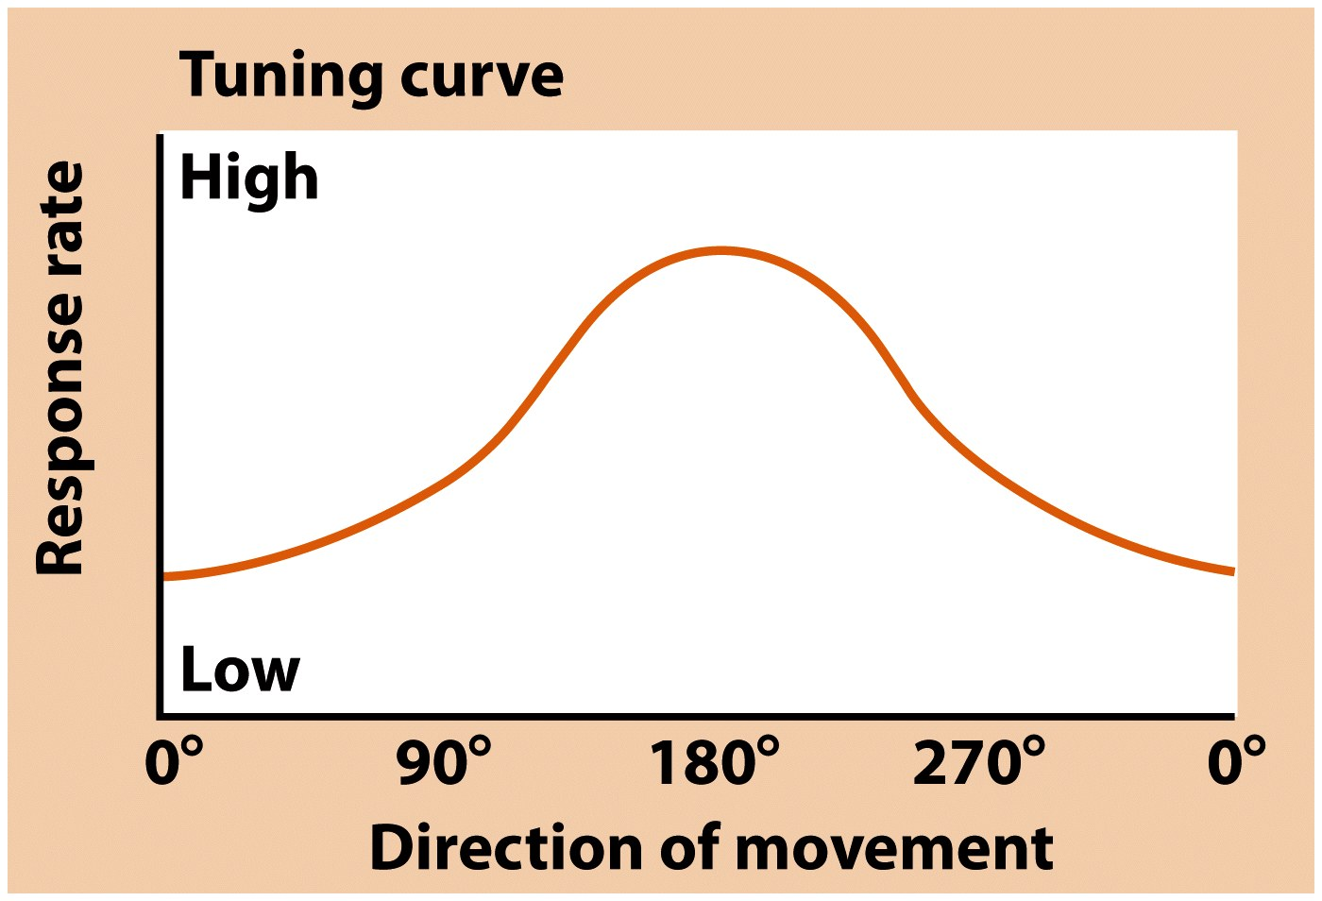
Notes:
Figure 7.16b The population vector provides a cortical representation of movement. The activity of a single neuron in the motor cortex is measured for each of the eight movements (a) and plotted as a tuning profile (b). The preferred direction for this neuron is 180°, the leftward movement.

Slide 27
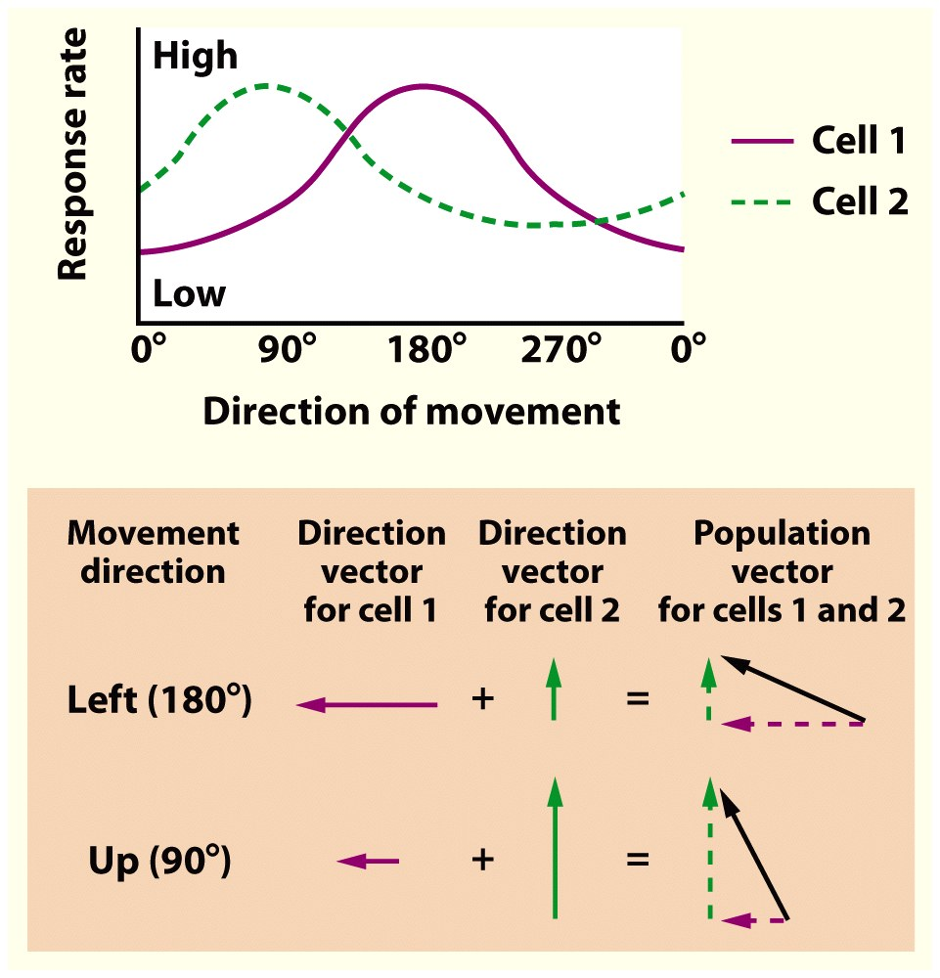
Notes:
Figure 7.16c Each neuron’s contribution to a particular movement can be plotted as a vector. The direction of the vector is always plotted as the neuron’s preferred direction, and the length corresponds to its firing rate for the target direction. The population vector (dashed line) is the sum of the individual vectors.

Slide 28
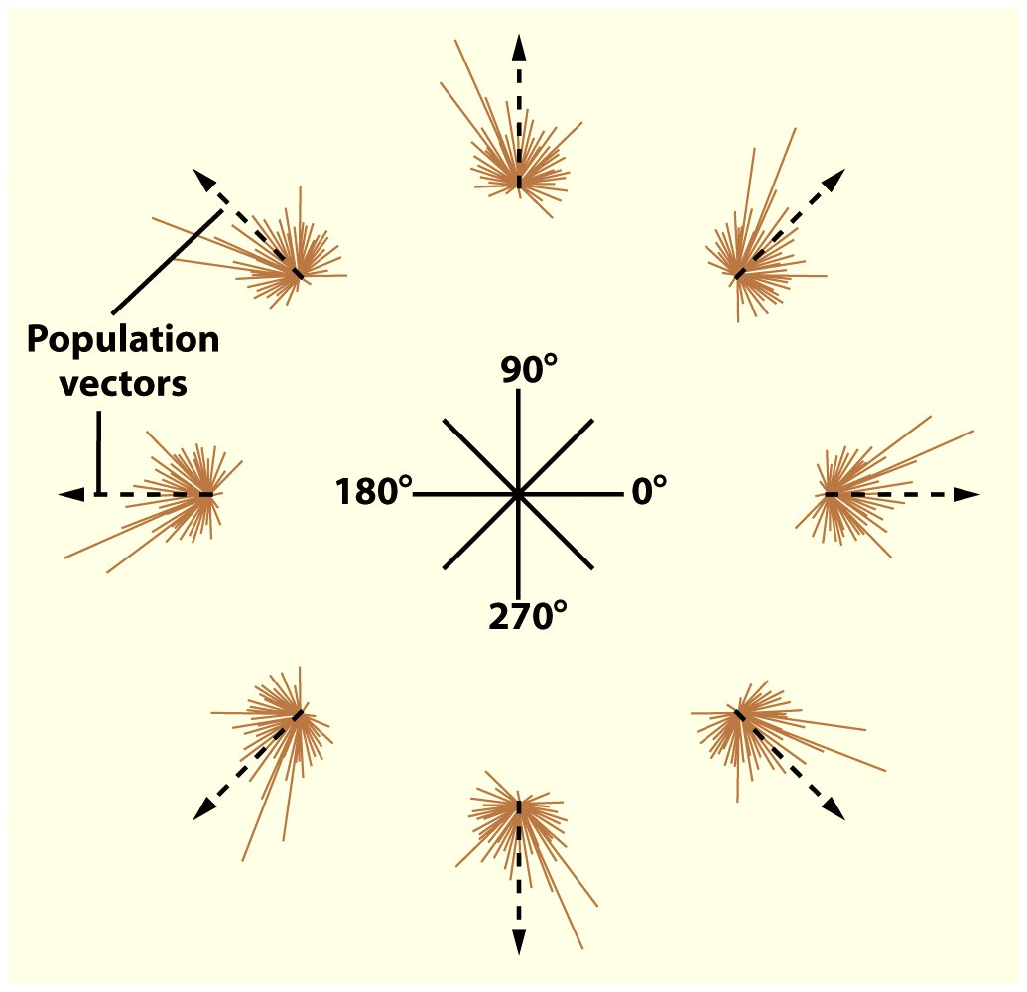
Notes:
Figure 7.16d For each direction, the solid lines are the individual vectors for each of 241 motor cortex neurons; the dotted line is the population vector calculated over the entire set of neurons. Although many neurons are active during each movement, the summed activity closely corresponds to the actual movements.

Slide 29
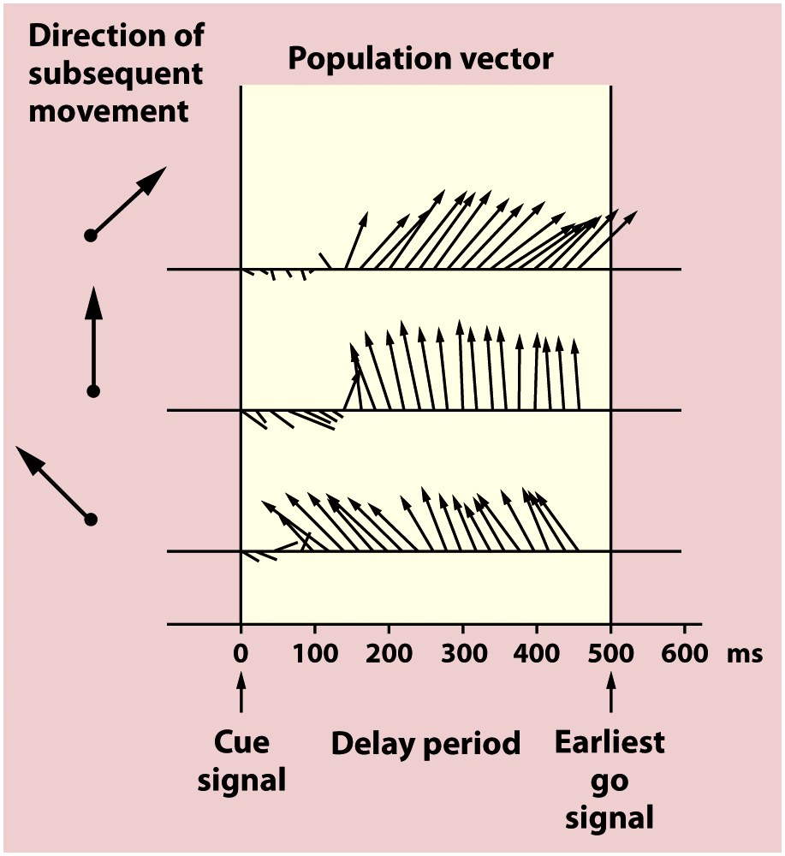
Notes:
Figure 7.18 The direction of the population vector predicts the direction of a forthcoming movement. At the cue, one of the eight targets is illuminated, indicating the direction for a subsequent movement. The animal must refrain from moving until the go signal. The population vector was calculated every 20 ms. The population vector is oriented in the direction for the planned movement, even though EMG activity is silent in the muscles.

Slide 30
Primary Motor Cortex (M1)
Neurons fire before the contraction of muscle
Neurons encode force of contraction
Neurons encode direction of movement
Neurons encode extent of movement
Neurons encode speed of movement
Notes:
If we record these neurons, we find that they fire before the contraction of the videos.
Are they just saying move or don’t move?

Slide 31
Motor Homunculus
Notes:
Primary motor cortex was defined by its ability to drive specific parts of the body upon electrical stimulation
Small amounts of cortex would cause movements in M1
In higher areas like SMA/PM, need more current
This corresponds to the somatosensory homunculus
There is an organized mapping of the brain onto the body
There is also a map in higher areas [[although it is a little bit less organized]]
Go through different parts of the body
Stimulate here, move hand etc.
More cortex for more important areas
e.g. need lots of neurons to make complicated hand movements
Like picking up a cup tossing it in the air
[[throw a ball into the audience]]
Facial expressions are very important for making good social signals, so need lots of motor cortex for it

Slide 32
Long stimulation (e.g., 500 msec) of motor cortex elicits stereotyped postures
Graziano et al.,
Neuron, 2002 34:841-51.
Notes:
If stimulate M1 briefly, get a brief twitch
If stimulate longer, especially in higher areas, get a whole complex movement
So, the story is much more complicated than this simple picture
[[download Graziano video??]]

Slide 33
Action Zones
Aflalo & Graziano,
Neuron, 2007

Slide 34
Motor Homunculus vs. Action Zones
Notes:
Primary motor cortex was defined by its ability to drive specific parts of the body upon electrical stimulation
Small amounts of cortex would cause movements in M1
In higher areas like SMA/PM, need more current
This corresponds to the somatosensory homunculus
There is an organized mapping of the brain onto the body
There is also a map in higher areas [[although it is a little bit less organized]]
Go through different parts of the body
Stimulate here, move hand etc.
More cortex for more important areas
e.g. need lots of neurons to make complicated hand movements
Like picking up a cup tossing it in the air
[[throw a ball into the audience]]
Facial expressions are very important for making good social signals, so need lots of motor cortex for it

Slide 35
Motor Cortex
Notes:
Motor cortex helps you encode specific movements, plus all of the parameters that you need to make those movements
e.g. picking up food has a lot of variables
How does the primary motor cortex know what to do?

Slide 36
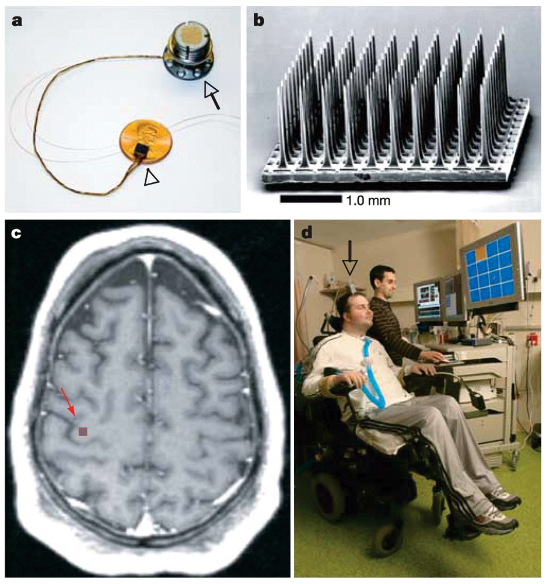
Notes:
Figure 7.21a–d Brain–machine interface used by M.N. (a) The size of the implanted electrode device in relation to a U.S. penny. (b) A magnified image of the recording electrode array. (c) The location in the precentral gyrus where the electrode array was implanted. (d) The subject M.N. with the implanted device. He is controlling a cursor on the computer screen with his neural activity.

Slide 37
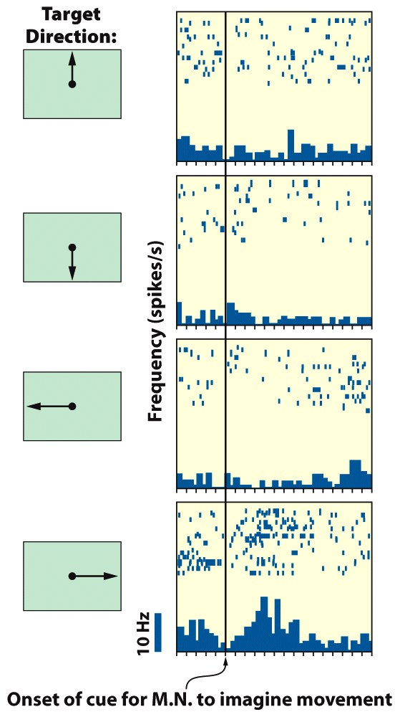
Notes:
Figure 7.21e Brain–machine interface used by M.N.
The firing of one cell during four different conditions in which M.N. was cued to imagine moving his hand up, down, left, or right. The cell shown here fired best when M.N. imagined moving his hand to the right; other cells fired selectively when M.N. imagined moving his hand left, up, or down. When information from all of the cells recorded from the implanted electrode were combined, the desired direction of movement could be predicted. Once the BMI device learned how the pattern of M.N.’s activity correlated with the desire to move in these directions, M.N. could begin to use his intentions to move a cursor wherever he chose. Using this technology, M.N. was also able to open simulated e-mails, operate a television, open and close a prosthetic hand, and move a robotic arm. Such technology holds great promise for people like M.N. who cannot otherwise physically interact with their environment.

Slide 38
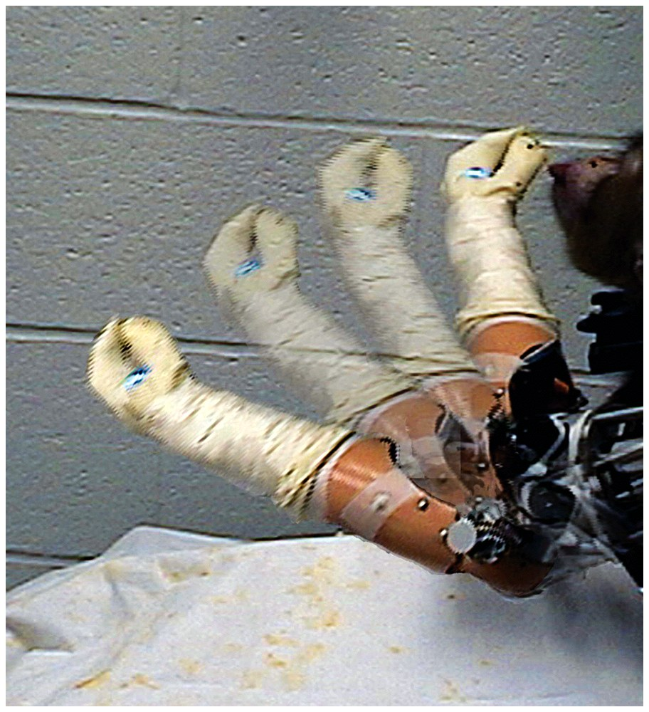
Notes:
﻿Figure 7.20 With this brain–machine interface, Andrew Schwartz and his colleagues trained monkeys to use thoughts to control a robotic arm to grasp peanuts at arbitrary locations and then move the device to the mouth to deliver the reward.

Slide 39
Premotor Cortex
Preparation for movement (“Motor set”)
Notes:
Polishing black shoe with brown polish, premotor cortex lights up when they see inappropriate actions
Or trying to put coin in perpendicular to slot
Analyzing the motor activity

Slide 40
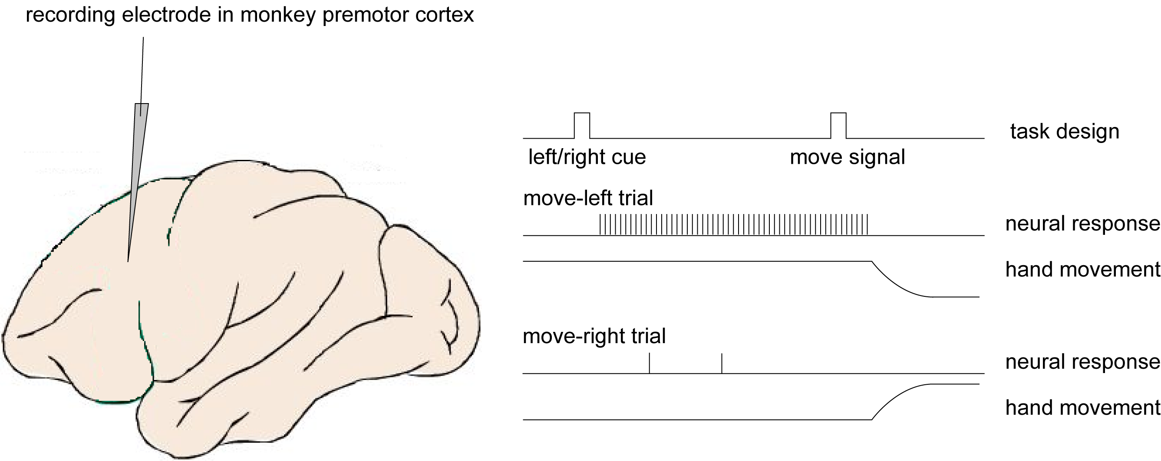
Premotor cortex is involved in preparation for movement
Notes:
Train monkey many may times—separate out motor plan from execution
We do this all of the time—light is red, but when it turns green, I will drive straight or turn
What’s happening in the spinal cord? Nothing
But in motor cortex
[[drive in New York City]]
This neuron is telling you to get ready to turn left

Slide 41
Premotor Cortex
Preparation for movement (“Motor set”)
Sensory aspects associated with motor acts
Notes:
Polishing black shoe with brown polish, premotor cortex lights up when they see inappropriate actions
Or trying to put coin in perpendicular to slot
Analyzing the motor activity

Slide 42
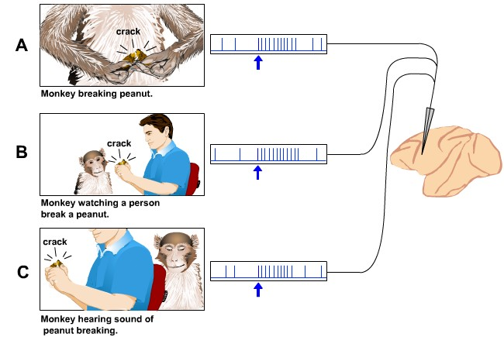
Premotor Cortex “Mirror” Neuron
Notes:
They fire not only to the act itself but
Lots of speculation but this is how you learn to imitate other actions

Slide 43
Premotor Cortex
Preparation for movement (“Motor set”)
Sensory aspects associated with motor acts
Behavioral context
Notes:
Polishing black shoe with brown polish, premotor cortex lights up when they see inappropriate actions
Or trying to put coin in perpendicular to slot
Analyzing the motor activity

Slide 44
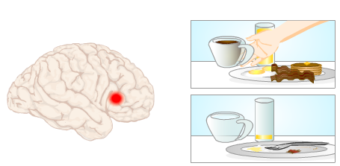
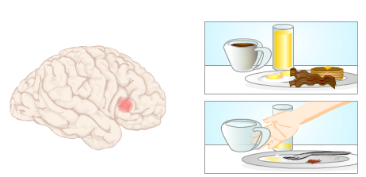
Premotor cortex encodes behavioral context
Notes:
What study is this?
Video clips of different tasks

Slide 45
Premotor Cortex
Preparation for movement (“Motor set”)
Sensory aspects associated with motor acts
Behavioral context
Signals correct and incorrect actions
Notes:
Polishing black shoe with brown polish, premotor cortex lights up when they see inappropriate actions
Or trying to put coin in perpendicular to slot
Analyzing the motor activity

Slide 46
Motor Cortex

Slide 47
Supplementary Motor Area
Programming complex sequences of movements
Coordination of bilateral movements
Transformation of kinematic to dynamic information
Notes:
Kinematic to Dynamic
Define movements in terms of speed and angle
Dynamics: what forces are needed for this movement
Some evidence that neurons in SMA go from K->D

Slide 48
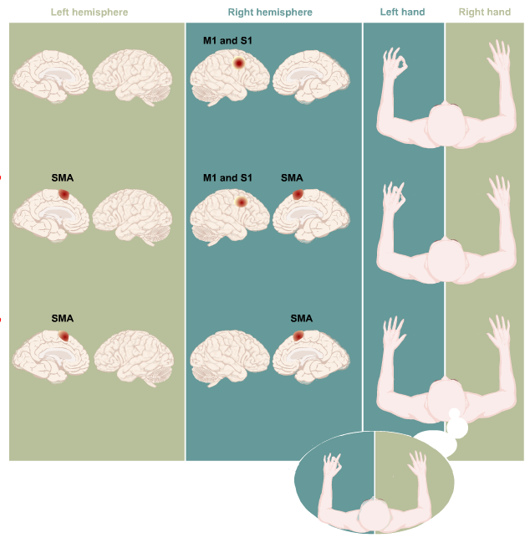
Notes:
Experiment about motor sequences and bilateral
With your left hand do a simple movement, see activity in contralateral M1/S1
Next, do a more complicated task
A specific finger sequence 4-3-5-1
Now you see greater SMA activity in BOTH hemispheres
Now, don’t move, just imagine making the complex sequences
Now you see mainly SMA activity

Slide 49
Supplementary Motor Area
Programming complex sequences of movements
Coordination of bilateral movements
Transformation of kinematic to dynamic information
Notes:
Kinematic to Dynamic
Define movements in terms of speed and angle
Dynamics: what forces are needed for this movement
Some evidence that neurons in SMA go from K->D

Slide 50
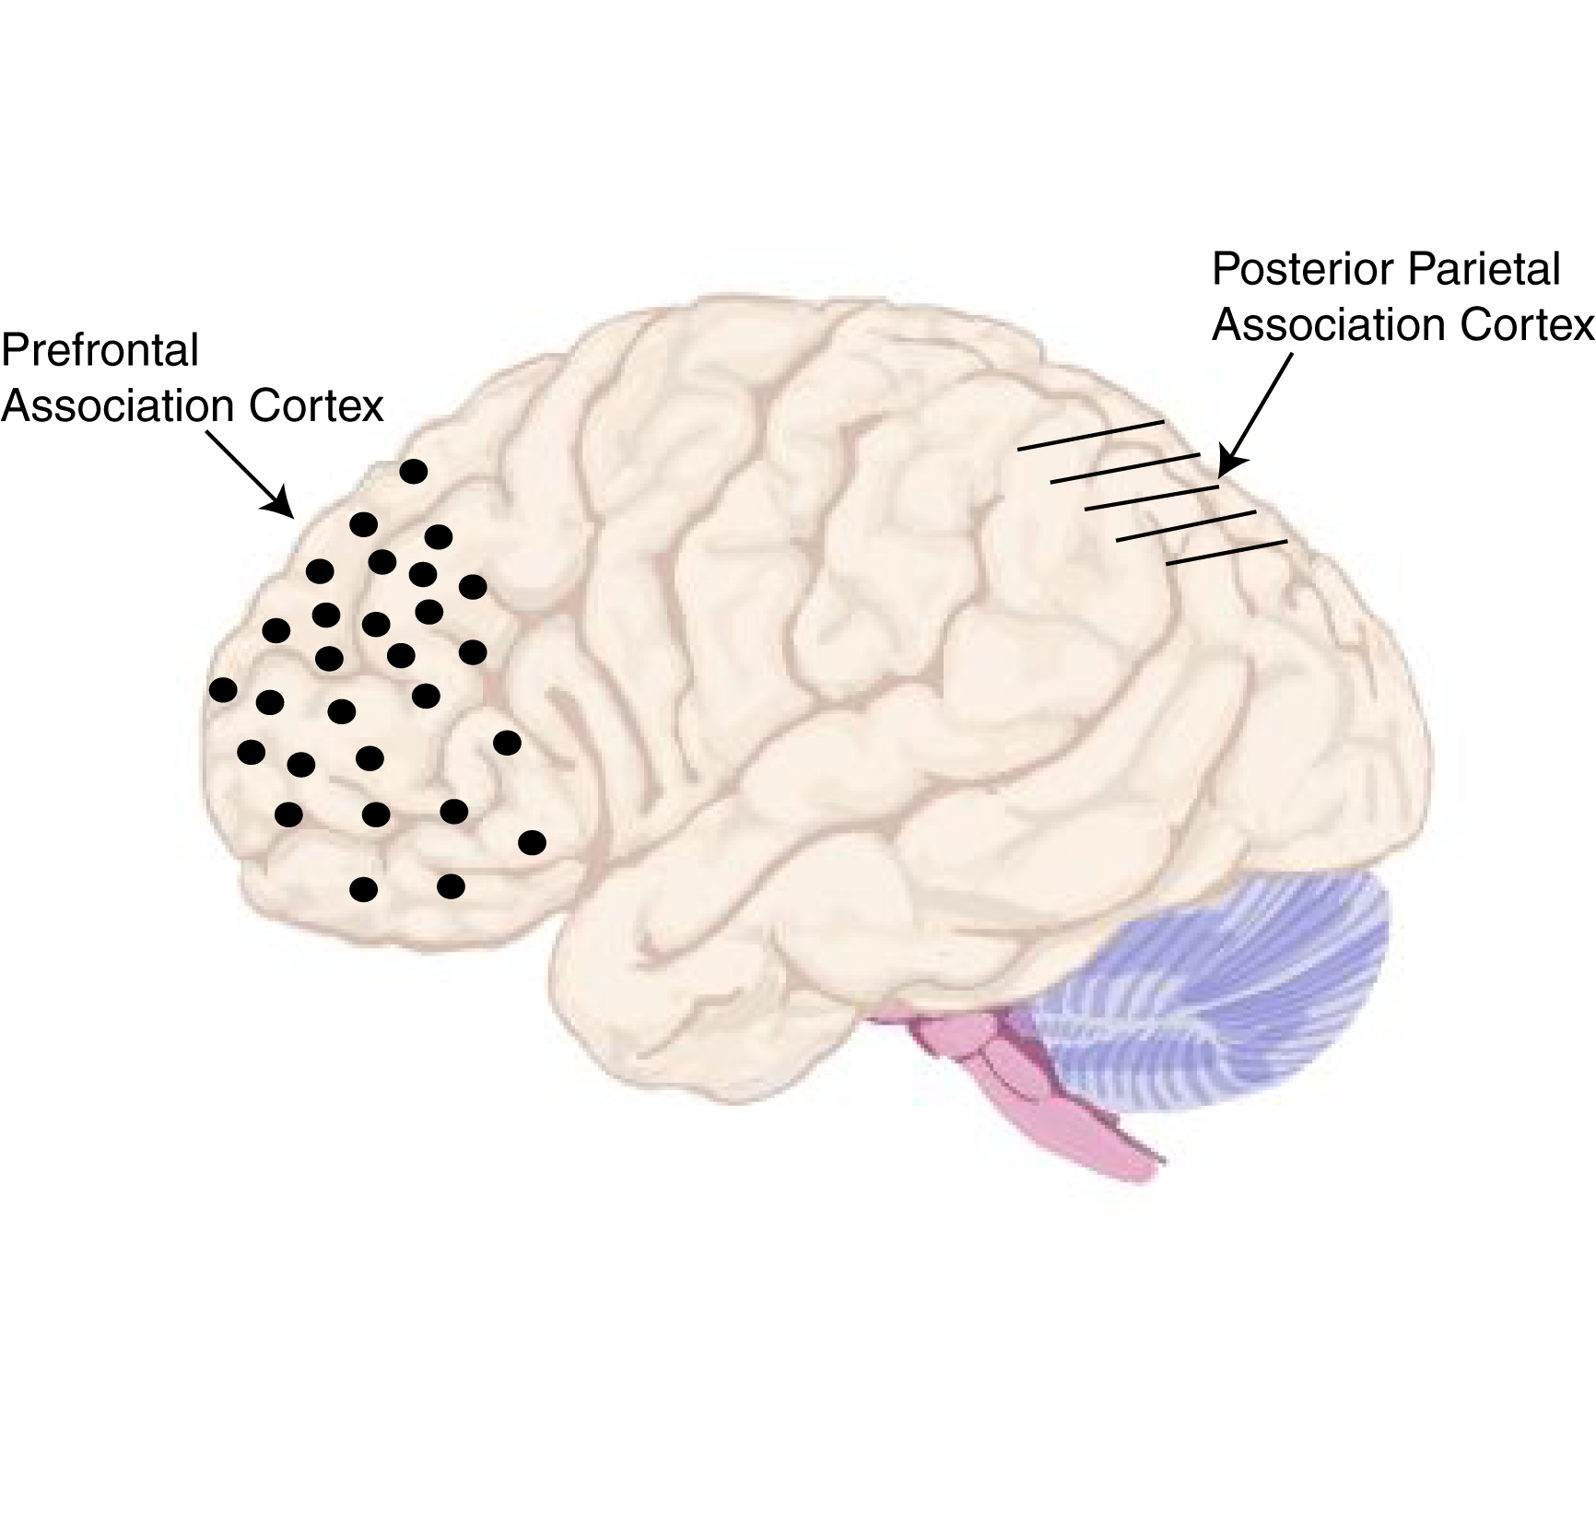

Slide 51
Association Cortex
4th hierarchical level
Goals, context, attention, spatial layout of environment
Posterior parietal cortex
Notes:
Not motor cortex per se
But still help
Posterior parietal cortex helps transform coordinates from egocentric to allocentric
e.g. goal is to pick up box and move it to top of room
That is the allocentric goal
e.g. go get a snack at French Corner
Liaison between sensory processing and motor output areas.

Slide 52
Constructional Apraxia
Notes:
Bizarre deficits caused by lesions to these ctructures
Apraxia—problems with coordinated movements
Asked to copy the left set of blocks, but can’t make a copy of the target
Can’t translate the sensory input to a motor input
Dressing apraxia—can’t get dressed
[[a general problem—it seems easy for us, but it is actually very complicated]]
They might think it is right, but if pressed might admit that it is off

Slide 53
Notes:
Prefrontal association cortex
Put actions in their appropriate behavioral task
e.g. thirsty
Have to grab your own cup to drink from
Grabbing someone else’s cup is what someone with prefrontal cortex
[[that is why kids do this!!]]
Can’t make long term goals
Not appropriate for behavioral context

Slide 54
Hierarchical Organization and Functional Segregation
of Central Motor Structures
Level 4: Association Cortex
Side Loop 1:
Basal Ganglia
(Caudate Nucleus, Putamen, Globus Pallidus, Substantia Nigra, Subthalamic Nucleus)
Level 3: Motor Cortex
Thalamus
(VA,VL,CM)
Level 2: Brain Stem
(Red Nucleus, Reticular Formation, Vestibular Nuclei, Tectum, Pontine Nuclei, Inferior Olive)
Side Loop 2: Cerebellum
Level 1: Spinal Cord
Notes:
Higher-level areas—what do I want to do
Lower level—what muscles have to contract to do the movements
Side loops—separate lectures on each of them
Start with the lower levels

