Slide 1


Motor Systems: Lecture 4
Michael S. Beauchamp, Ph.D.
Assistant Professor
Department of Neurobiology and Anatomy
University of Texas Health Science Center at Houston
Houston, TX
Michael.S.Beauchamp@uth.tmc.edu

Slide 2
Hierarchical Organization and Functional Segregation
of Central Motor Structures
Level 4: Association Cortex
Side Loop 1:
Basal Ganglia
(Caudate Nucleus, Putamen, Globus Pallidus, Substantia Nigra, Subthalamic Nucleus)
Level 3: Motor Cortex
Thalamus
(VA,VL,CM)
Level 2: Brain Stem
(Red Nucleus, Reticular Formation, Vestibular Nuclei, Tectum, Pontine Nuclei, Inferior Olive)
Side Loop 2: Cerebellum
Level 1: Spinal Cord
Notes:
Higher-level areas—cells in the higher levels are involved in representing what do I want to do, coordinating the force of the movements
Outout motor neurons control exactly which muscle spindles to contract to achieve the desired force
e.g. go up on my toes, who cares exactly which muscles or spindles to contract
Lower level—what muscles have to contract to do the movements
Side loops—separate lectures on each of them
Today we’ll talk about the basal ganglia.
There are very important for motor functions, but they also influence many cognitive functions as well.
Damage to the basal ganglia causes what are called extrapyramidal syndrome, because this is outside the pyramids.
Produces its own set of diseases which you will hear about from Dr. Mancias.
Of course, there is lots of cross talk between the pyramidal and extrapyramidal systems, so they are not truly separate systems.

Slide 3
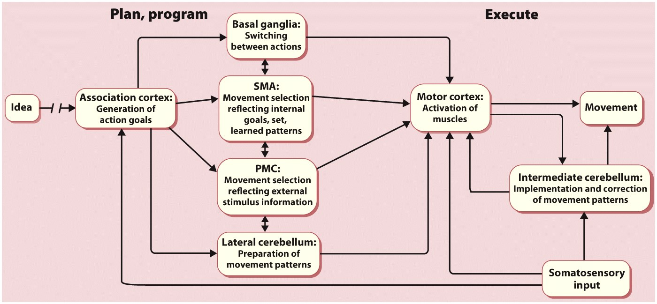
Notes:
Figure 7.47b Functional architecture of the motor system.
Functional hypotheses for how these different structures contribute to actions.

Slide 4
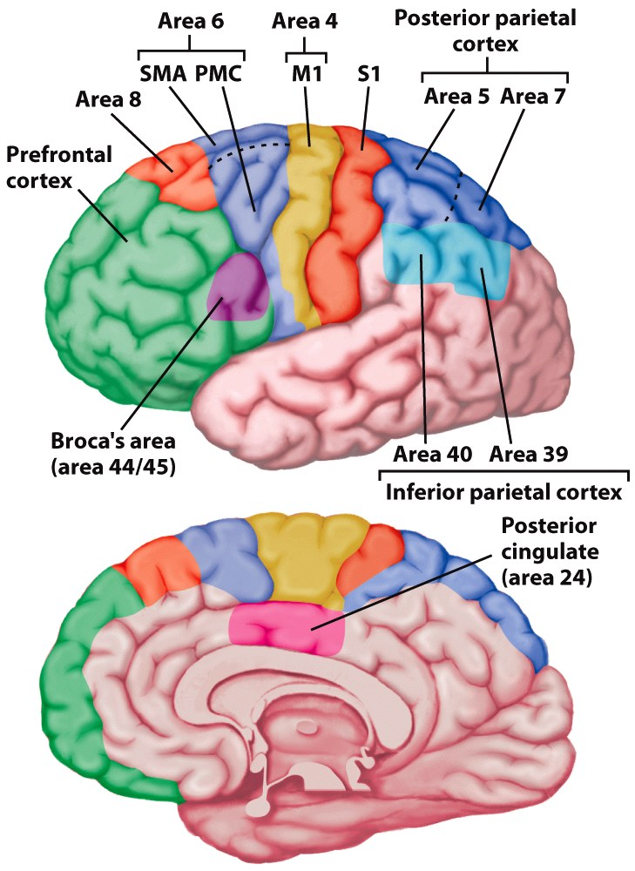
Notes:
Figure 7.6 Motor areas of the cerebral cortex. Area 4 is the primary motor cortex (M1). Brodmann area 6 encompasses the supplementary motor area (SMA) on the medial surface and premotor cortex (PMC) on the lateral surface. Area 8 includes the frontal eye fields. Inferior frontal regions (area 44) are involved in speech. Regions of parietal cortex associated with the planning and control of coordinated movement include S1, the primary somatosensory cortex, secondary somatosensory areas, and posterior and inferior parietal regions.

Slide 5
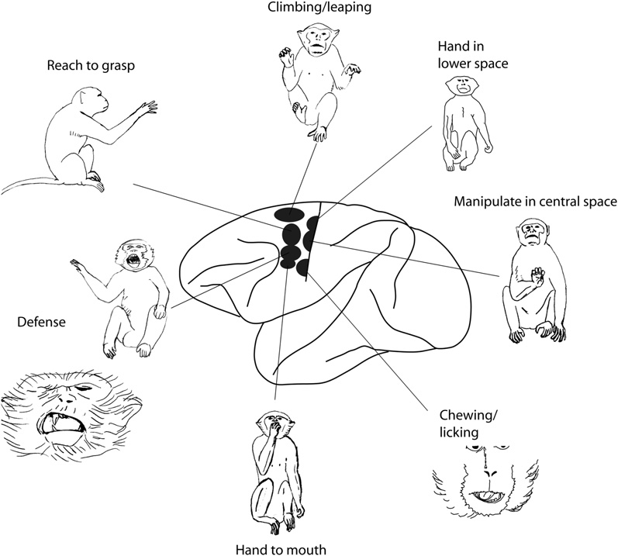
Action Zones
Aflalo & Graziano,
Neuron, 2007

Slide 6
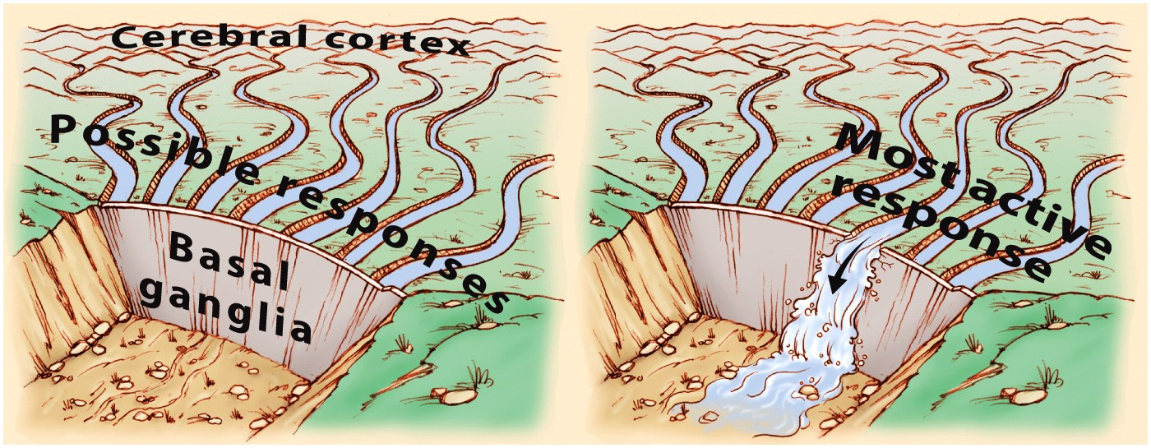
Notes:
Figure 7.41 The basal ganglia play a critical role in movement initiation.
Inihibit motor program that you don’t want
Activate motor programs that you do want
Potential responses are held in check until the --basal ganglia provide a triggering response.
“gating function”

Slide 7
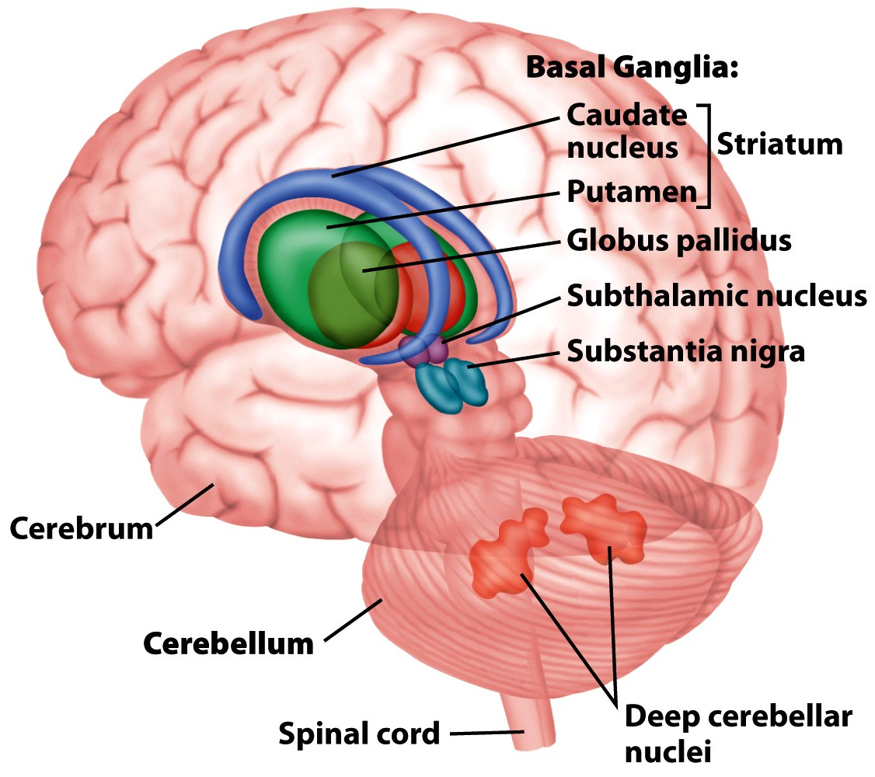
Notes:
Figure 7.5 The basal ganglia and the cerebellum are two prominent subcortical components of the motor pathways. The basal ganglia proper include the caudate, putamen, and globus pallidus, three nuclei that surround the thalamus. Functionally, however, the subthalamic nuclei and substantia nigra also are considered part of the basal ganglia. The cerebellum sits below the posterior portion of the cerebral cortex. All cerebellar output originates in the deep cerebellar nuclei.

Slide 8
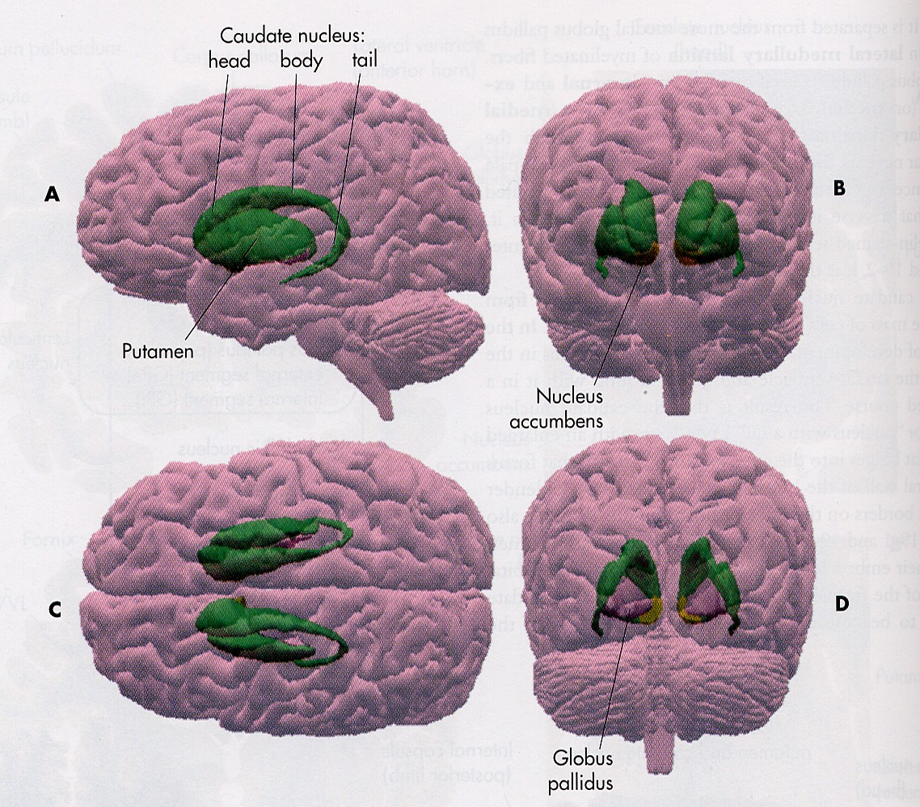
From J. Nolte (2002) The Human Brain, 5th Edition
Notes:
This is a diagram from Nolte which shows a 3-dimensional picture of what the basal ganglia looks like
Caudate is a C shaped structure that follows along the lateral ventricle from the frontal lobe all the way down to the temporal lobe

Slide 9
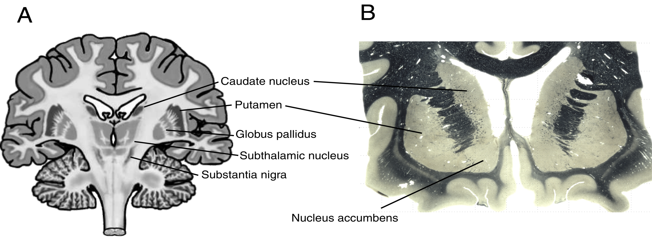
Basal Ganglia
Notes:
Here is a schematic cross section
Accumbens means leaning, leans against medial wall
Also known as the ventral striatum
This is the area of fusion of the putamen and caudate nucleus
Called the striatum (or stripes) because of these bridges of cells between the putamen and caudate nucleus

Slide 10
Basal Ganglia Nomenclature
Corpus striatum
Nucleus accumbens
Caudate
Putamen
Globus pallidus
Subthalamic nucleus
Substantia nigra
(Ventral Tegmental Area)
Striatum or Neostriatum
Lenticular nucleus
Notes:
Here is a schematic cross section
Accumbens means leaning, leans against medial wall
Also known as the ventral striatum
Called the striatum (or stripes) because of these bridges of cells between the putamen and caudate nucleus
Substantia nigra has two parts:
SN pars reticulata (pr) is like Gpi
SN pars compacta contains the pigmented neurons

Slide 11
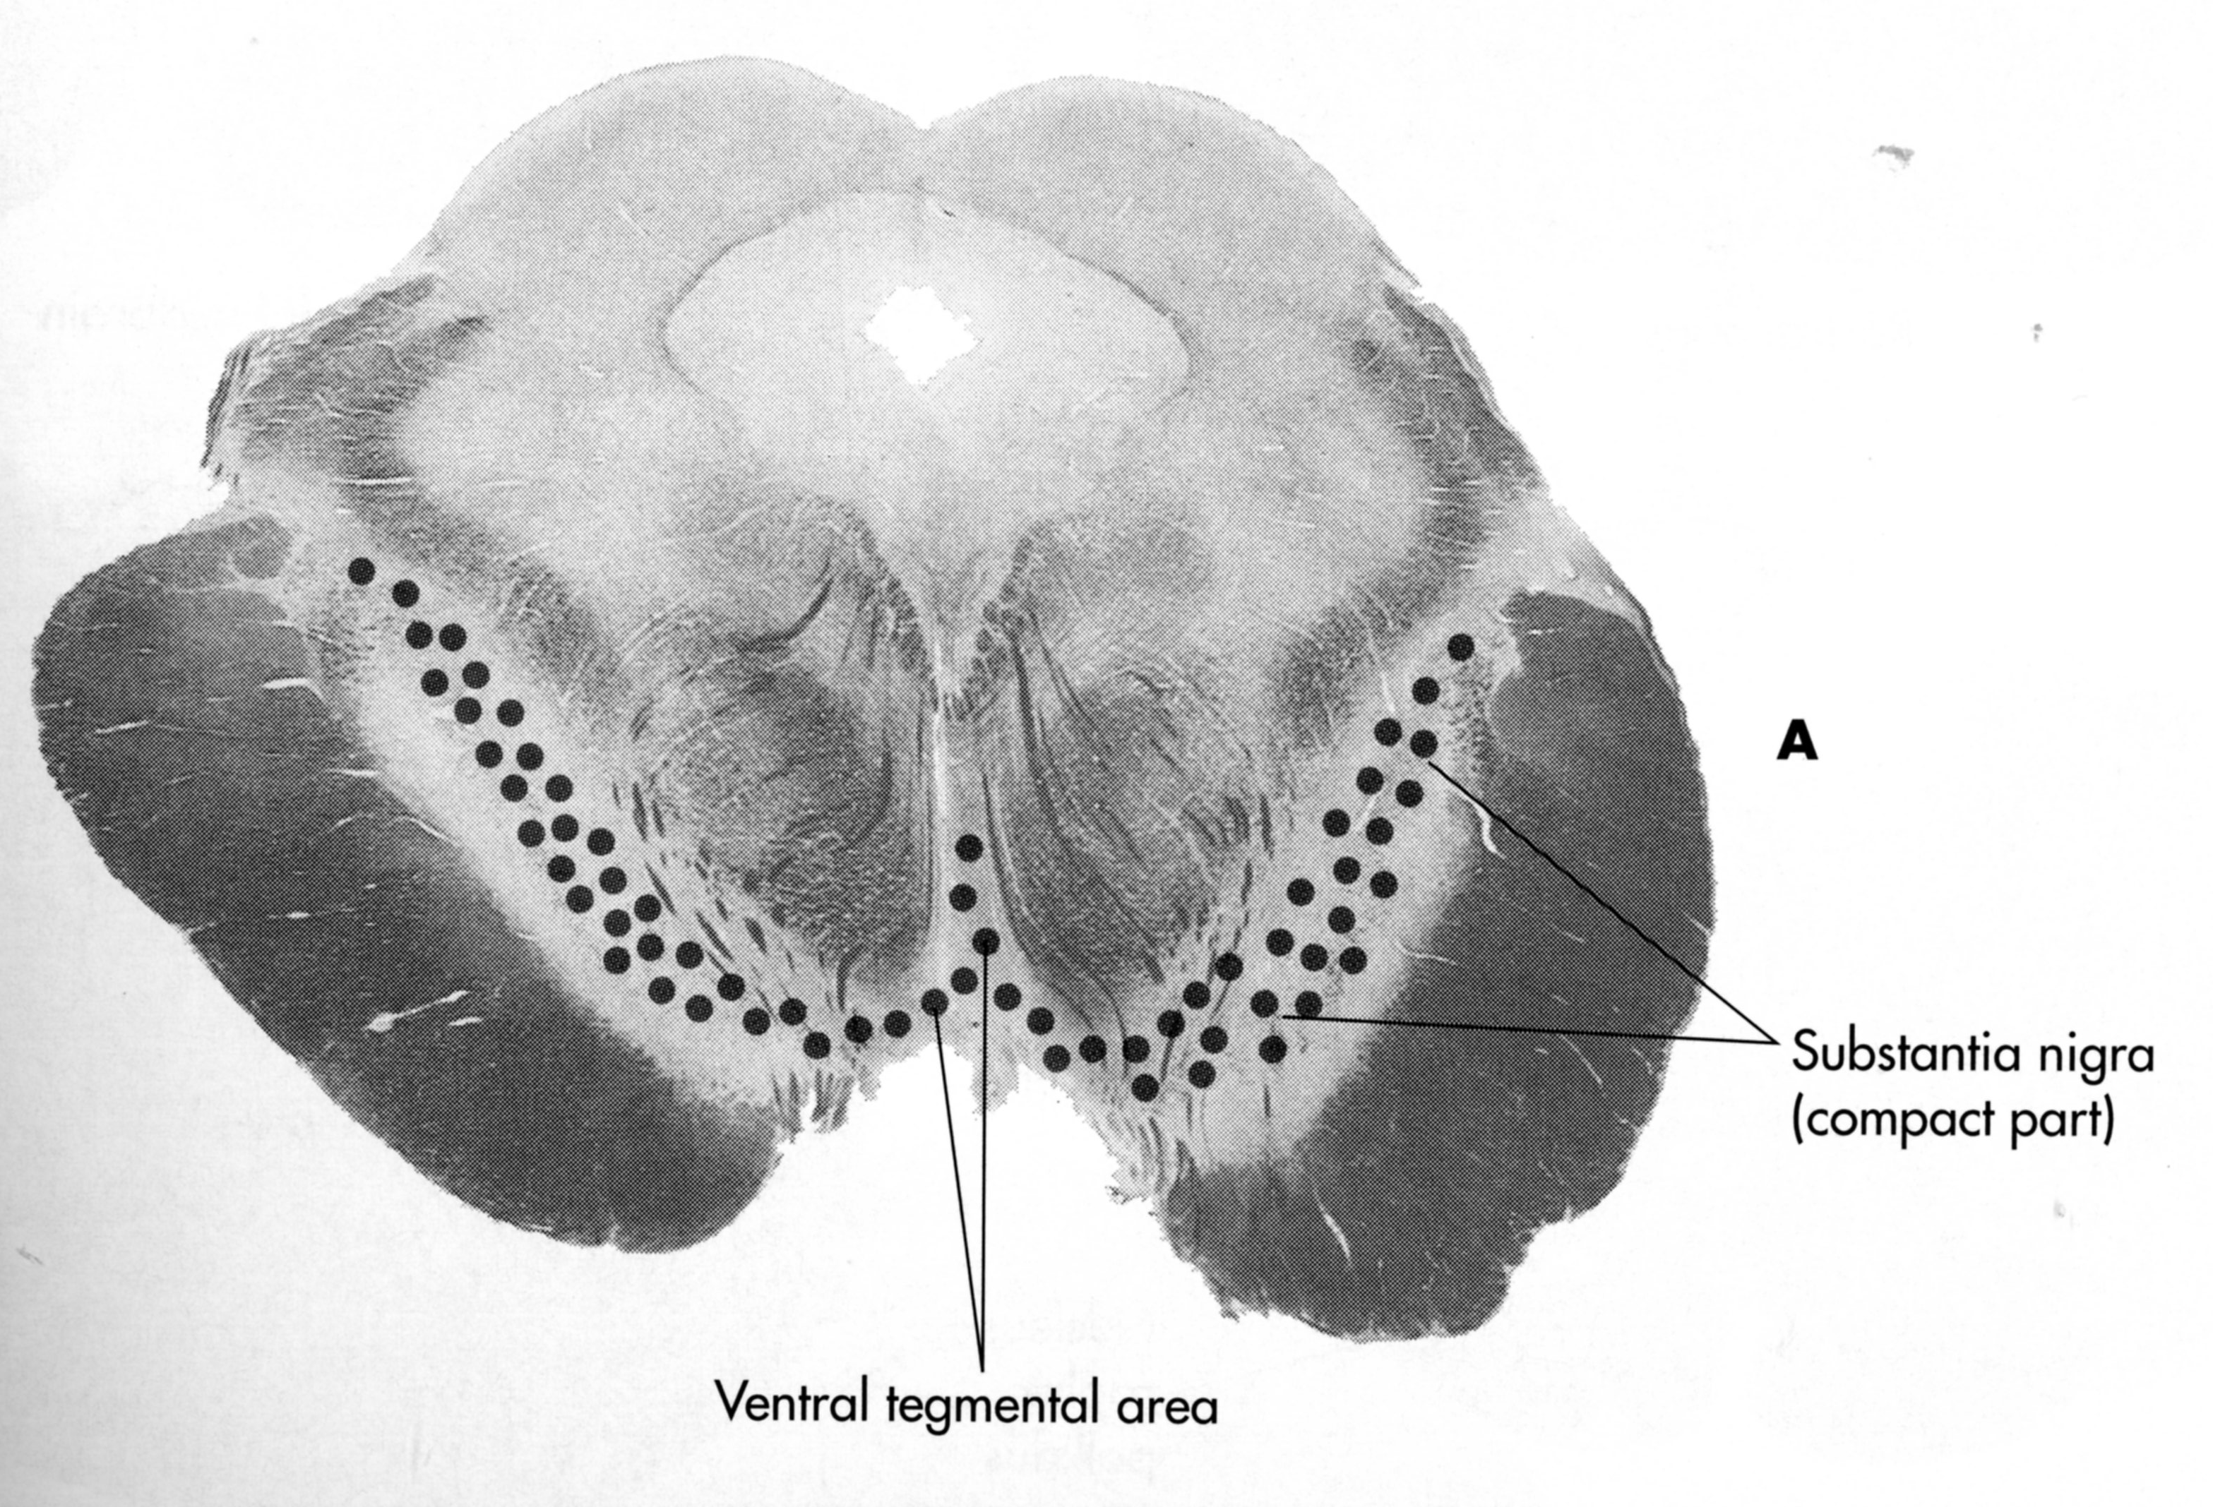
Ventral Tegmental Area

Slide 12
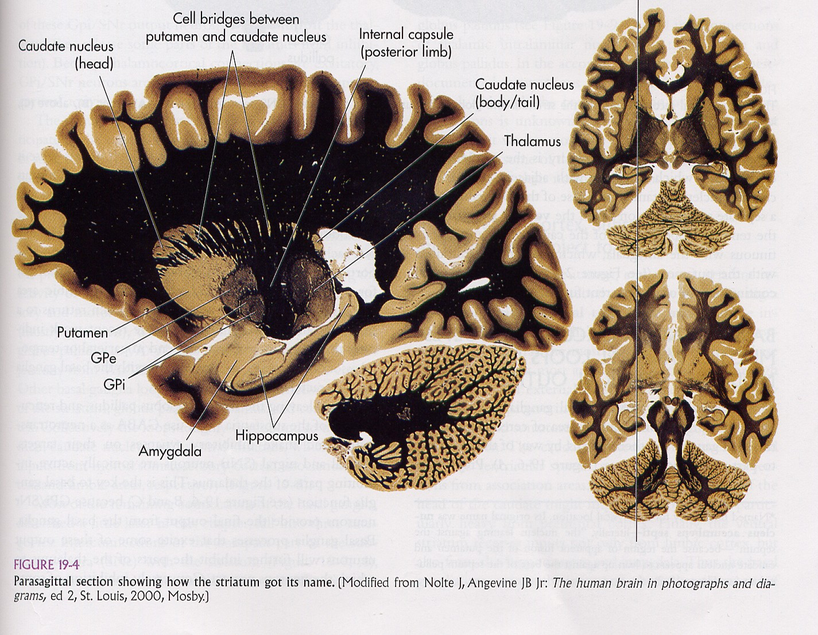
How the striatum got its name…
Notes:
Here is a parasagittal section showing how the striatum got its name
This slice shows the stripes nicely

Slide 13
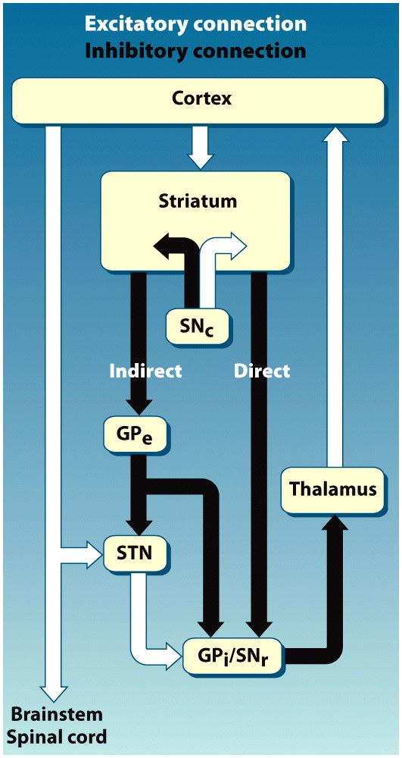
Notes:
Basal Ganglia connections are characterized by LOOPS
Figure 7.40 Wiring of the basal ganglia. White links indicate excitatory projections, and black links indicate inhibitory projections. Inputs from the cortex project primarily to the striatum. From here, processing flows along two pathways
All of the striatal neurons use GABA and form inhibitory synapses.
.The direct pathway goes to the output nuclei: the internal segment of the globus pallidus (GP_{i}) and the pars reticularis of the substantia nigra (SN_{r}). The indirect pathway includes a circuit through the external segment of the globus pallidus (GP_{e}) and the subthalamic nucleus (STN), and then to the output nuclei. The output projections to the thalamus are relayed to the cortex, frequently terminating close to the initial source of input. The dopaminergic projections of the pars compacta of the substantia nigra (SN_{c}) modulate striatal activity by facilitating the direct pathway via the D₁ receptors and inhibiting the indirect pathway via the D₂ receptors.
Concept of tonic activity: GP and SNr neurons are tonically activity, inhibiting the thalamus and preventing it from exciting the cortex

Slide 14
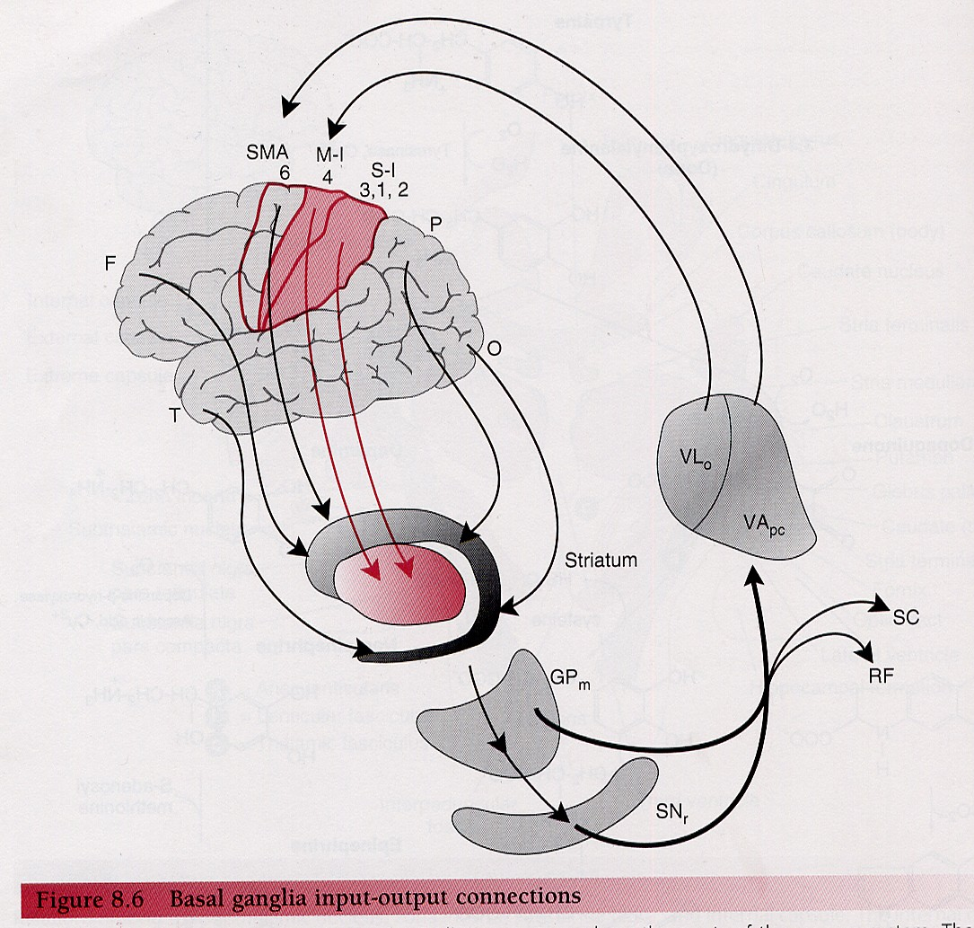
Basal ganglia have motor and nonmotor functions
Notes:
It is considered by many to be a motor structure, but the basal ganglia also have non-motor functions
Putamen—gets input mainly from M1/S1—more motor; stimulation of the putamen causes discrete movements
But Caudate gets input from whole brain in a topographic manner
Frontal lobe goes to head of caudate
Occipital lobe to body and tail of caudate
Temporal lobe to extreme tail
From Kingsley RE (2000) Concise Text of Neuroscience, 2nd Ed.

Slide 15
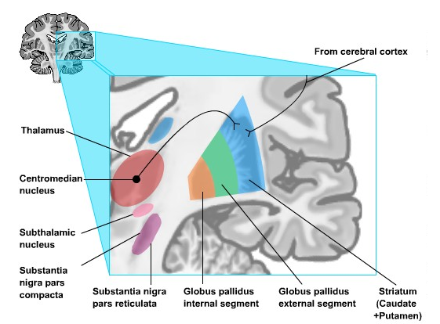
Basal Ganglia Afferents
Notes:
To understand what the basal ganglia is doing, we need to understand the circuitry—what is the anatomy
Caudate + Putamen are the input zones
In most species they are just one nucleus called the striatum, but in primates they have been split apart by the internal capsule
Excitatory inputs from thalamus and cortex
[[ERROR IN DIAGRAM IN HANDOUT—may show inhibitory instead of excitatory]]

Slide 16
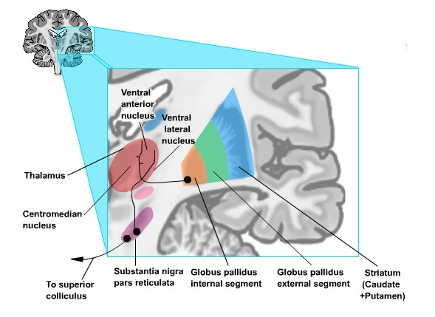
Basal Ganglia Efferents
Notes:
Gpi sends output to the thalamus, especially the Ventral anterior, ventral lateral nuclei
SNpr sends output to the thalamus and SC; this is essential for eye movements, which Dr. Dragoi will discuss in the next set of lectures
Very important for clinical diagnosis

Slide 17
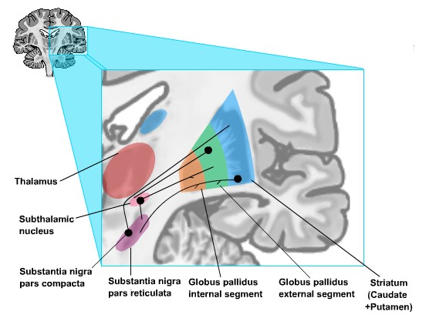
Basal Ganglia Intrinsic Connections
Notes:
There are lots of intrinisic connections within the basal ganglia
Go through each one
Most of these connections are INHIBITORY
Except for STN
This can make things confusing—like a double negative on an exam question!

Slide 18
Functions
Direct Pathway: select appropriate movements
Indirect Pathway: inhibit inappropriate movements

Slide 19
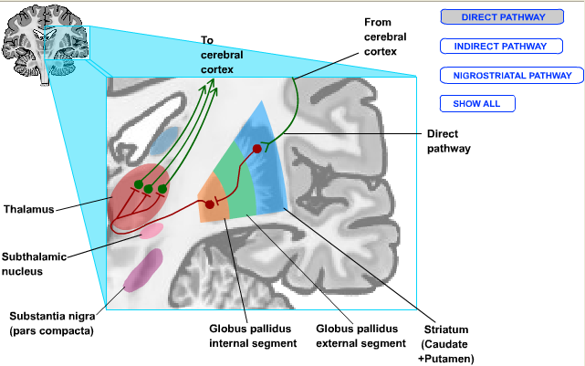
Direct Pathway
Direct Pathway excites motor cortex
E I I
Cortex → striatum → GPint → thalamus
+1 x –1 x –1 = +1
Notes:
Feedback loop from the cortex back to the cortex (trace through each synapse)
Glutamate, GABA
What actually happens?
Work backwards…
To explain what happens
This is called “Disinhibition”
Net effect—excitation

Slide 20
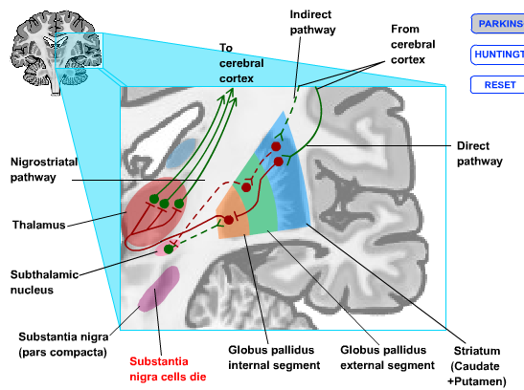
Direct and Indirect Pathways
Notes:
How does the indirect pathway work?
Go through each synapse
Net effect is to inhibit motor cortex
These parallel pathways with opposing effects is they key to understanding why some BG problems cause too much movement (Huntington’s) or too little (PD)
Study this again in PNL

Slide 21
Direct and Indirect Pathways
Direct Pathway excites motor cortex
Indirect Pathway inhibits motor cortex
Indirect Pathway
E I I E I
Cortex → striatum → GPext → Subthalamic Nucleus → GPint → thalamus
+1 x –1 x –1 x +1 x –1 = –1
Notes:
The fact that there is two pathways is the key to understanding why these extrapyramidal disorders can cause two kinds of problems”
Too much movement (Huntington’s disease)
Too little movements (Parkinson’s Disease)

Slide 22
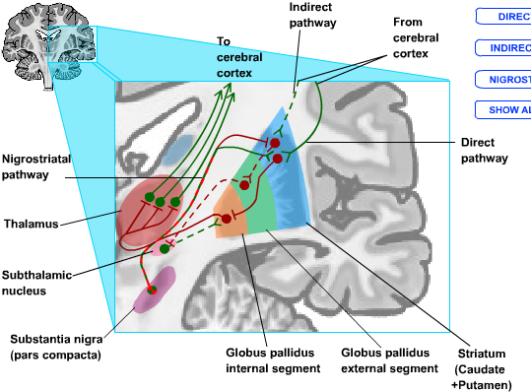
Dopaminergic Input from Substantia Nigra
Nigrostriatal pathway excites motor cortex by
(1) exciting Direct Pathway
(2) inhibiting Indirect Pathway
Notes:
In PD disease, the cells that die are in SNpc
This pathway has both effects
It is dopamine
D1 dopamine receptor are EXCITATORY so it excites the direct pathway
D2 dopamine receptors are INHIBITORY so it inhibits the indirect pathway
So net effect is to excite the motor pathways in two ways
So, the proper functioning of the BG depends on an exquisite balance between these two pathways
If you get too much excitation, you get problems
If you get too much inhibition, you get problems
[[think of computer laptops, if one key did exciting another did inhibitory]

Slide 23
Functions of Basal Ganglia
Enable automatic performance of practiced motor acts
Gating the initiation of voluntary movements by modulating motor programs stored in the motor cortex
Cognitive functions
Notes:
Let’s try to use this knowledge of the circuitry to understand what the BG does
Enables -- doesn’t start the movement, but somehow in ways that are not completely understood, it allows automatic execution
Gating— initiation comes from motor cortex
We don’t really understand exactly how this works—many scientists are working hard to figure out how this part of the brain works.

Slide 24
Action Zones
Aflalo & Graziano,
Neuron, 2007

Slide 25

Notes:
Figure 7.34 Response selection involves a competitive process between potential responses. The writer wishes to take a swig from his coffee cup. He can achieve this goal by reaching with the left or right hand, either from his current position or by rotating his trunk. Various sources of information—the location of the cup, the current activity of the hands, experience—help resolve the competition.

Slide 26
Notes:
Figure 7.41 The basal ganglia play a critical role in movement initiation.
Inihibit motor program that you don’t want
Activate motor programs that you do want
Potential responses are held in check until the basal ganglia provide a triggering response.

Slide 27
Notes:
Figure 7.40 Wiring of the basal ganglia. White links indicate excitatory projections, and black links indicate inhibitory projections. Inputs from the cortex project primarily to the striatum. From here, processing flows along two pathways. The direct pathway goes to the output nuclei: the internal segment of the globus pallidus (GP_{i}) and the pars reticularis of the substantia nigra (SN_{r}). The indirect pathway includes a circuit through the external segment of the globus pallidus (GP_{e}) and the subthalamic nucleus (STN), and then to the output nuclei. The output projections to the thalamus are relayed to the cortex, frequently terminating close to the initial source of input. The dopaminergic projections of the pars compacta of the substantia nigra (SN_{c}) modulate striatal activity by facilitating the direct pathway via the D₁ receptors and inhibiting the indirect pathway via the D₂ receptors.

Slide 28
Functions of Basal Ganglia
Enable automatic performance of practiced motor acts
Gating the initiation of voluntary movements by modulating motor programs stored in the motor cortex
Cognitive functions
Notes:
Let’s try to use this knowledge of the circuitry to understand what the BG does
Enables -- doesn’t start the movement, but somehow in ways that are not completely understood, it allows automatic execution
Gating— initiation comes from motor cortex
We don’t really understand exactly how this works—many scientists are working hard to figure out how this part of the brain works.

Slide 29
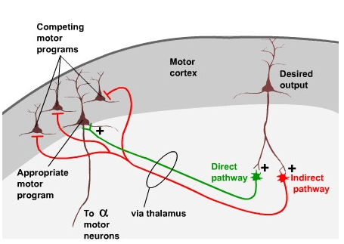
Role of the basal ganglia in exciting one motor program via direct pathway and inhibiting competing programs via indirect pathway
Notes:
We may have conflicting motor programs
We eat food, defend yourself
Or
Softball hit at your head—stand up vs. hit the deck
Excites the appropriate motor pathway
Inhibits the other motor pathway
How does the BG now which is which?

Slide 30
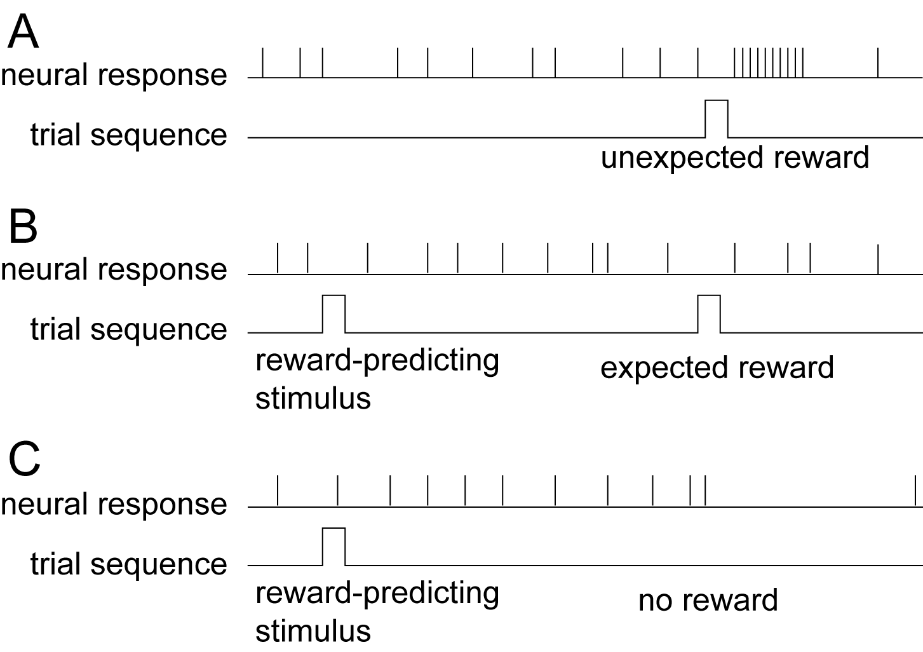
Dopamine neurons of substantia nigra signal unexpected reward or unexpected absence of reward
Notes:
This is where the dopamine neurons in the SN come in.
Has to be linked to REWARD.
Monkey has a lever and a tube that squirts juice in his mouth.
(This is actually VTA, but functionally it is the same as the SN)
Over time, the monkey learns that every time he presses the lever (when the right stimulus comes on)
The monkey gets his reward
If the dopamine cells were just interested in reward, they should fire in (B) but they don’t
Because you have learned the association
What about in C—expects reward, doesn’t get it,
Monkey gets mad—where’s my reward.
Dopamine cells stop firing
Something went wrong, maybe I need to change my behavior

Slide 31
Dopaminergic Input from Substantia Nigra
Notes:
That’s that this SN pathway is good for
Helps to set up the synapses
That behavior produced a good outcome, I need to do it more
Change circuitry of direct pathway to make the behavior better
Turn down other behaviors
OR the reverse if there is no expected reward
Change behavior to make it better for the animal.
Obviously very important for addicition.
Drugs of abuse hijack this system to make you do “BAD” things
Getting reward signals for things that are not REALLY good for you

Slide 32
Functions of Basal Ganglia
Enable automatic performance of practiced motor acts
Gating the initiation of voluntary movements by modulating motor programs stored in the motor cortex
Cognitive functions
Notes:
Let’s try to use this knowledge of the circuitry to understand what the BG does
Enables -- doesn’t start the movement, but somehow in ways that are not completely understood, it allows automatic execution
Gating— initiation comes from motor cortex
We don’t really understand exactly how this works—many scientists are working hard to figure out how this part of the brain works.

Slide 33
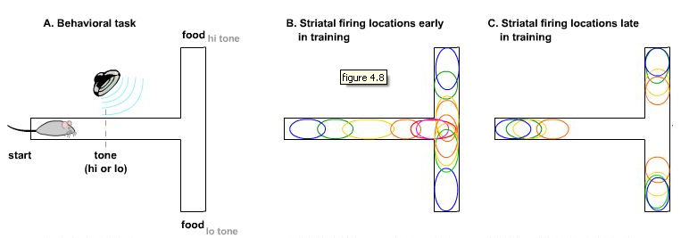
Striatal Neurons and Response/Habit Learning
Jog et al. (1999) Building Neural Representations of Habits. Science 286: 1745-1749.
Notes:
Important for learning of responses/habit
Runs down a maze, hears a high or low tone
Lo tone: turn right, get food
Hi tone: turn left, get food
If the rat does trial and error a few dozen times, it learns what direction to go.
Early on, striatal neurons fire throughout the maze
After the rat has learned the task, the neurons only fire at the beginning of the trial, when you kick off the motor program
Then, at the end, there is an evaluation period—did I get my reward or not
Evaluate it and modify the behavior
Motor/Cognitive learning
Essentially could do it auomatically

Slide 34
Basal Ganglia Damage Impairs Probabilistic Classification Task
60%
15%
40%
85%
75%
30%
25%
70%
Notes:
This is true in humans do.
Weather prediction—”Probabilistic classification”
Each symbol has a different probability
Just like a real cloud—might rain, might not
Confusing and frustrating task, but this is like the real world
People may think they are just guessing, but they learn it
Unconscious learning
Basal ganglia damage impairs your ability to learn this task

Slide 35
Disorders of Basal Ganglia
1. Huntington’s Disease
2. Parkinson’s Disease
Notes:
Disorders of the basal ganglia—as a warmup to Mancias clinical correates on Wednesday

Slide 36
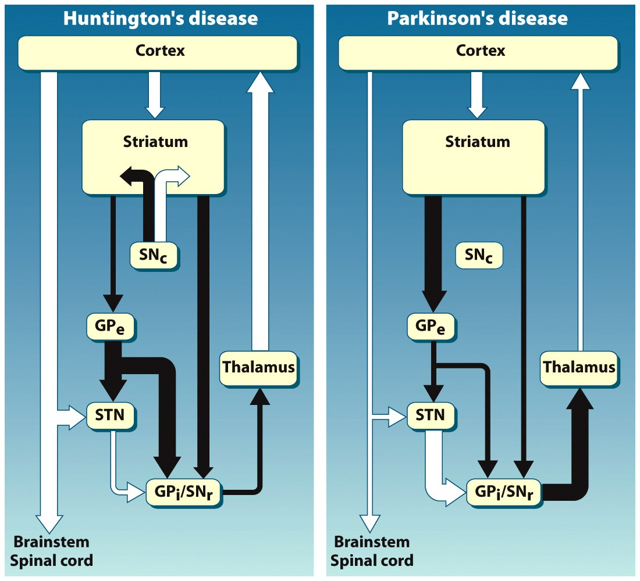
Notes:
Figure 7.42 Differential neurochemical alterations in Huntington’s and Parkinson’s diseases. As in Figure 7.40, white links indicate excitatory projections, and black links indicate inhibitory projections. (a) In Huntington’s disease, the inhibitory projection along the indirect pathway from the striatum to the external segment of the globus pallidus (GPe) is reduced. The net consequence is reduced inhibitory output from the globus pallidus and thus an increase in cortical excitation and movement. (b) Parkinson’s disease primarily reduces the inhibitory activity along the direct pathway, resulting in increased inhibition from the globus pallidus to the thalamus and thus a reduction in cortical activity and movement.

Slide 37
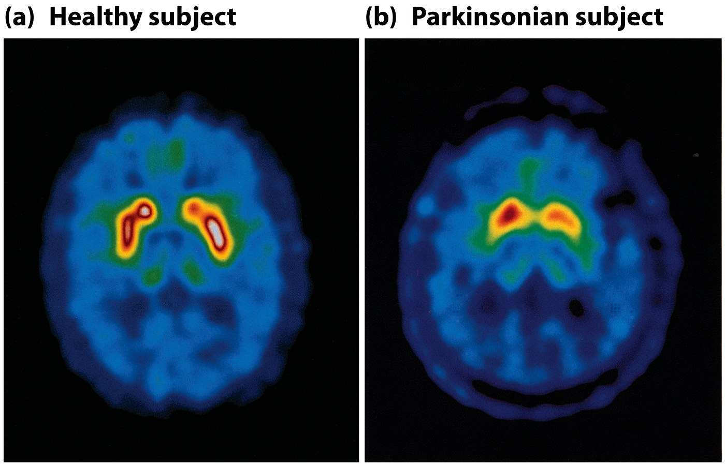
Notes:
Figure 7.43 New neuroimaging techniques are able to label the distribution of specific transmitter systems. This procedure provides an opportunity to visualize reduced dopaminergic activity in patients with Parkinson’s disease. Healthy subjects and Parkinson’s disease patients were injected with a radioactive tracer, fluorodopa. This agent is visible in the striatum, reflecting the dopaminergic projections to this structure from the substantia nigra. Compare the reduced uptake in the scan from a healthy subject (a) to the uptake in a patient’s scan (b).

Slide 38
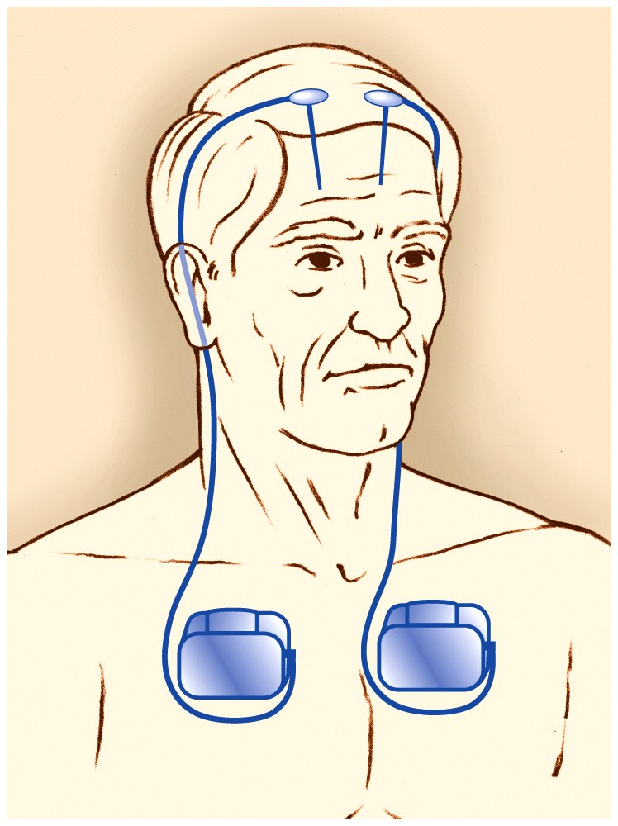
Notes:
Figure 7.45 Deep-brain stimulation for Parkinson’s disease is achieved by the implantation of electrodes in the basal ganglia (most commonly in the subthalamic nuclei bilaterally, or the globus pallidus bilaterally). A pacemaker-like device is connected to the electrodes and implanted sub-cutaneously. The electrodes can then be stimulated by the pacemaker at regular intervals to relieve many of the symptoms of Parkinson’s disease.

Slide 39
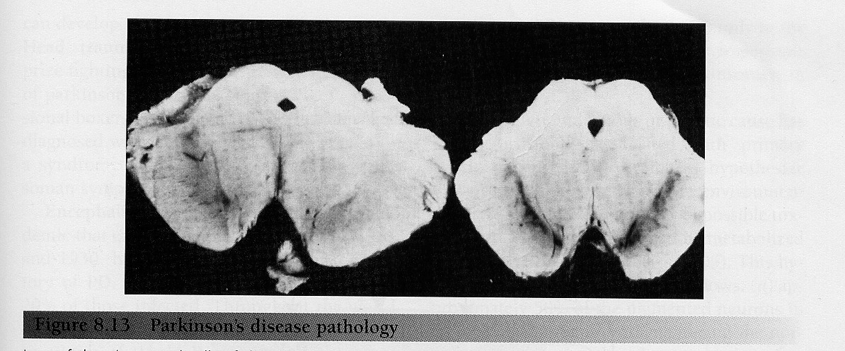
From Kingsley RE (2000) Concise Text of Neuroscience, 2nd Ed.
Notes:
PD disease—cross-section through brainstem
On right, normal subject has lots of black stuff (substantia nigra) between red nuclei and crux cerebri
This is lost on left side
A main symptom is poverty ot movement
(also tremors, but you can live with that)

Slide 40
Parkinson’s Disease
Notes:
Why?
SN neurons have a net effect of exciting the motor cortex (+ direct, - inhibit)
Get rid of them,upset this balance
suppress activity in motor cortex
So you have upset this balance, turn off ability to initiate movements in M1

Slide 41
Parkinson’s Disease

Slide 42
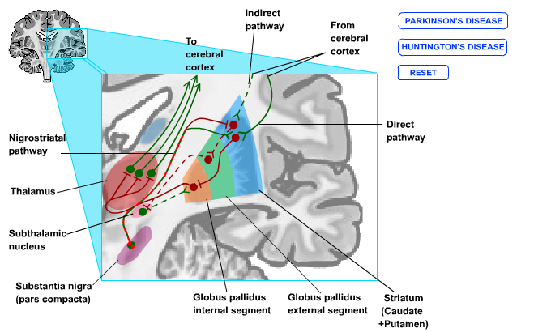
Huntington’s Disease
Notes:
In HD, the indirect pathway cells die
They are no longer inhibiting the motor programs
More excitation in the thalamus
So they are constantly moving, gyrating
Too much movement
[[practice stepping through the synapses]]

Slide 43
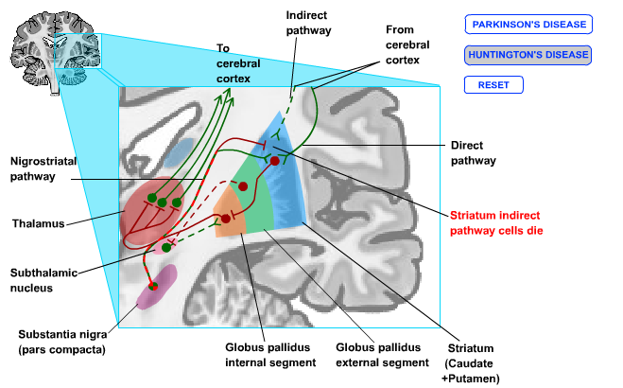
Huntington’s Disease

Slide 44
Notes:
Figure 7.42 Differential neurochemical alterations in Huntington’s and Parkinson’s diseases. As in Figure 7.40, white links indicate excitatory projections, and black links indicate inhibitory projections. (a) In Huntington’s disease, the inhibitory projection along the indirect pathway from the striatum to the external segment of the globus pallidus (GPe) is reduced. The net consequence is reduced inhibitory output from the globus pallidus and thus an increase in cortical excitation and movement. (b) Parkinson’s disease primarily reduces the inhibitory activity along the direct pathway, resulting in increased inhibition from the globus pallidus to the thalamus and thus a reduction in cortical activity and movement.

Slide 45
Notes:
Figure 7.43 New neuroimaging techniques are able to label the distribution of specific transmitter systems. This procedure provides an opportunity to visualize reduced dopaminergic activity in patients with Parkinson’s disease. Healthy subjects and Parkinson’s disease patients were injected with a radioactive tracer, fluorodopa. This agent is visible in the striatum, reflecting the dopaminergic projections to this structure from the substantia nigra. Compare the reduced uptake in the scan from a healthy subject (a) to the uptake in a patient’s scan (b).

Slide 46
Notes:
Figure 7.45 Deep-brain stimulation for Parkinson’s disease is achieved by the implantation of electrodes in the basal ganglia (most commonly in the subthalamic nuclei bilaterally, or the globus pallidus bilaterally). A pacemaker-like device is connected to the electrodes and implanted sub-cutaneously. The electrodes can then be stimulated by the pacemaker at regular intervals to relieve many of the symptoms of Parkinson’s disease.

Slide 47
Hierarchical Organization and Functional Segregation
of Central Motor Structures
Level 4: Association Cortex
Side Loop 1:
Basal Ganglia
(Caudate Nucleus, Putamen, Globus Pallidus, Substantia Nigra, Subthalamic Nucleus)
Level 3: Motor Cortex
Thalamus
(VA,VL,CM)
Level 2: Brain Stem
(Red Nucleus, Reticular Formation, Vestibular Nuclei, Tectum, Pontine Nuclei, Inferior Olive)
Side Loop 2: Cerebellum
Level 1: Spinal Cord
Notes:
Higher-level areas—what do I want to do
Lower level—what muscles have to contract to do the movements
Side loops—separate lectures on each of them
Start with the lower levels

