Slide 1


Motor Systems: Lecture 5
Michael S. Beauchamp, Ph.D.
Assistant Professor
Department of Neurobiology and Anatomy
University of Texas Health Science Center at Houston
Houston, TX
Michael.S.Beauchamp@uth.tmc.edu

Slide 2
Hierarchical Organization Of Motor Structures
Level 4: Association Cortex
Side Loop 1:
Basal Ganglia
(Caudate Nucleus, Putamen, Globus Pallidus, Substantia Nigra, Subthalamic Nucleus)
Level 3: Motor Cortex
Thalamus
(VA,VL,CM)
Level 2: Brain Stem
(Red Nucleus, Reticular Formation, Vestibular Nuclei, Tectum, Pontine Nuclei, Inferior Olive)
Side Loop 2: Cerebellum
Level 1: Spinal Cord
Notes:
We gone through the whole motor loop.
Today we’ll talk about another side loop, the cerebellum
Like the basal ganglia, it influence the motor cortex through projections back to the thalamus. But unlike the basal ganglia, it directly effect motor output and receives sensory input through the spinocerebellar tracts.

Slide 3
Cerebellar Functions
10% of brain volume, > 50% of brain’s neurons
The coordination of movement
Maintenance of balance and posture
Coordinated execution of voluntary movements
Motor learning
Cognitive functions
Notes:
Small volume but contains more than half the neurons in the brain, presumably they’re doing something important.
lots of neurons, what are they doing?
As you’ll see in the clinical correlates Friday morning, it’s very important for maintenance of balance and posture, as you will see in the videos of the patients with cerebellar dysfunction on Friday morning.
It’s also needed for coordination of voluntary movements.
Basically, the cerebellum helps you to learn how to make coordinate movements, and keeps them that way,so that you can execute them.
Like the basal ganglia, it does these same jobs for cognitive functions. We still know much less about those.

Slide 4
Notes:
A quick tour of the anatomy, since you learned it in lab on Monday.
Here is the cerebellum in this ventral view of the brain, here at the back of the brain, it is sort of in a bad neighborhood, as you see in all of those Chiari malformation videos patients that Dr. Mancias shows you, not like the basal ganglia which are safe and secure on the inside of the brain.

Slide 5
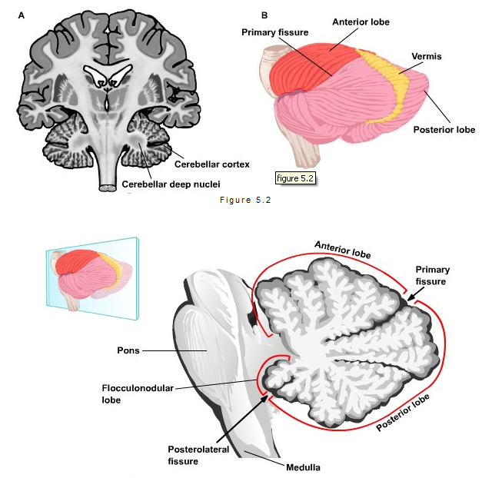
Notes:
In our slice through the whole motor system
The deep nuclei are the output of the cerebellum
And the highly convoluted cerebellar cortex which is what we see from the outside.
We see the anterior lobe and posterior lobe separated by the primary fissure
And the vermis, this midline structure, that’s latin for worm because it looks wormy.
Now if we take a slice through the cerebellum, we can see the primary fissure separating the anterior and posterior lobes and the posterolateral fissure separating the floccolnodular lobe.
If we took the cerebellar cortex and stretched it out, we would see…

Slide 6
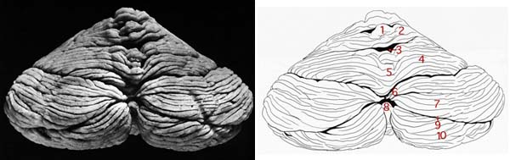
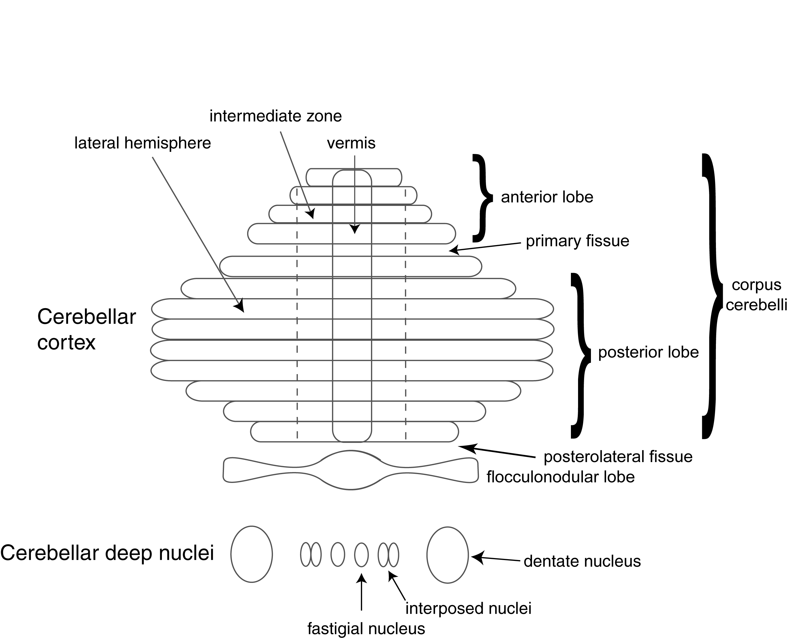
Gross Anatomical Organization of Cerebellum
Notes:
Cortex is convoluted sheet that’s mashed up to fit in the small space.
Just to orient you, here is the anterior lobe of the cerebellum, the posterior lobe.
Once you have this diagram, the cerebellum is divided into three zone.
Most medially, we have the vermis.
Then, we have the intermediate zone.
Finally, we have the lateral zone.
The dashed line indicates that just looking at the cerebellum you can’t see the difference, but the connectivity patterns distinguish the intermediate zone from the other zones
Down here are the deep cerebellar nuclei; The only way information can get out of the cerebellum. The nuclei are the ONLY output, so lesioning them is the same as getting rid of the whole cerebellum.
The cerebellum is bilaterally symmetric, just like the cortex, and this extends the cerebellar deep nuclei.
The largest is the dentate nucleus, one for each cerebellar hemisphere; the interposed nuclei for each hemisphere; and one fastigial nucleus for each half of the cerebellum.
The gives you the cast of characters, now we are going to go through the connectivity.

Slide 7
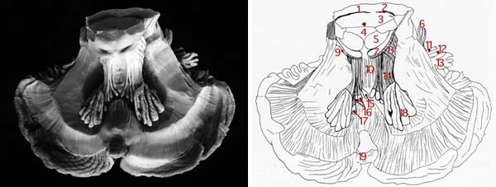
Deep Cerebellar Nuclei
Also
Lateral
Vestibular
Fastigial
Interposed
Dentate
Notes:
Here’s a gross dissection of the cerebellar nuclei: fastigial, interposed and dentate.
As you can see the dentate is much bigger than the other two.
That’s because it gets input from the lateral hemisphere of the cerebellum, the largest parts of the cerebellum.
Because they provide the outputs, we are going to use them as our organizing principle
We use the nuclei as an organizing pattern to understand how the cerebellum works.
Go through them one by one.

Slide 8
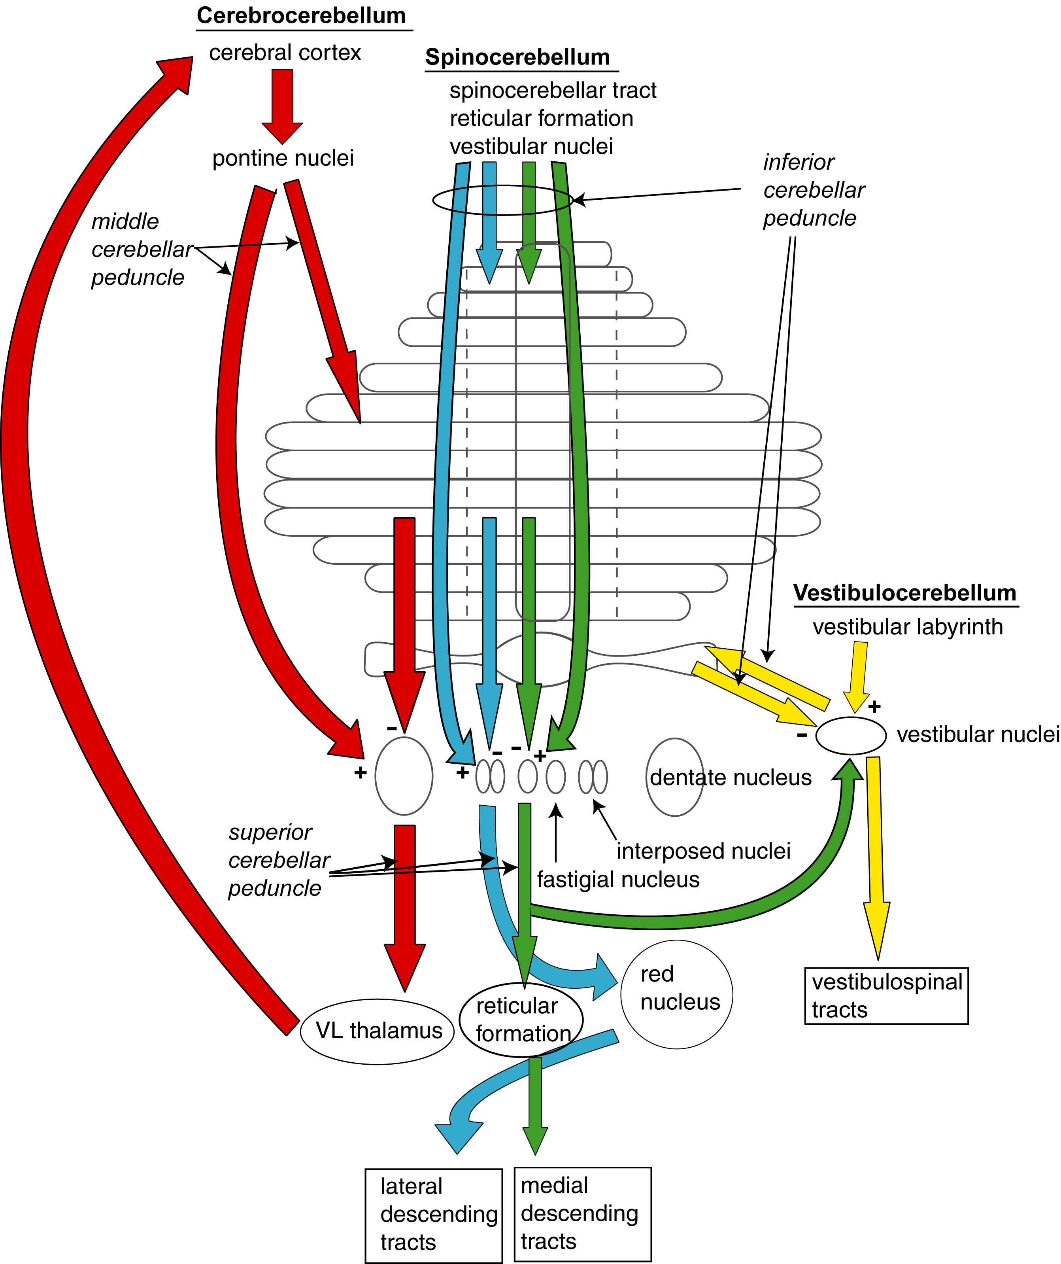
Cerebellar Afferents and Efferents
Notes:
Here is the overall diagram of the connections of the cerebellum, all of the different input output pathways.
It looks complicated at first; in neuroscience online you can go through each pathway individually.
It is less complicated than it looks.
The main thing is to understand the organizing principle.
The different colors all have the same basic pattern, they are just connecting different parts
To each other.
All inputs have a direct excitatory synapse to the deep cerebellar nuclei, and a disynaptic inhibitory pathway through the cerebellar cortex which then inhibits the cerebellar nuclei.
Same pattern of connectivity, just the details of what is connected to what.

Slide 9
Deep Cerebellar Nuclei
Fastigial Nucleus
inhibitory input from cerebellar cortex: vermis
excitatory input: vestibular, proximal somatosensory, auditory, visual
projects to vestibular nuclei, reticular formation
Notes:
We will start by examining them medial to lateral to keep them straight
The fastigial nucleus is the most medial nucleus. It receives inhibitory input from the most medial part of the cerebellar cortex, the vermis on the midline.
Know nuclei and hemispheres from medial to lateral, and you will be able to line them up very easily.
Its excitatory input comes from sensory regions of cortex and the vestibular nuclei and projects back to vestibular nuclei and reticular formation.
(go back one slide)

Slide 10
Cerebellar Afferents and Efferents
Notes:
Its excitatory input comes from sensory regions of cortex and the vestibular nuclei and projects back to vestibular nuclei and reticular formation.
(trace green lines on diagram)
Go over one lateral, we find the interposed nuclei.

Slide 11
Deep Cerebellar Nuclei
Fastigial Nucleus
inhibitory input from cerebellar cortex : vermis
excitatory input: vestibular, proximal somatosensory, auditory, visual
projects to vestibular nuclei, reticular formation
Interposed
inhibitory input from cerebellar cortex : intermediate zone
excitatory input : spinal, proximal somatosensory, auditory, visual
projects to contralateral red nucleus
Notes:
The interposed nuclei excites inhibitory input from the intermediate zone of the cerebellar cortex.
Then it gets excitatory input from spinal cord, also sensory.
Very similar inputs to fastigial pathway.
Projects to contralateral red nucleus.
Vestibular nuclei excites fastigial, inhibits via vermis

Slide 12
Cerebellar Afferents and Efferents
Notes:
Follow blue lines showing connections of the interposed nuclei.
Indirect pathway, two short lines
Direct pathway, one long line
Output blue line projects to contralateral red nucleus.
Of course, red nucleus, has an output that again cross the midline to lateral descending tracts.
Notice this double crossing—
Like all cerebellar processes, it controls the ipsilateral side of the body
(as opposed to cerebral cortex, where right hemisphere controls the left side of the body and vice-versa)
But the cerebellum has ipsilateral organization, the left halff of the cerebellum conrols the left half of the body.
Next, we move to the next nucleus, the most lateral nucleus, the dentate nucleus.

Slide 13
Deep Cerebellar Nuclei
Fastigial Nucleus
inhibitory input from cerebellar cortex : vermis
excitatory input: vestibular, proximal somatosensory, auditory, visual
projects to vestibular nuclei, reticular formation
Interposed
inhibitory input from cerebellar cortex : intermediate zone
excitatory input : spinal, proximal somatosensory, auditory, visual
projects to contralateral red nucleus
Dentate
inhibitory input from cerebellar cortex : lateral hemisphere
excitatory input: cortex via pontine nuclei
projects to contralateral red nucleus, thalamus (VL)
Notes:
The dentate nucleus gets inhibitory input from the lateral hemisphere of the cerebellar cortex. Its excitatory input comes from the cerebral cortex via the pontine nuclei.
The output goes to red nucleus, Ventrolateral nucleus of the thalamus.

Slide 14
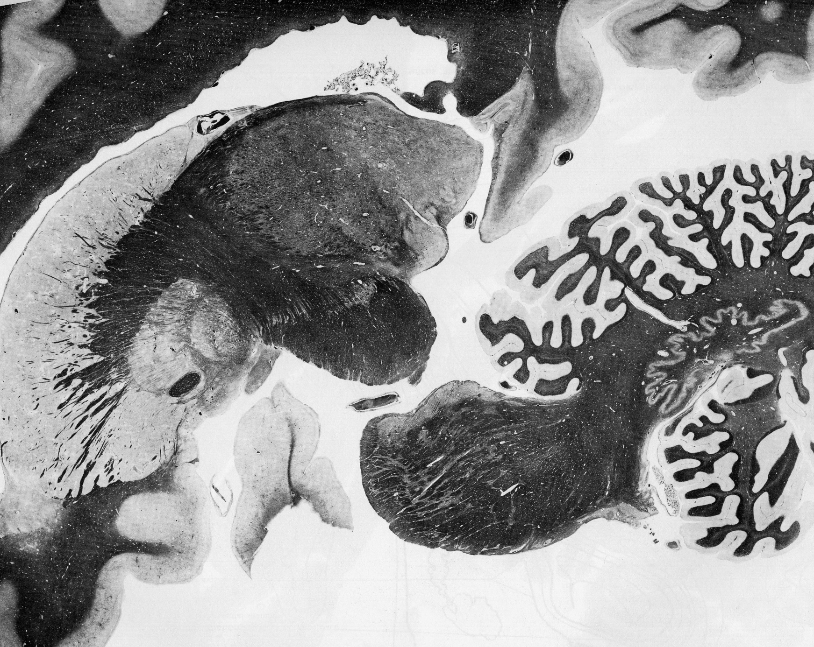
DeArmond Fig. 81
Notes:
Anatomically, here we see the dentate nucleus lying under the cerebellar cortex. It is the only nucleus that we can see in the gross brain specimen.

Slide 15
Cerebellar Afferents and Efferents
Notes:
So the indirect pathway is input from the cerebral cortex to the pontine nuclei (all those cranial nerve nuclei) up into the lateral cerebellar cortex and then down to the dentate nucleus.
The indirect pathway is directly from the pontine nuclei to the dentate nucleus.
The output goes back to the VL thalamus, which then goes back to cortex.
Feedback loop—to VL thalamus and back to cortex
That’s the basic connectivity pattern of these nuclei.
Next, we consider the vestibular nuclei.
Although the vestibular nuclei are not physically present in the cerebellum, they form close connections with the same type of circuitry as these other deep nuclei, so we consider them functionally equivalent to cerebellar nuclei.

Slide 16
Deep Cerebellar Nuclei
Fastigial Nucleus
inhibitory input from cerebellar cortex : vermis
excitatory input: vestibular, proximal somatosensory, auditory, visual
projects to vestibular nuclei, reticular formation
Interposed
inhibitory input from cerebellar cortex : intermediate zone
excitatory input : spinal, proximal somatosensory, auditory, visual
projects to contralateral red nucleus
Dentate
inhibitory input from cerebellar cortex : lateral hemisphere
excitatory input: cortex via pontine nuclei
projects to contralateral red nucleus, thalamus (VL)
Vestibular
inhibitory input from cerebellar cortex : flocculonodular lobe
excitatory input: vestibular labyrinth
projects to motor nuclei
Notes:
Vestibular nuclei are not physically in the cerebellum, but they are connected exactly the same way so we consider them as part of the Cerebellum—one of the deep cerebellar nuclei
Input from flocculo-nodulus

Slide 17
Cerebellar Afferents and Efferents
Notes:
Show connections with yellow lines. Input from vestibular labyrinth.
Send information to flocculo-nodular lobe, which processes the information, sends inhibitory output back to vestibular nuclei, which then passes it down the vestibulospinal tracts.
To summarize, the same pattern of connectivity in each of these output nuclei, with indirect inhibitory pathways and direct excitatory pathways.
Remember the medial to lateral organization.
Anatomically, it is important to understand how these input and output arrive and leave the cerebellum.

Slide 18
Cerebellar Peduncles
Input and output tracts of cerebellum
Inferior Cerebellar Peduncle (restiform body)
Primarily afferent fibers from medulla
Middle Cerebellar Peduncle (brachium pontis)
Primarily afferent fibers from pons
Superior Cerebellar Peduncle (brachium conjunctivum)
Primarily efferent fibers from the cerebellar nuclei
Cerebellum controls the IPSILATERAL side of the body
Notes:
The cerebellar peduncles are the feet that connect the cerebellum to the rest of the brain. These are the input and output tracts of the cerebellum
The inferior cerebellar peduncle get afferent fibers from medulla.
Middle cerebellar peduncle—the big one
All of the input from the pons comes through this peduncle.
Superior—all of the efferent (or output) fibers from the cerebellar deep nuclei
Remember—ipsilateral
Through double-crossing
e.g. even ones that project to contra red nucleus, which then projects contra

Slide 19
Functional Divisions of Cerebellum
Vestibulocerebellum
flocculonodular lobe
lateral vestibular nuclei
oldest part of cerebellum
postural and vestibular reflexes
Spinocerebellum
vermis and intermediate zone
fastigial and interposed nuclei
motor coordination
Cerebrocerebellum
lateral hemispheres
dentate nuclei
planning and timing of movements
Notes:
These anatomical pathways are segregated because they have different functions
For instance, the vestibulocerebellum comprises the flocculonodular lobe and the lateral vestibular nuclei.
This is the Oldest part of the cerebellum—all animals have it.
Inovlved in postural and vestibular reflexes.
Spinocerebellum—midline parts the vermis and the intermediate zone
That’s important for motor coordination.
Finally, the cerebrocerebellum the includes the lateral hemispheres and the dentate nuclei.
Involved in planning and timing of movements
Connections with cerebral cortex, allowing for planning and timing of movements.
Much bigger in us than in other animals, like mice.
We color these in different colors on the next slide

Slide 20
Cerebellar Afferents and Efferents
Notes:
The vesetibulocerellum is the yellow pathway.
The spinocerebellar is the green and blue pathway.
And the cerebrocerebellar pathway is in red.
Inferior cerebellar peduncle—input from medullar
Middle cer ped—input to cerebellar
See why middle cerebellar peduncle is so huge
Because it carries inputs to the largest part of the cerebellum
Outputs through sup cere ped (point).

Slide 21
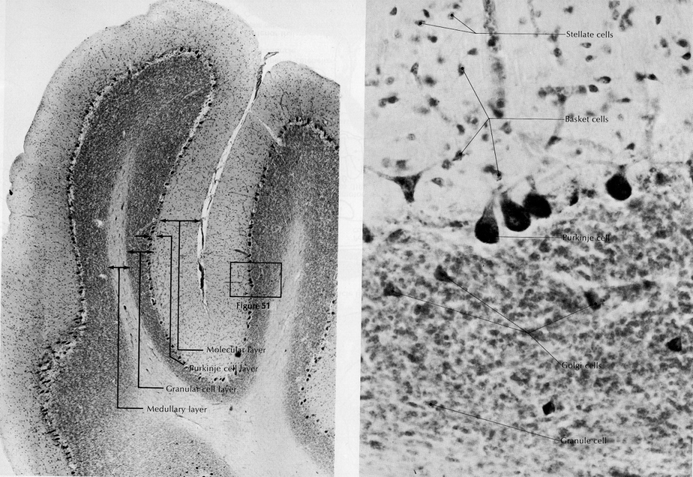
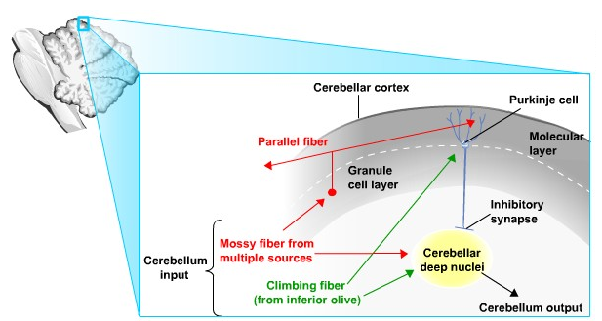
Internal Circuitry of Cerebellum
Notes:
Next, we look at what is the internal circuitry of the cerebellum?
Looks complicated but not that bad—
The same circuit gets repeated over and over again through the whole expanse of the cerebellum.
So if we understand it once, we should be able to figure out the cerebellum
(although we still don’t really understand what it does).
They get inputs from the mossy fibers, excitatory pathway to deep nuclei, then indirect pathway through cerebellar cortex.
Excites granule cell later (point to dark band in cerebellum section).
Very Tiny neurons jam-packed together
Most of the neurons (And the brain!) Are in the granule cell layer
Then these neurons go up to the molecular layer where they split into two and are called parallel fibers.
Point to Purkinje cells—one layer of big cells (point to in section) that separate the granule cell layer from the molecular layer.
Purkinje cells are just one layer of cells that are the sole output of the cerebellar cortex—they make inhibitory synapses onto the deep nuclei
(make distinction—Purkinje cells are output of Cb cortex not whole cerebellum)
Get excitatory direct inputs and inhibitory inputs from Purkinje cells.
The other input that the cerebellum gets are from the inferior olive
These are called climbing fibers.
These climbing fibers climb like vines on a trennis up the branches of the Purkinje cell
They make many many synapses. Very powerful set of synapses
Whenever the climbing fibers fire, they always make the Purkinje cell fire
But each climbing fiber only touches a few (about 10) Purkinje cells
As opposed to the mossy fibers, which travel a few mm (relatively a long way) touching thousands of Purkinje cells
So an individual mossy fiber can contact dozens of granule cells which contact thousands of Purkinje cells—a lot
Whereas climbing fibers is just a few.
This is the basic internal circuitry of the cerebellum. This is the wiring diagram of the cerebellum.
How does this circuit work?

Slide 22
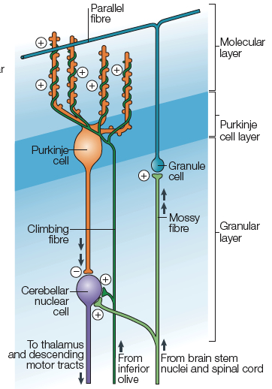

Slide 23
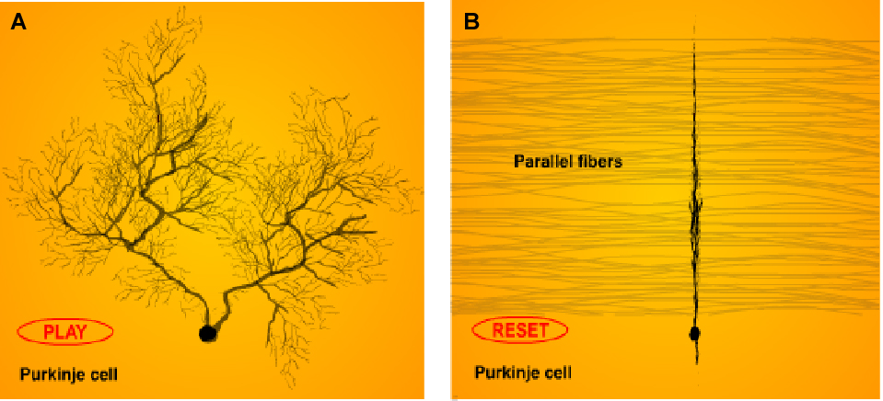
Notes:
The Purkinje cell is an interesting and unusual cell type.
It has a very elaborate dendritic arbor.
But if we rotate it, we can see that it is basically flat—a 2-D cell
The parallel fibers are orthogonal to the Purkinje cells
Purkinje cell like a telephone pole
The parallel fibers travel along them like the telephone wires
A very unique organizational feature.
The role of the granule cells is to integrate information from many sources (the mossy fiber) and then give that information to many Purkinje cells.
The Purkinje cells can get information from many cells to do the calculation

Slide 24
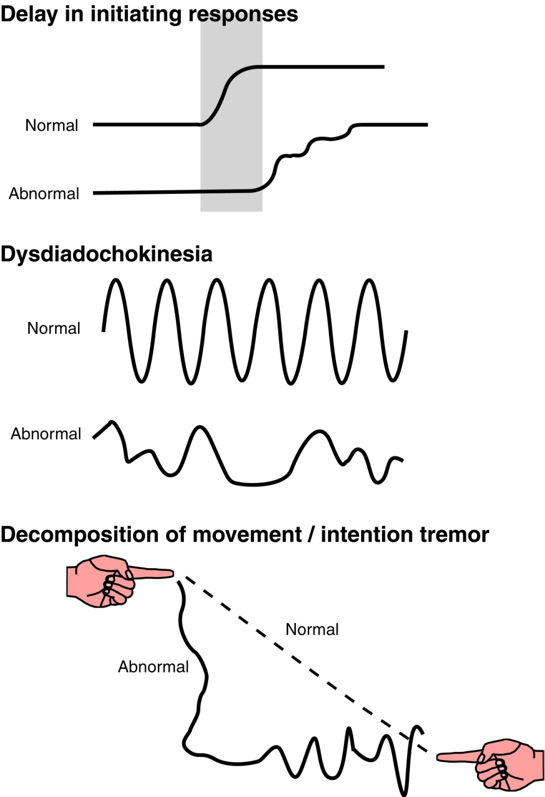
Cerebellum Produces Movement Disorders
Notes:
How does the cerebellum work. We don’t really know, but the first place to start is to ask, what happens when we disrupt the Cerebellum. Well, it produces movement disorders.
What do these look like?
Here are the symptoms,
Imagine the task is to turn on a light on a button and then touch it.
In the normal subject, the light turns on, very quickly you start moving your hand and then you reach the target. In a patient, it takes longer to start the movement, and the movement is not smooth, it has a few steps in it.
This is true regardless of the movement modality—e.g. imaging just move your eyes to the button that lights up you see the same pattern in eye movements.
Dysdiadochokinesia
Imaging you have to make rapid pronation-supination of the hand
Very easy to make rapid back and forth movements
Very hard for a cerebellar patient to do this, make coordinated movements
Coordination
A normal person makes a coordinated movement e.g. when reaching for a cup, move all joints
Cb patient decomposes that movement into the component parts, shoulder, elbow wrist must individual move different joints instead of making one fluid movement.
We also have an intention tremor.
When reaching the cup, hand starts out moving, then when it gets close to the cup the hand starts to wave back and forth
This is different than the Parkinsonian tremor. The PD tremor is at rest—resting tremor that goes away during voluntary movements
While the Cb intention tremor is the opposite—no tremor at rest, only during voluntary movement

Slide 25
Cerebellum and Motor Learning
Vestibulo-ocular reflex
Coordination of movements
Pavlovian Classical Conditioning
Notes:
Why do you get this broad set of symptoms?
What is the Cb good for?
Motor learning seems to be the key to understanding the Cb.
To help understand this, we will go through 3 phenomena.
Vestibulo-ocular reflex
As you are moving around the world, need to move eyes to compensate
Need to learn this—e.g. every time you get a new glasses prescription
Vestibular system detects head movements, moves eyes in exactly the opposite direction so that your image of the world doesn’t jump around.
You need to learn this—e.g. if you have glasses and get a new prescription you feel a little dizzy at first because your eyes are not compensating properly. Over a couple hours, you learn the new
e.g. if you have a strong prescription, try looking through bottom of your glasses and move your head
Your eyes are compensated for the prescription, but down here you don’t have it.
Image will slip on your retina, look weird
You can be even more dramatic—put prisms on the glasses
e.g. make the dartboard 10 degrees to the left.
A normal person can completely flip their eye movements, but with cerebellar nucleus you can’t do it
Coordination of movements? Another important function of the cerebellum.
Have to learn to make them
Why are babies uncoordinates? Their Cb have not yet been programmed.
But as your body changes, you are constantly learning adjustments.
Even to walk have to learn new ways as you get bigger/fatter/sprain your ankle

Slide 26
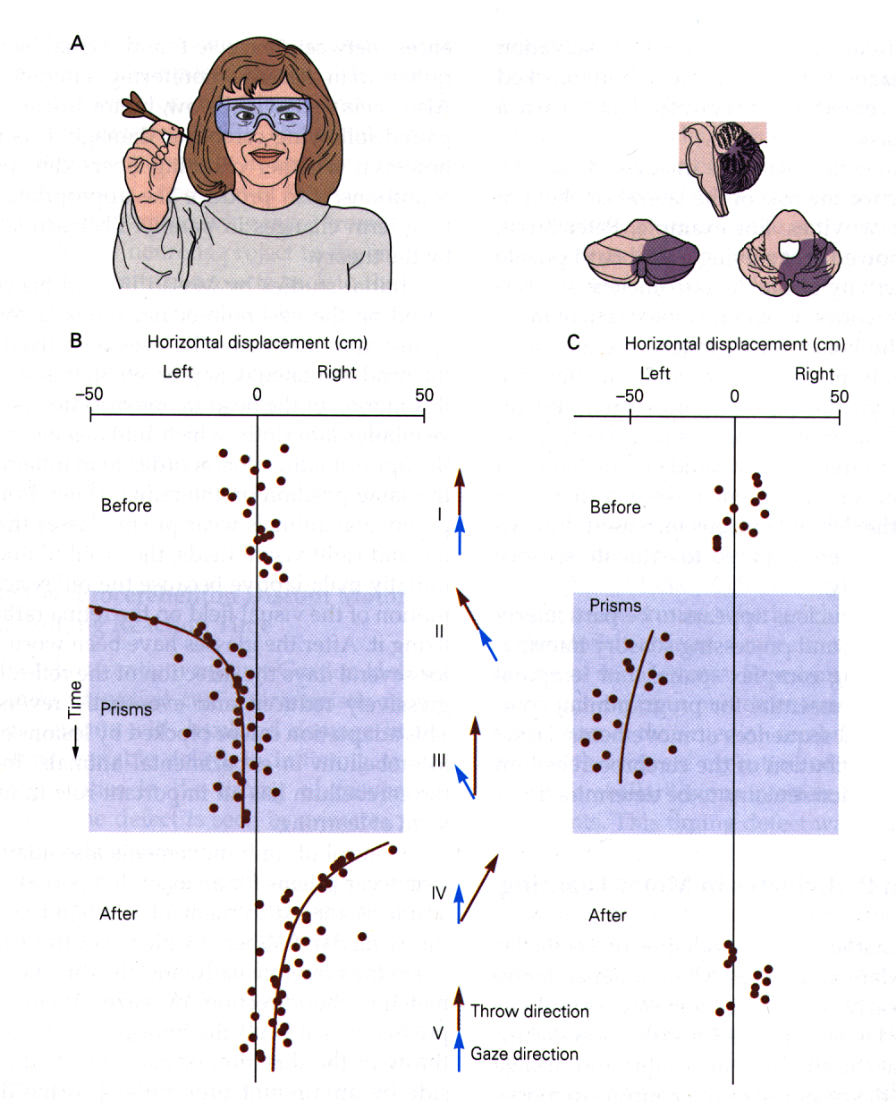
The Cerebellum and Motor Learning
Notes:
Classic example
Association between sensory visual information and motor information needed to throw a dart.

Slide 27
Notes:
Here is what happens in a normal subject
Throwing darts, get them right
(top few point)
Put on shifting goggles
Miss by a lot
But then person gets better and better
Then take the goggles of, they have been trained to throw to the right.
So it takes them a while to learn the other direction.
So there is learning, and then re-learning to throw accurately.
Not conscious.
[if it was just conscious, you could know right away]

Slide 28
Notes:
Patient with Cb lesion
Never get better after put goggles on
And don’t need to relearn after to take goggles off.
Note that the motor program isn’t stored in the Cb—can still throw the dart
Just can’t change the motor program flexibly.

Slide 29
Cerebellum and Motor Learning
Vestibulo-ocular reflex
Coordination of movements
Pavlovian Classical Conditioning
Notes:
So the cerebellum is really important for creating coordinated movements.
Another important experimental paradigm is Pavlovian classical conditioning.
So Pavlov has his dogs, and like all dogs they love meat.
If you hold a big steak in front of your dog what does he do, he start slobbering
(some dogs slobber all the time, but those dogs slobber even more when you give them a steak).
Now every time before you give them a steak, you ring a bell.
What happens after a few trials of this?
Everytime you ring the bell, the dog (or your boyfriend in the beer commercial) starts slobbering.
Many parts of the cerebellum are involved with classical conditions. You don’t have to use food, because it’s harder to repeat over and over, so the paradigm that’s used most is eyeblink conditioning in rabbits.

Slide 30
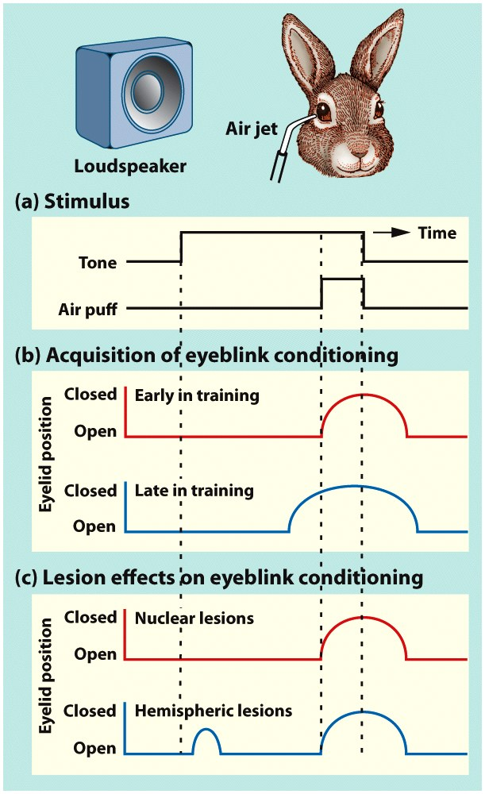
Notes:
Lesions of the cerebellum disrupt the learned response in eyeblink conditioning. (a) A neutral tone precedes and coterminates with an aversive air puff to the eye. (b) Early in training, the air puff causes the animal to blink. Late in training, after a hundred trials, the animal blinks in response to the tone, thus reducing the impact of the air puff. (c) Lesions of the deep cerebellar nuclei abolish the learned response. The fact that the animal continues to blink reflexively in response to the air puff indicates that the lesion has produced a learning deficit and not a motor deficit. The anticipatory, learned responses are still present following lesions of the cerebellar cortex. However, they are timed inappropriately and thus are no longer adaptive.

Slide 31
Cerebellum as a Control System
Feedback Controller for Slow movements (e.g., posture)
Feedforward Controller for Fast movements (e.g., most voluntary movements)
Notes:
What does this have to do with deficits?
The relationship between motor learning and the problems you have with cerebellar damage.
We need to talk a little about engineering, or control theory
There are two kinds of controllers.
Feedback controller for slow movements
These are good for slow movements, like posture.
For instance, the stretch reflex
Someone puts a heavy weight on the waiter’s tray
Muscle spindle stretches, feedback tells muscles to contract to keep tray up
This is a feedback loop
Feedforward is what you need for fast movements
Because no time for feedback
They are only good for slow movements, but most of our movements are fast movements.

Slide 32
Feedback control system
COMPARATOR
+
DESIRED
OUTPUT
Error signal
EFFECTOR
OUTPUT
–
Feedback signal
SENSOR
Notes:
Desired output
Effector (in the body, is the muscle)
The sensor tells you where your muscle is, use that to modulate the output
Comparator just looks for a match between what is happening and what I want to happened.
If sensory says what I want to happen is not happening, that creates an error signal which adjusts the control of the effector
e.g. in tray example
Sensor is proprioceptive muscle spindles
Sends out error signal to control muscles
Only works as well as how fast sensor system works
So in our example of the stretch reflex, the sensor is the muscle spindle which sends an error signal back to the comparator in the spinal cord, adjust that my contracting the muscle.
Works only as well as fast as the sensor can sense the signal and send it back to the comparator.

Slide 33
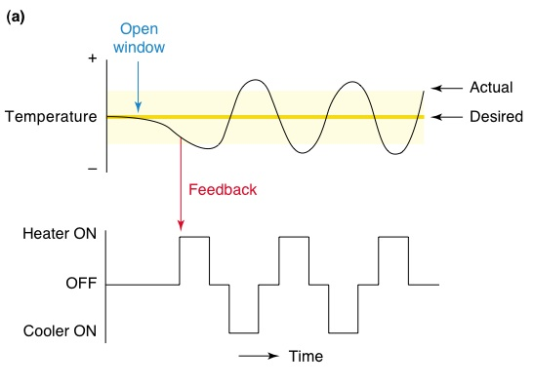
Notes:
Let’s use a temperature in your house analogy.
Imagine if you heating and AC in your house controlled by the thermostat.
Set it to exactly 72, does it stay there?
Now
The slower the thermostat is the bigger these get.
Even if you have a giant air conditioner it doesn’t make it any better.
The limiting factor is the speed of your thermostat.
e.g. thermostat in your house
If instead of checking the temperature in your house every second, it checked every hour
Oscillations between too cold and too hot.

Slide 34
Feedforward control system
DESIRED OUTPUT
ADVANCE
INFORMATION
SENSOR
FEED-FORWARD CONTROLLER
Feed-forward
control signal
EFFECTOR
OUTPUT
Notes:
Doesn’t work for grabbing a cup because feedback is too slow
Because feedback from proprioceptors will take too long to get up to the brain and let you make adjustments.
So we have this other kind of organization, called feedforward.
Cerebellum is involved in a feed-forward system
Take advance information about the world, figure out the best way to make the movement
Key is to take advance information about what you need to do to produce a desired output, then use that to program the movements. You can do that ahead of time, without having to wait for the feedback
e.g. in thermostat example, know that you have to turn on the air conditioner for 5 minutes
But you have to learn that advance information.
Don’t know exactly—have to learn that the way my body is, under these conditions, make these movements.
How does it learn how to use the advance information?

Slide 35
Cerebellum as a feedforward control system
Climbing Fibers (Error signal)
MOTOR CORTEX
Mossy Fibers
ADVANCE
INFORMATION
SENSOR
Mossy Fibers
CEREBELLUM
Feed-forward
control signal
EFFECTOR
OUTPUT
Notes:
Need lots of trial and error learning to figure out how to make movements
This is what the cerebellum does.
Mossy fibers are the sensory advance information and the desired output from motor cortex.
Climbing fiber give very powerful input to Purkinje cells, giving them the error signals.
e.g. have to throw dart this way .
That was bad, try making the movement a different way to make it better.
A feedforward controller doesn’t change it during the movement, change it for the next time.
In the brain, the climbing fibers from the pons provide the error signal
These have to be very strong to show you that you did something wrong
Mossy fibers provide advance information about what you know about the world and what the current state of the body

Slide 36
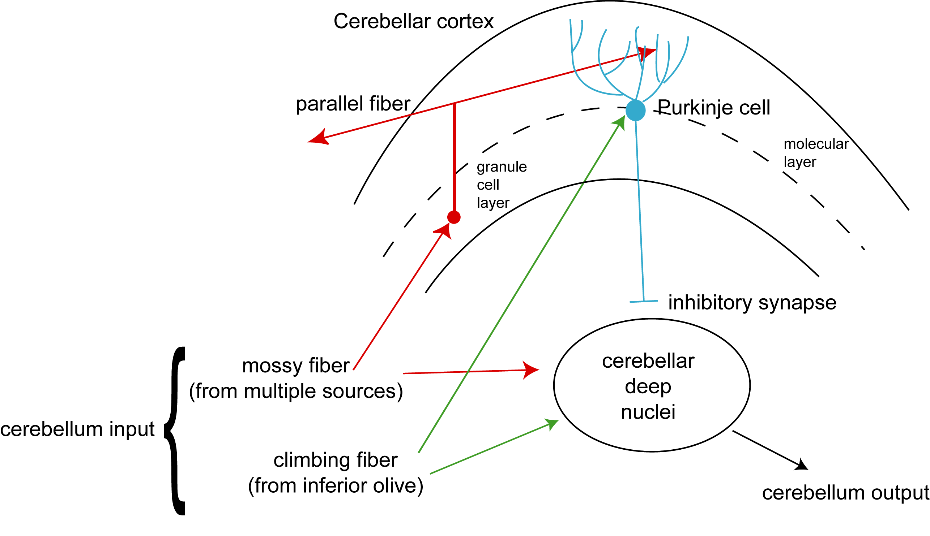
Internal Circuitry of Cerebellum
desired output
advance sensory information
error signal
Notes:
Olive evaluates that movement and creates an error signal—change the synapses to make a different movement.

Slide 37
VOR and feedforward control
vestibular information
about head movement
retinal slip
Notes:
Example about the VOR
The mossy fibers tell you whether you are moving your head from the vestibular system.
Old glasses—climbing fibers are silent
Put on thick glasses, climbing fibres are saying retinal slip, retinal slip
If the image on your retina is moving (retinal slip) climbing fibers say “ERROR!”
Tells Purkinje cell to change connections

Slide 38
Notes:
Why do problems in this feedforward control system cause cerebellar disorders.
Without feedforward controller, movements are awkward and have to manually control it—use feedback which is slow and takes a long time.
No more automated system to automatically program in the movements.
For dysdiadochokinesia
Have to co-ordinate starting and stopping movements, which requires the coordination of many different muscles. can’t happen without Cb
Baby hasn’t learned how to precisely time the movements to make them smooth and coordinated.
Because you can’t you make them one at a time. So you have to make on-line adjustments which are slow.
Intention tremor comes from compensating for them on-line.

Slide 39
Cerebellum as feed forward controller
Cerebellum plays a crucial role in motor coordination by acting as a feedforward controller, allowing the organism to learn through trial and error what exact pattern and sequence of motor commands is necessary to produce rapid, accurate, and effortless movements
Notes:
So, to sum up cerebellum plays a crucial role in motor coordination by acting as a feedforward controller for voluntary movements. It can also play a role in modulating the feedback circuits used for slower things like postural reflexes.

