Slide 1


Prelab Lecture: Lab 9
Michael S. Beauchamp, Ph.D.
Assistant Professor
Department of Neurobiology and Anatomy
University of Texas Health Science Center at Houston
Houston, TX
Michael.S.Beauchamp@uth.tmc.edu

Slide 2
From Motor Cortex

Slide 3
To Spinal Cord

Slide 4
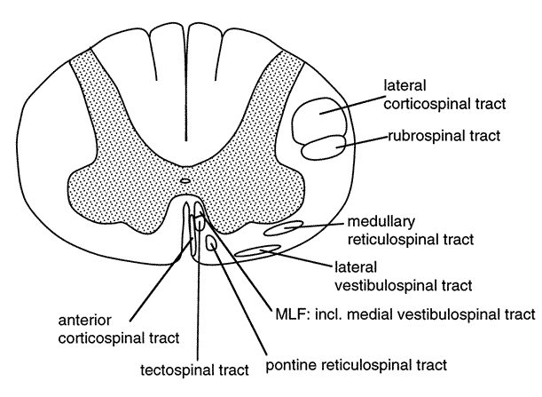
Notes:
To the spine.

Slide 5
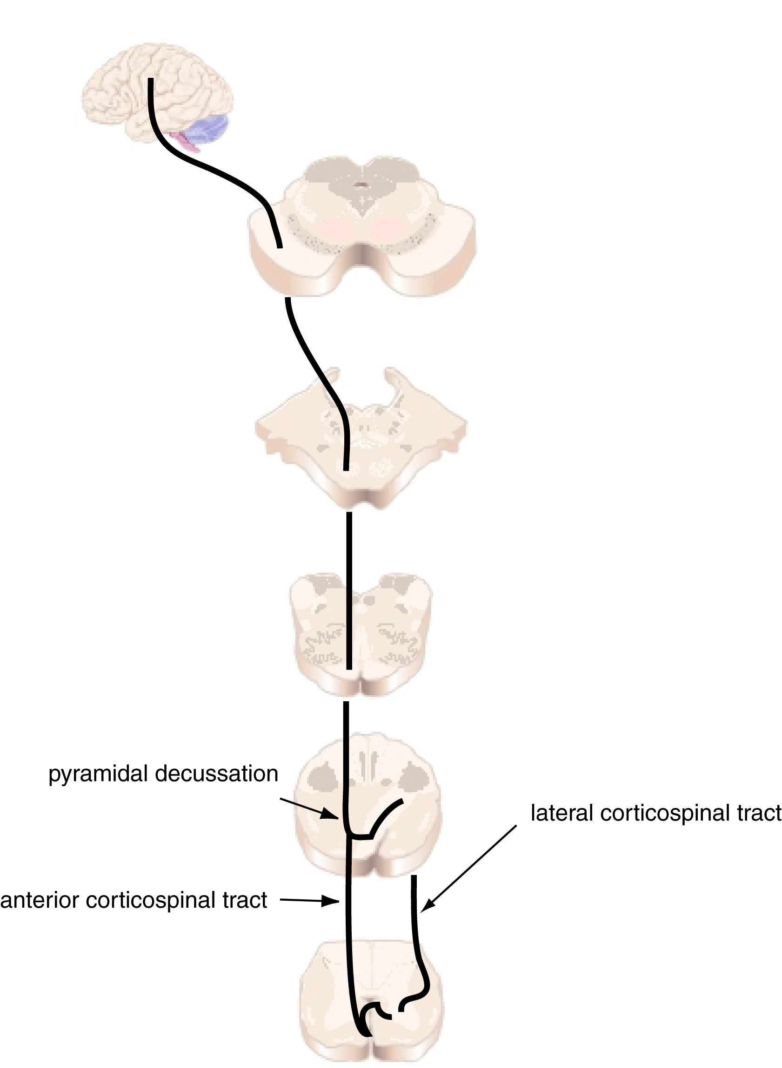
Corticospinal
Tracts
Notes:
The corticospinal tract originates in the motor cortex. The axons of the motor projection neurons travel down through the corona radiata to converge in the posterior limb of the internal capsule. From there, they continue to the middle third of the cerebral peduncle, as shown on the next slide

Slide 6
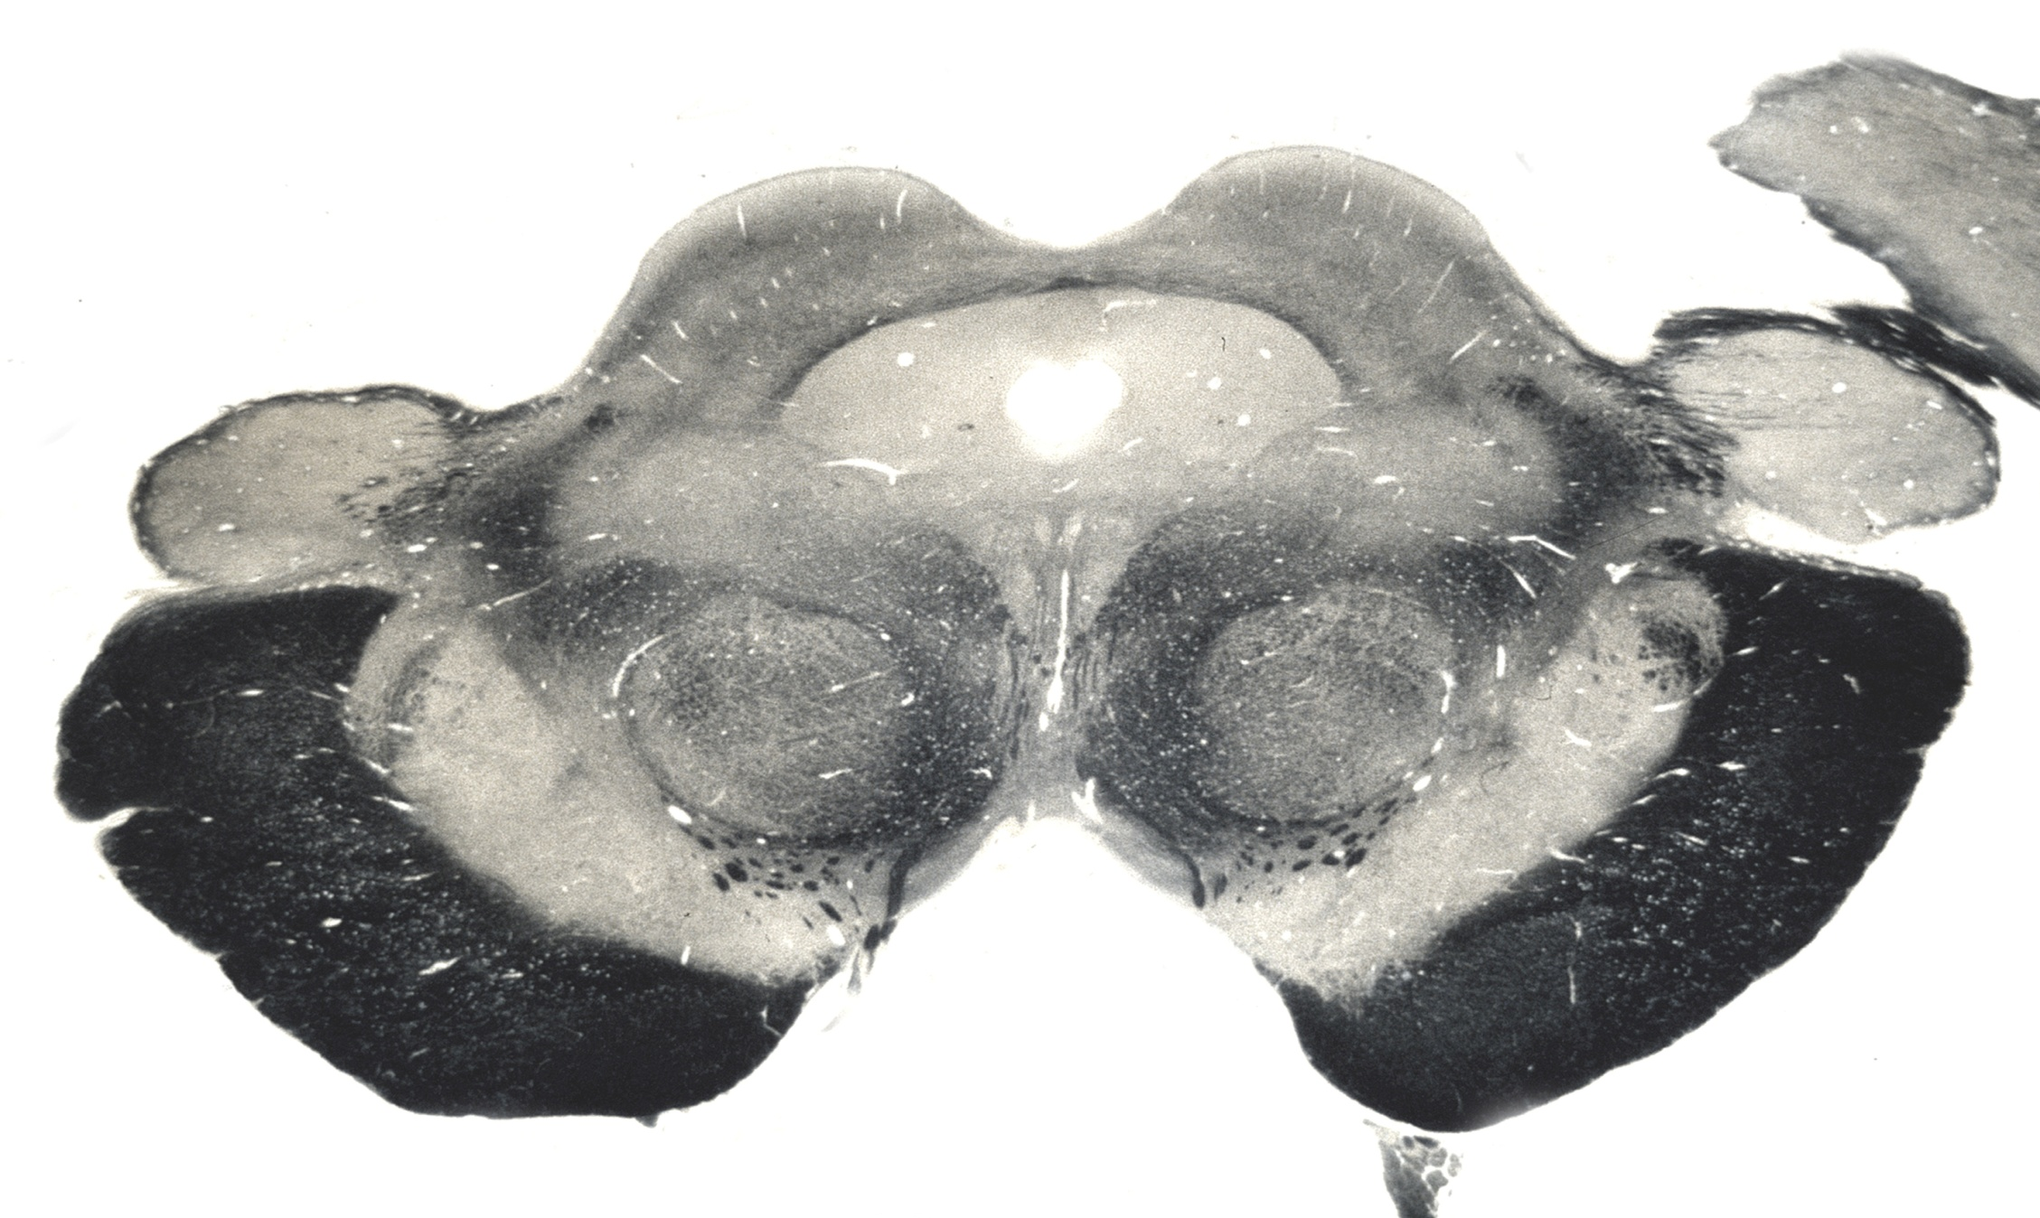

Slide 7
Corticospinal
Tracts
Notes:
Then, at the level of the medulla, these fibers form the medullary pyramids on the ventral surface of the brain stem (point).
Let’s follow these down on the next three slides.

Slide 8
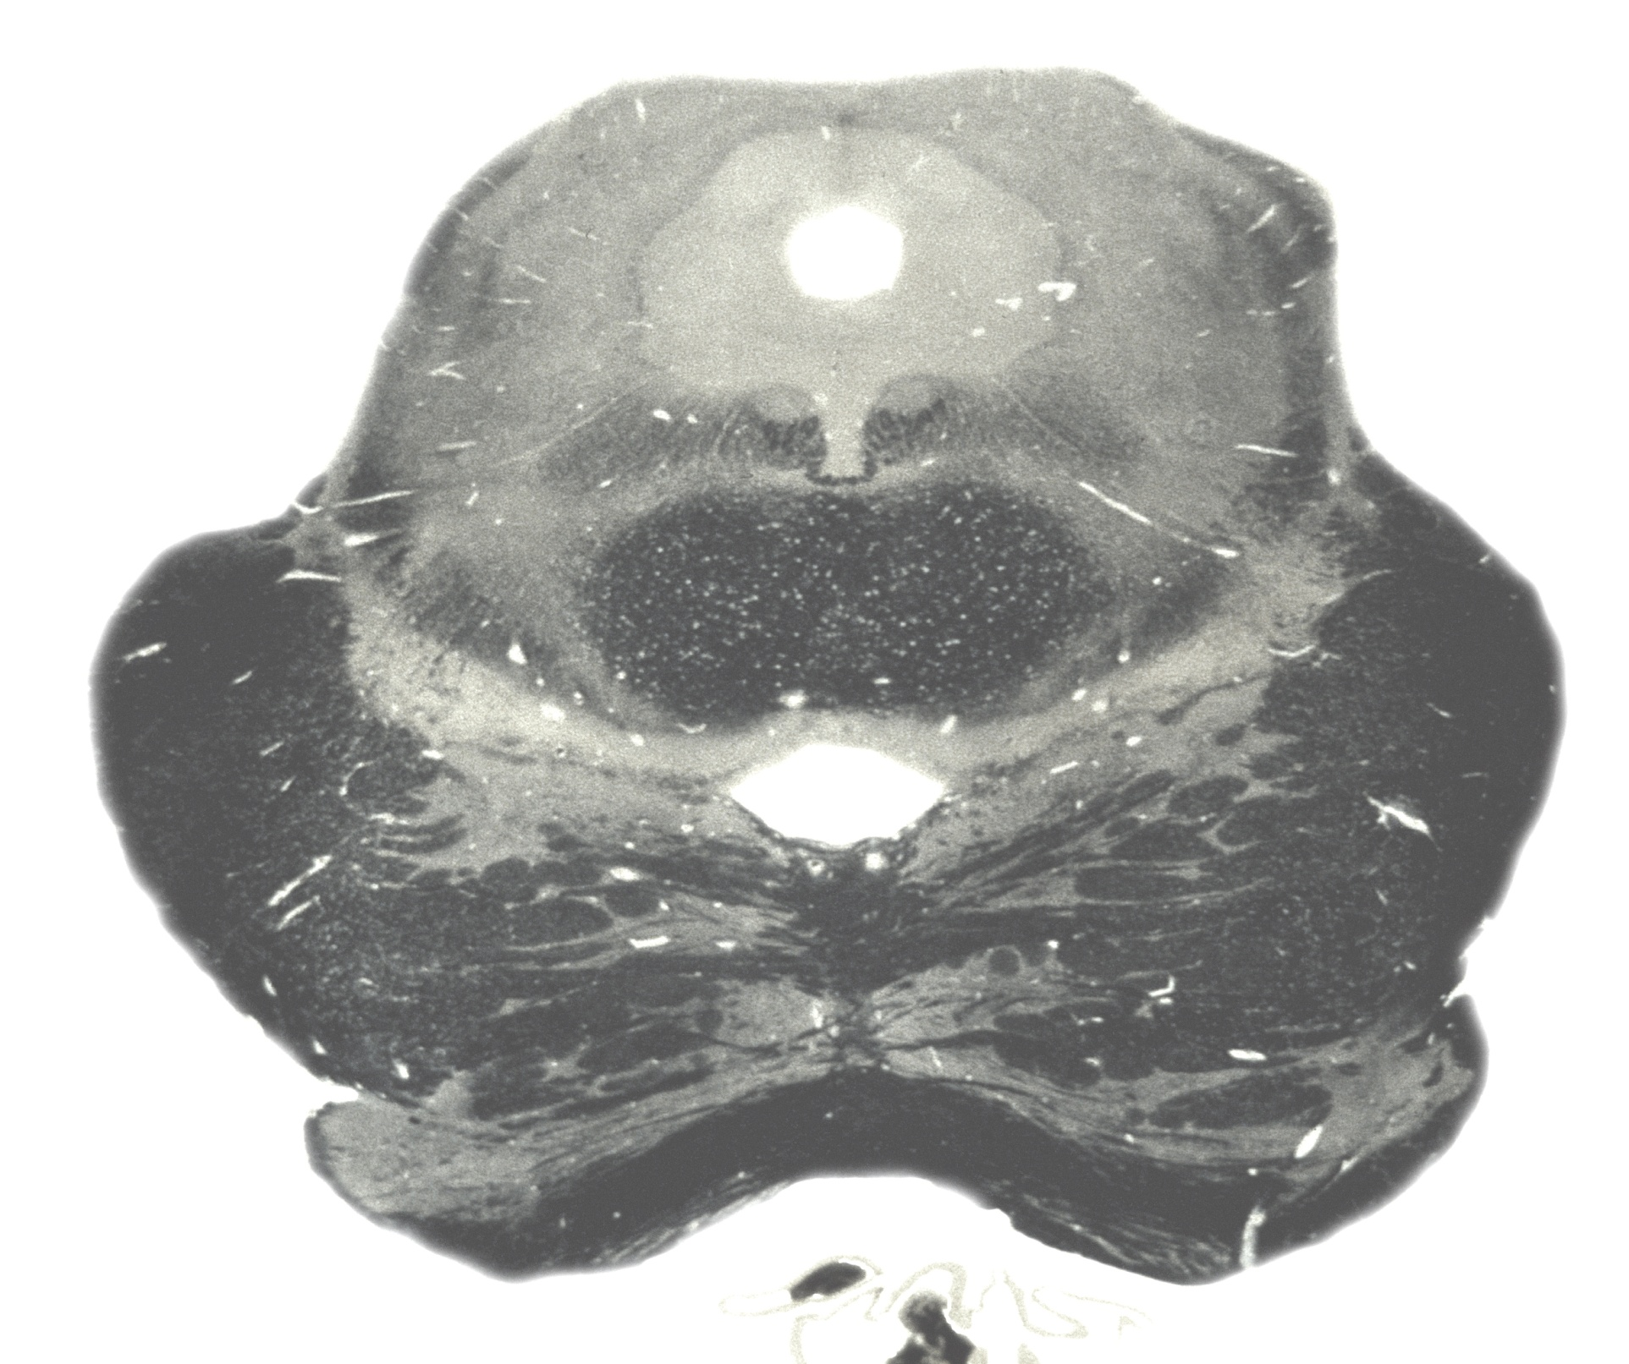

Slide 9
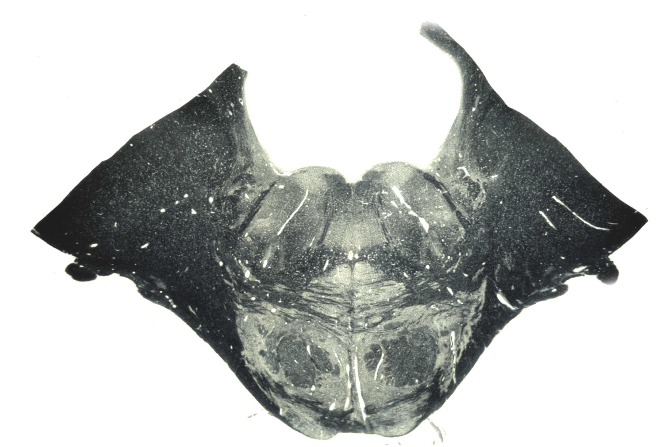

Slide 10
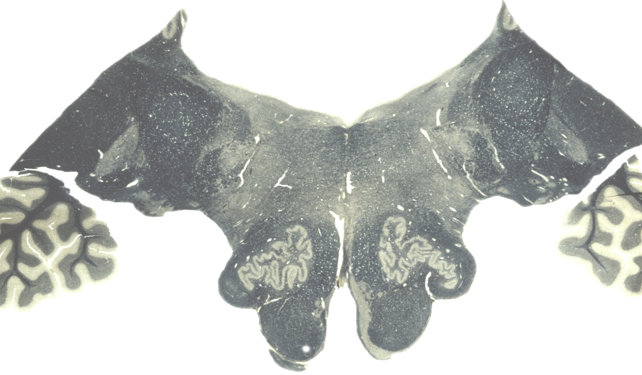

Slide 11
Corticospinal
Tracts
Notes:
Then, at the level of the caudal medulla, the corticospinal tract splits into two tracts. Approximately 90% of the axons cross over to the contralateral side at the pyramidal decussation, forming the lateral corticospinal tract.
The next slide shows the decussation.

Slide 12
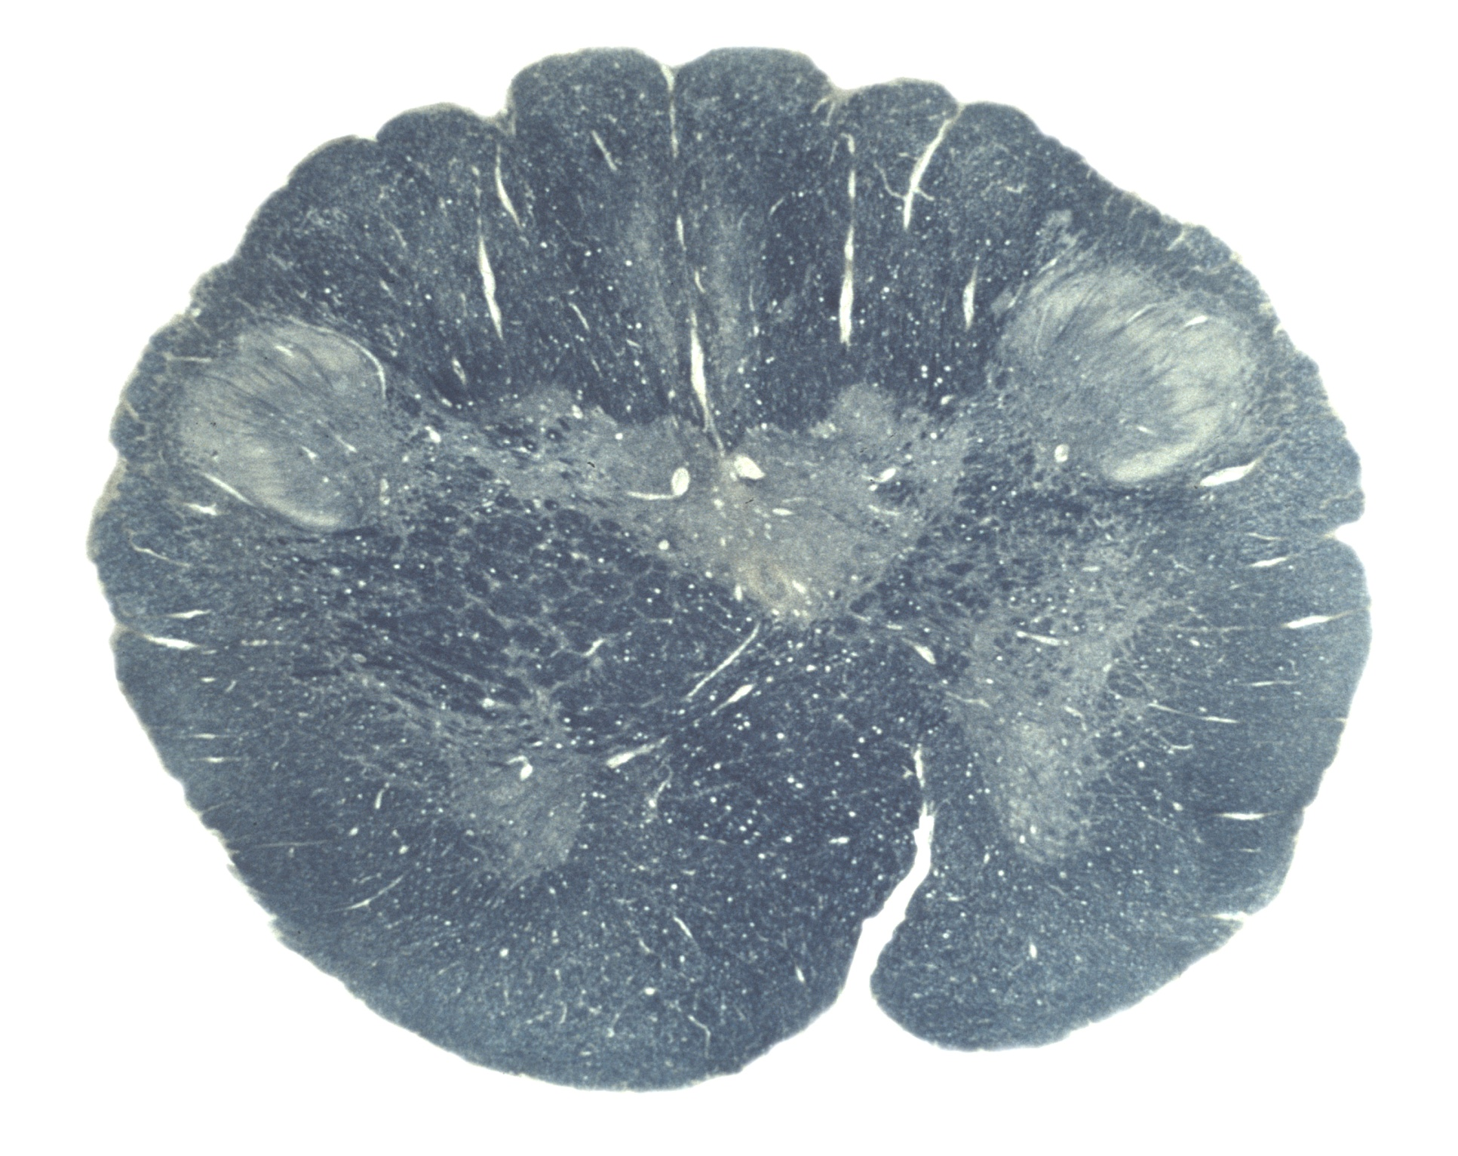

Slide 13
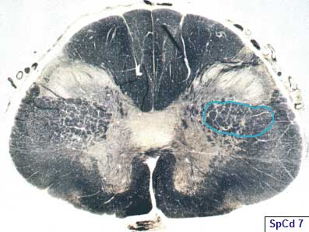
Notes:
Here is the lateral corticospinal tract at the level of C1

Slide 14
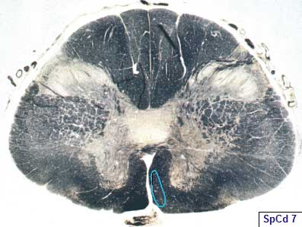
Notes:
Here is the anterior corticospinal tract.

Slide 15
Notes:
These axons continue to course through the lateral funiculus of the spinal cord, before synapsing either directly onto alpha motor neurons or onto interneurons in the ventral horn.
The remaining 10% of the axons that do not cross at the caudal medulla constitute the anterior corticospinal tract, as they continue down the spinal cord in the anterior funiculus. When they reach the spinal segment at which they terminate, they cross over to the contralateral side through the anterior white commissure and innervate alpha motor neurons or interneurons in the anterior horn. Thus, both the lateral and anterior corticospinal tracts are crossed pathways; they just cross the midline at different locations.
The lateral corticospinal tract controls the distal musculature—fine hand movements.
The Betz cells terminate on alpha motor neurons and interneurons in the ventral horn… other fibers (most of them( terminate on interneurons in the spinal gray matter.
Next, we will talk about the origins of the rubrospinal tract, shown here.

Slide 16
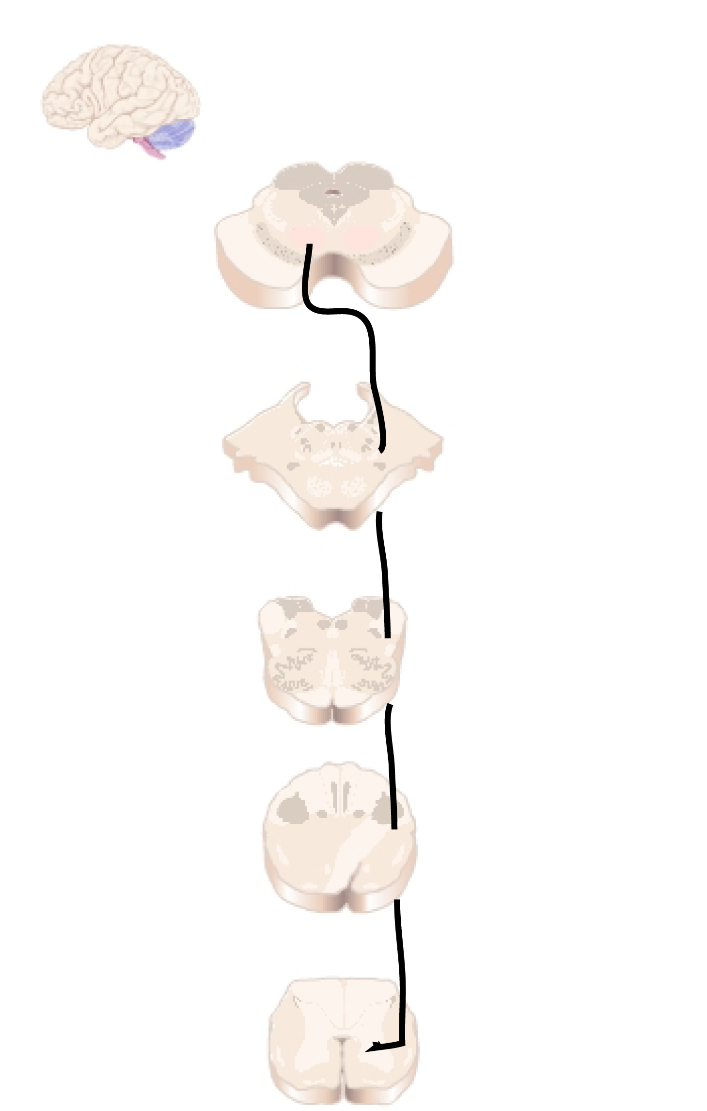
Rubrospinal
Tract
Notes:
The rubrospinal tract originates in the red nucleus of the midbrain. The axons immediately cross to the contralateral side of the brain, and they course through the brainstem and the lateral funiculus of the spinal cord.

Slide 18
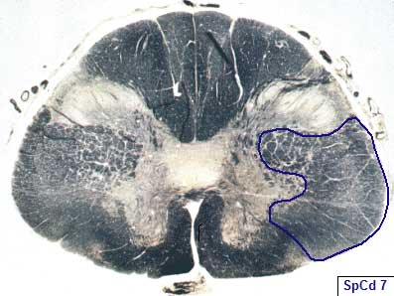
Notes:
Here is the lateral funiculus, which contains the rubrospinal tract.

Slide 19
Notes:
The red nucleus receives most of its input in cerebellum, so it is important in smooth rapid movements. It also receives input from motor cortex, and it is therefore probably an important pathway for the recovery of some voluntary motor function after damage to the corticospinal tract.
Next, we will talk about the origins of the medial and lateral vestibulospinal tracts, that you can see here.

Slide 20
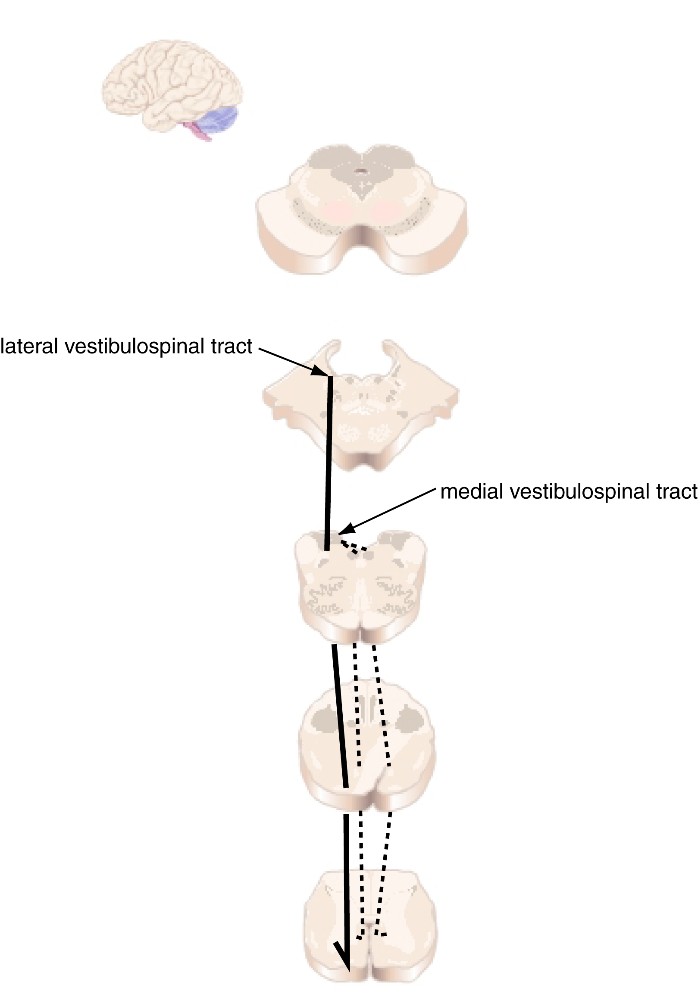
Vestibulospinal
Tracts
Notes:
The two vestibulospinal tracts originate in 2 of the 4 vestibular nuclei. The lateral vestibulospinal tract originates in the lateral vestibular nucleus. It courses through the brainstem and through the anterior funiculus of the spinal cord on the ipsilateral side, before exiting ipsilaterally at all levels of the spinal cord.
The medial vestibulospinal tract originates in the medial vestibular nucleus, splits immediately and courses bilaterally through the brainstem via the medial longitudinal fasciculus (MLF) and through the anterior funiculus of the spinal cord.

Slide 21
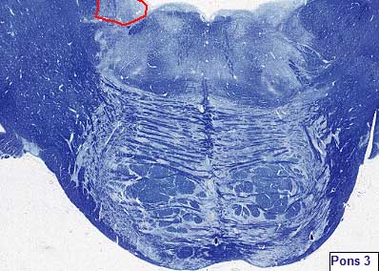
Notes:
Here are the lateral and medial vestibular nuclei.
http://isc.temple.edu/neuroanatomy/lab/atlas/pmj/

Slide 22
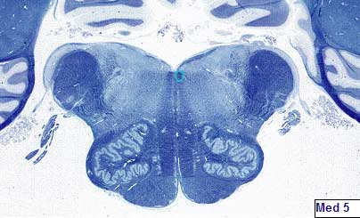
Notes:
MLF, medial longitudinal fasciculus, containing the med. vestibulospinal & med. Reticulospinal
http://isc.temple.edu/neuroanatomy/lab/atlas/pmj/

Slide 23
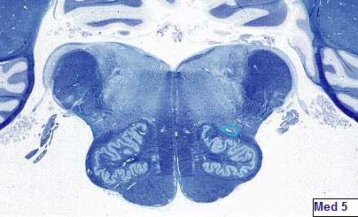
Notes:
Lat. vestibulospinal & lat. reticulospinal

Slide 24
Notes:
The vestibulospinal tracts mediate postural adjustments and head movements. They also help the body to maintain balance. Small movements of the body are detected by the vestibular sensory neurons, and motor commands to counteract these movements are sent through the vestibulospinal tracts to appropriate muscle groups throughout the body. The lateral vestibulospinal tract excites antigravity muscles in order to exert control over postural changes necessary to compensate for tilts and movements of the body. The medial vestibulospinal tract innervates neck muscles in order to stabilize head position as one moves around the world. It is also important for the coordination of head and eye movements
Next, we will talk about the origins of the pontine and medulary reticulospinal tracts, shown here.

Slide 25
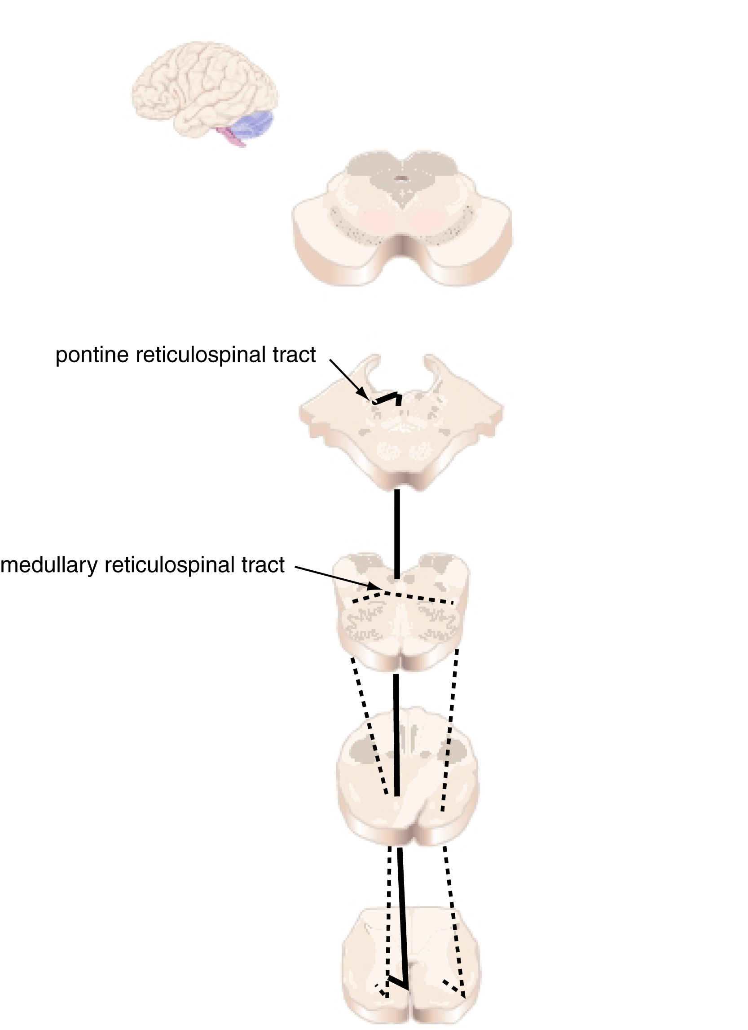
Reticulospinal
Tracts
Notes:
The two reticulospinal tracts originate in the brainstem reticular formation, a large, diffusely organized collection of neurons in the pons and medulla
The pontine reticulospinal tract is also known as the medial reticulospinal tract.
It originates in the pontine reticular formation, courses ipsilaterally through the medial longitudinal fasciculus and through the anterior funiculus of the spinal cord, and exits ipsilaterally at all spinal levels.
The medullary reticulospinal tract is also known as the lateral reticulospinal tract.
It originates in the medullary reticular formation, courses mainly ipsilaterally (although some fibers cross the midline) through the anterior funiculus of the spinal cord, and exits at all spinal levels.

Slide 26
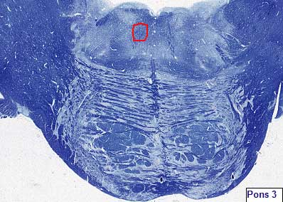
Notes:
Here is the pontine reticular formation

Slide 27
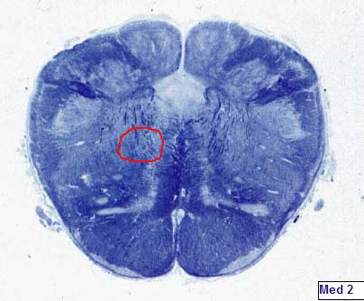
Notes:
Here is the medullary (medial) reticular formation)

Slide 28
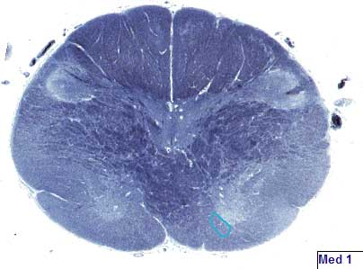
Notes:
Medial reticulospinal tract at the level of the pyramidal decussations.

Slide 29

Notes:
Lateral reticulospinal at the level of the pyramidal decussations.

Slide 30
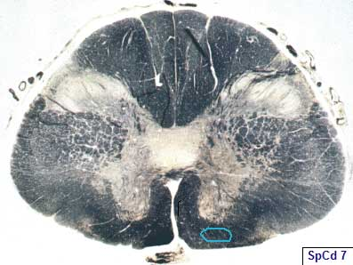
Notes:
Medial reticulospinal tract at the level of the cervical enlargement (C1)

Slide 31
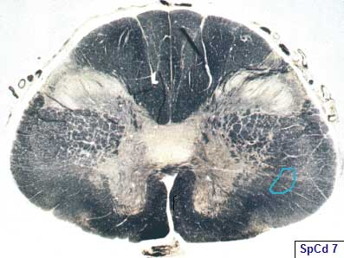
Notes:
Lateral reticulospinal

Slide 32
Notes:
The reticulospinal tracts are a major alternative to the corticospinal tract, by which cortical neurons can control motor function by their inputs onto reticular neurons. These tracts regulate the sensitivity of flexor responses to ensure that only noxious stimuli elicit the responses. Damage to the reticulospinal tract can thus cause harmless stimuli, such as gentle touches, to elicit a flexor reflex. The reticular formation also contains circuitry for many complex actions, such as orienting, stretching, and maintaining a complex posture. Commands that initiate locomotor circuits in the spinal cord are also thought to be transmitted through the medullary reticulospinal tract. Thus, the reticulospinal tracts are involved in many aspects of motor control, including the integration of sensory input to guide motor output.
Next, we will talk about the tectospinal tract, shown here.

Slide 33
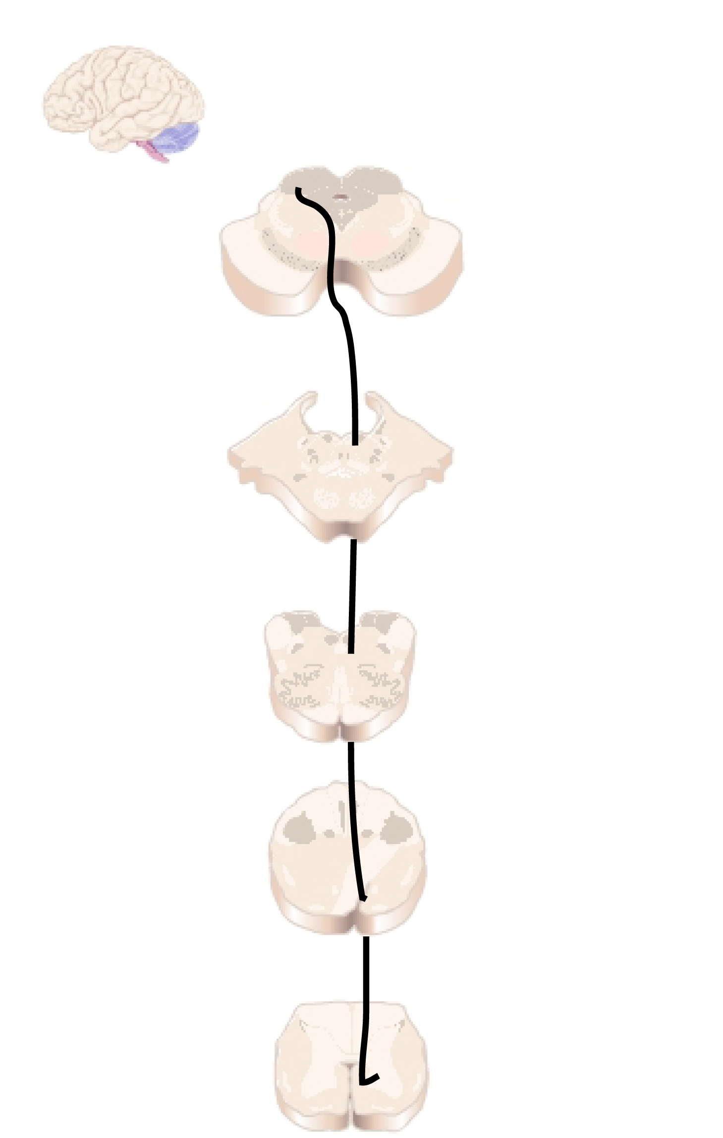
Tectospinal Tract
Notes:
The tectospinal tract (Figure 2.13) originates in the deep layers of the superior colliculus and crosses the midline immediately. It then courses through the pons and medulla, just anterior to the medial longitudinal fasciculus. It courses through the anterior funiculus of the spinal cord, where the majority of the fibers terminate in the upper cervical levels.

Slide 35
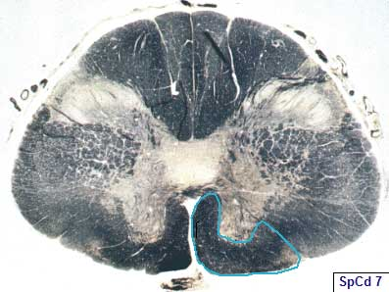
Notes:
Here is the anterior funiculus which contains the tectospinal fibers. They terminate in the anterior horn.

Slide 36
Notes:
Little is known about the function of the tectospinal tract, but because of the nature of the visual response properties of neurons in the superior colliculus (the optic tectum), it is presumably involved in the reflexive turning of the head to orient to visual stimuli.

